Slide 1
Glasgow 2026 Third Party Logistics SUPPLIER Expression of Interest

Slide 2
Altogether brilliant
Glasgow 2026 will be a bridge to the Commonwealth Games of the future
Taking place from 23 July to 2 August, Glasgow 2026 is an 11-day celebration that combines world-class sport with a future-focused vision, built and delivered by the vibrant spirit of Glasgow.
Set within a concentrated, eight-mile corridor that brings the Games closer to the fans than ever before, Glasgow 2026 will deliver:
a record-breaking Para sport programme – 47 events across six sports
the biggest Track Cycling and Swimming competitions seen at a Commonwealth Games
groundbreaking events like the return of the Commonwealth Mile in Athletics
10 exhilarating sports across four of the city’s iconic venues; from Scotstoun Stadium to the Scottish Event Campus (SEC), the Sir Chris Hoy Velodrome and Arena, to Tollcross International Swimming Centre.
Where 3,000 volunteers, alongside thousands of fans, and communities from across the city join together to welcome 3,000 athletes from 74 nations and territories to the city.
Glasgow 2026 invites you to be part of something unforgettable, where every brilliant moment is set to energise, excite and entertain. An opportunity to gather in Glasgow once again and to pioneer, shape, craft and experience an all-new version of The Games.
We welcome your expertise in helping us create a world-class experience for athletes and spectators at this prestigious event.

Slide 3
Expression of Interest Overview
Glasgow 2026 is setting out to deliver a Commonwealth Games within 9-months, with the competition scheduled from 23 July to 2 August 2026. A commitment to timelines is critical to our delivery and procurement process.
Process
We are seeking expressions of interest from organisations with a strong track record of delivering Third Part Logistics (3PL) services, preferably at major multi-sport events.
To determine interest and to help us shortlist suppliers for a subsequent tendering process, we require responses to the questions set out in this pack.
Please review the information in this pack and return your responses to Procurement by 4pm on 11th November 2025.
Clarifications and Contacts
We are creating a culture of collaboration and therefore are on hand to provide any support you require at any point in the procurement process.
If you have any questions, please email them to us at: procurement@glasgow2026.com

Slide 4

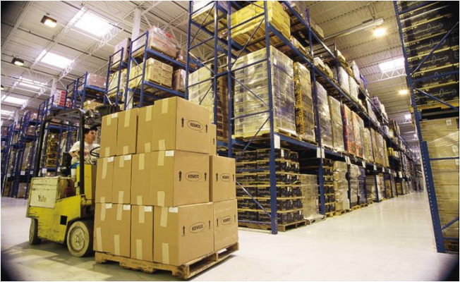
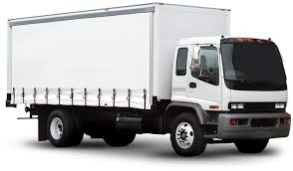
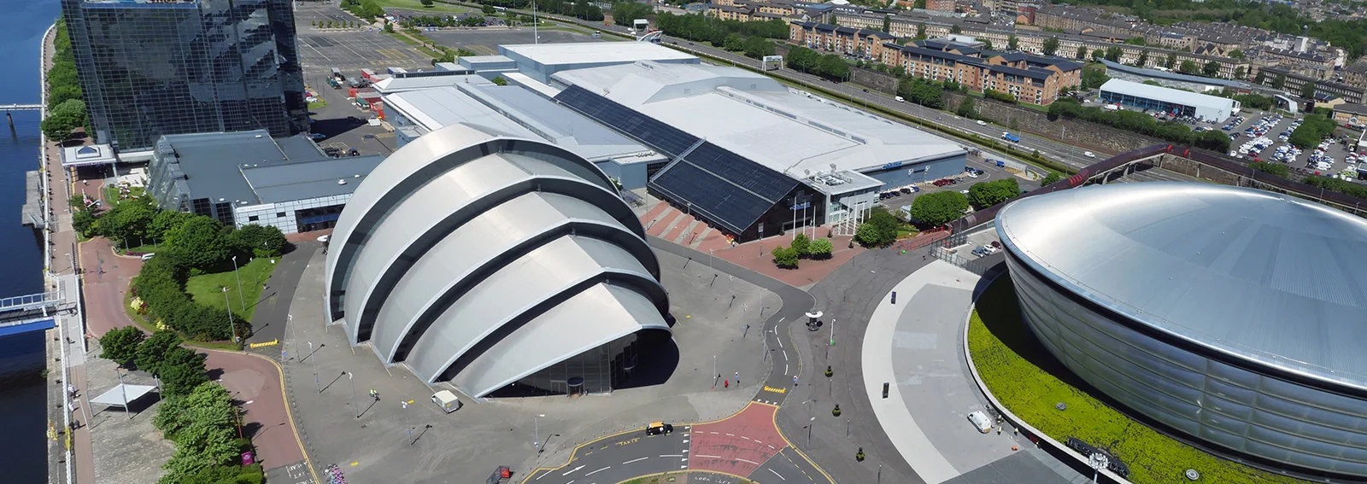
LOGISTICS AT THE GAMES
The Logistics (LOG) Functional Area (FA) is responsible for material planning, warehousing, distribution and Bump In of assets on venue. Following the Games, Logistics is responsible for removing these assets (Bump Out) and returning to the warehouse for their dissolution.
Material planning
Warehousing
Distribution
Bump In and venue operations
Dissolution
Return
Bump Out

Slide 5
High-Level Scope
We are seeking to engage a full-service 3PL Supplier. A full scope will be provided in the Invitation to Tender documentation – an overview is provided below:
Glasgow 2026 Commonwealth Games is seeking to engage a qualified and experienced Third Party
Logistics (3PL) Provider.
The 3PL Provider will work with the LOG FA to deliver the overall planning, management and
delivery of the following goods and services:
Warehouse Operations
Local storage, if required, from contract award on a per pallet basis
Central Logistics Warehouse, up to 50,000 sq ft, from June to August 2026
Distribution
Approximately 130 movements
Using a fleet comprising of artics to vans
Venue Workforce
Approximately 10 x general labour and 4 x forklift operators
Venue Material Handling Equipment (MHE)
Forklifts (including fuel), pallet jacks and trolleys
Freight forwarding and customs clearance services and courier services, if required on a user pays basis

Slide 6
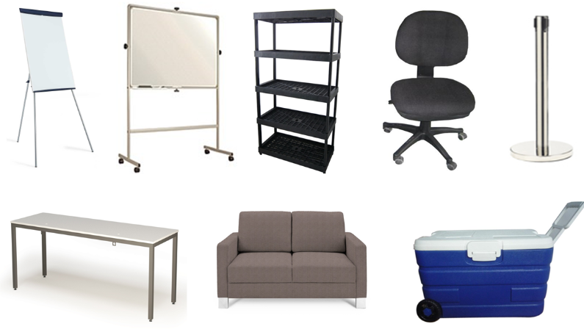
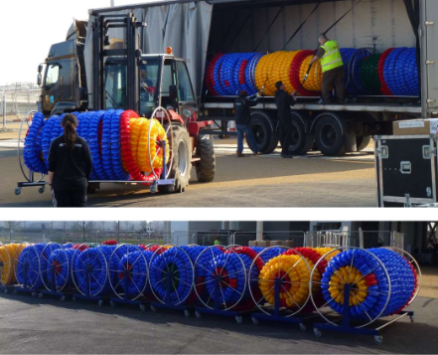
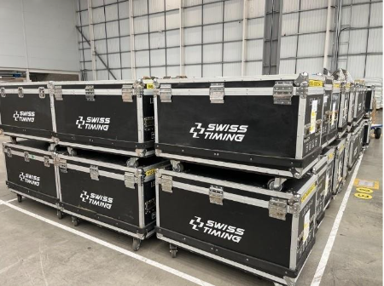
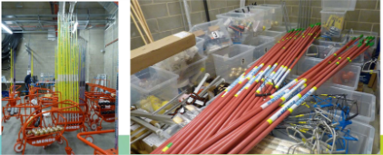
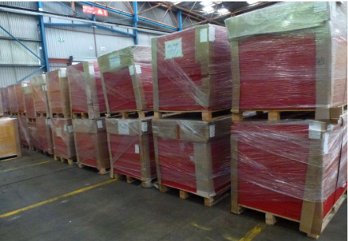
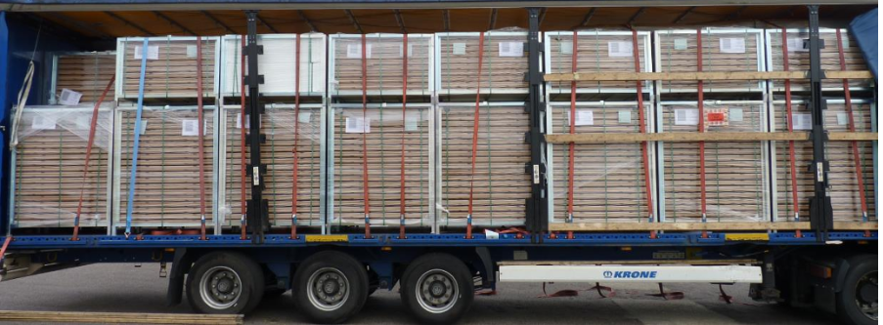
Indicative games assets

Slide 7
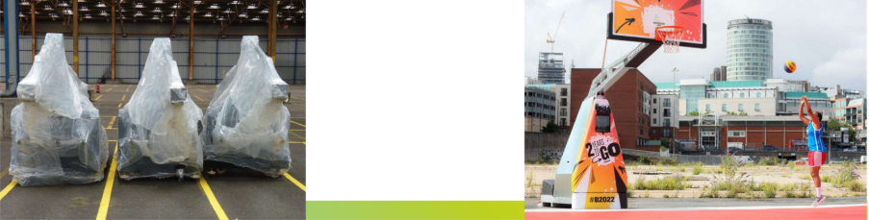
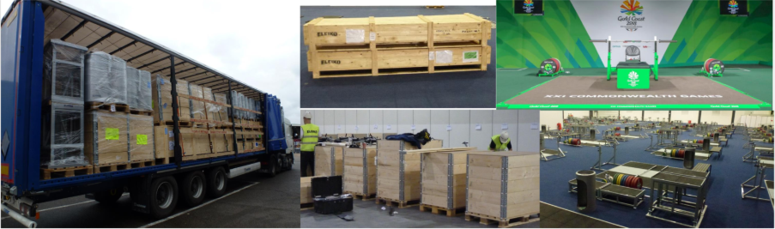
WHAT Does it look like when installed and when packaged?

Slide 8
EOI Qualification Questions
To qualify for inclusion in the next stages of the procurement process you must be able PASS the following questions. Please note that the OC may exclude you from participating further in the procurement process if you cannot answer YES to the following questions:
1. Can your oragnisation provide a warehouse space up to 50,000 sq ft from 1 June to 31 August within 50 miles of Games Headquarters (Bothwell Street, Glasgow) (YES/NO)?
2. Can your organisation meet the distribution requirements of approximately 130 movements during the Games period with a fleet of vehicles ranging from an artic to a van (YES/NO)?
3. Can your oragnisation demonstrate that you have relevant and comparable experience? (YES/NO)?
4. Can your organisation provide a suitable and experienced 3PL Account
Manager? (YES/NO)?
Please send your completed responses to procurement@glasgow2026.com by 4pm 11th November 2025

Slide 9
Indicative timeline
1
05 November 2025 : Expression of Interest published
2
11 November 2025 : ITT Issued
3
25 November 2025 11:00AM : ITT Response Deadline
4
01 December 2025 : Clarification sessions (in person) and warehouse visits
5
w/c 08 December 2025 : Contract Award
6
w/c 15 December 2025 : Contract Commencement

Slide 10
Sponsorship Opportunities
Sponsors will play a significant role in realising the vision of the Glasgow 2026 Commonwealth Games. We are seeking proactive, dynamic partners who can help generate interest, engagement, and excitement in the lead-up to, during, and after Glasgow 2026, as well as support the overall delivery of the Games.
To ensure the commercial viability of Glasgow 2026, suppliers providing services are asked to consider whether part or all of this could be contributed as value-in-kind (VIK). This contribution will be offset through a partnership with the Games, which would include appropriate sponsorship assets, enabling the partner to effectively amplify and drive commercial value from the association. These assets will be subject to negotiation but will be granted on a category-exclusive basis.
As part of the EOI response, suppliers are asked to confirm if they are interested in having a meeting with the Glasgow 2026 Commercial Partnerships team to explore how a potential partnership could be structured.

Slide 11




Any questions? If you have any questions or require further information, please contact procurement@glasgow2026.com We look forward to receiving your completed responses Thank you
http://www.glasgow2026.com/

