Slide 1


PROJECT COMMONWEALTH

Slide 2
PROJECT COMMONWEALTH
Learning outcomes
I can:
identify how diversity benefits communities
talk about my own heritage and home background
create a piece of artwork
carry out research and extract information about a Commonwealth nation.
Overview: In this range of activities pupils consider their own home backgrounds, find out more about the Commonwealth nations and territories and learn about the Birmingham 2022 Commonwealth Games mascot, Perry.
Learning objectives
Pupils will:
consider the benefits of diversity in communities
consider their own family heritage and backgrounds
find out more about nations participating in the Commonwealth Games.
Notes:
Teacher notes
You could also use pupils’ show and tell presentations, or their research projects to make links to the Birmingham 2022 festival, e.g.
'City of Empire to City of Diversity’. https://www.sampad.org.uk/projects/2020-2022-from-city-of-empire-to-city-of-diversity-a-visual-journey/
Generations project by Julian Germain.
Visit https://www.birmingham2022.com/news/2808904/birmingham-2022-festival-enjoyed-by-millions for more information on the festival.

Slide 3
PROJECT COMMONWEALTH
Curriculum links: potential links could be made to:
English: research; information gathering and extraction; comprehension
Geography: locational knowledge; place knowledge
History: a study of an aspect or theme in British history that extends pupils’ chronological knowledge beyond 1066.
Key words: Commonwealth; nation; territory; project; research; heritage; difference; diversity; mascot.
Time required: These activities will each take varying amounts of time.
Resources:
A5/flipchart paper for mind mapping exercise (slide 5)
Commonwealth Match Up worksheets
Perry the Mascot template
Classroom art materials and found materials

Slide 4
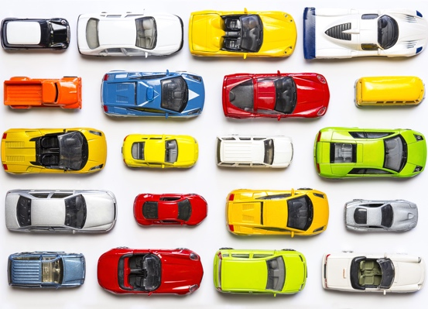

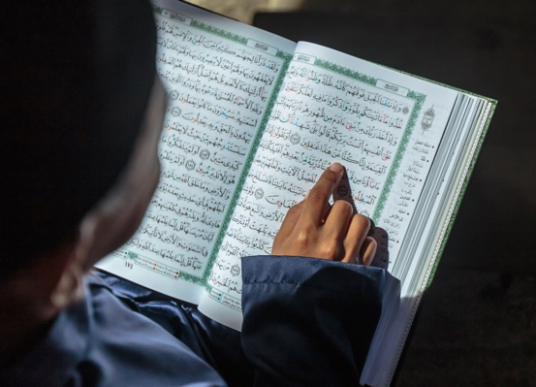
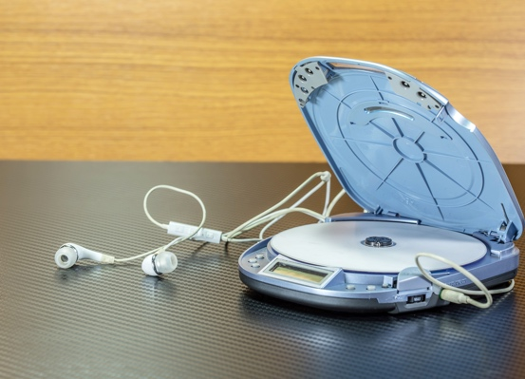
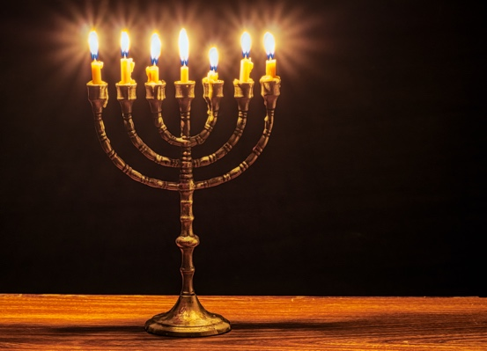
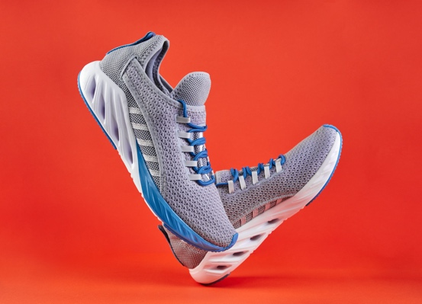
HERITAGE SHOW AND TELL
Heritage
Community
Diversity
Notes:
Teacher notes
Ask pupils to identify which communities everyone in the class is a part of and make a list. For example: school; town/village/local area/city; class.
Then ask them to make a list of different communities that people in the class might be part of. For example: cultural; religious; sports club; social; international etc. Use the lists to demonstrate that we can be members of the same and different communities at the same time.
Discuss the word ‘diversity’, what it means, and the benefits of diversity in a community (e.g. different food; different experiences; travel; understanding other people; more interesting; sports competition etc).
Tell pupils that we are going to find out a bit more about the diversity in the class. Ask them to bring in something that represents their heritage, whatever this might be (e.g. family history; town/city/country/area their family comes from; cultural or religious background etc). For example, a photo of their family (present or past), an image they find online, an object, some food etc.
Organise this in a way that suits your needs, with those bringing something in giving a short presentation about it and what it represents for them. When pupils have done their show and tells, the images or objects could form part of a class heritage display.
Note: please be sensitive to children who may be adopted, looked after in local authority care, or who may have a vulnerable family or cultural background for whatever reason. Be aware of pupils who may be refugees and potentially upset or traumatised by discussing their homes. All show and tells should be voluntary.

Slide 5
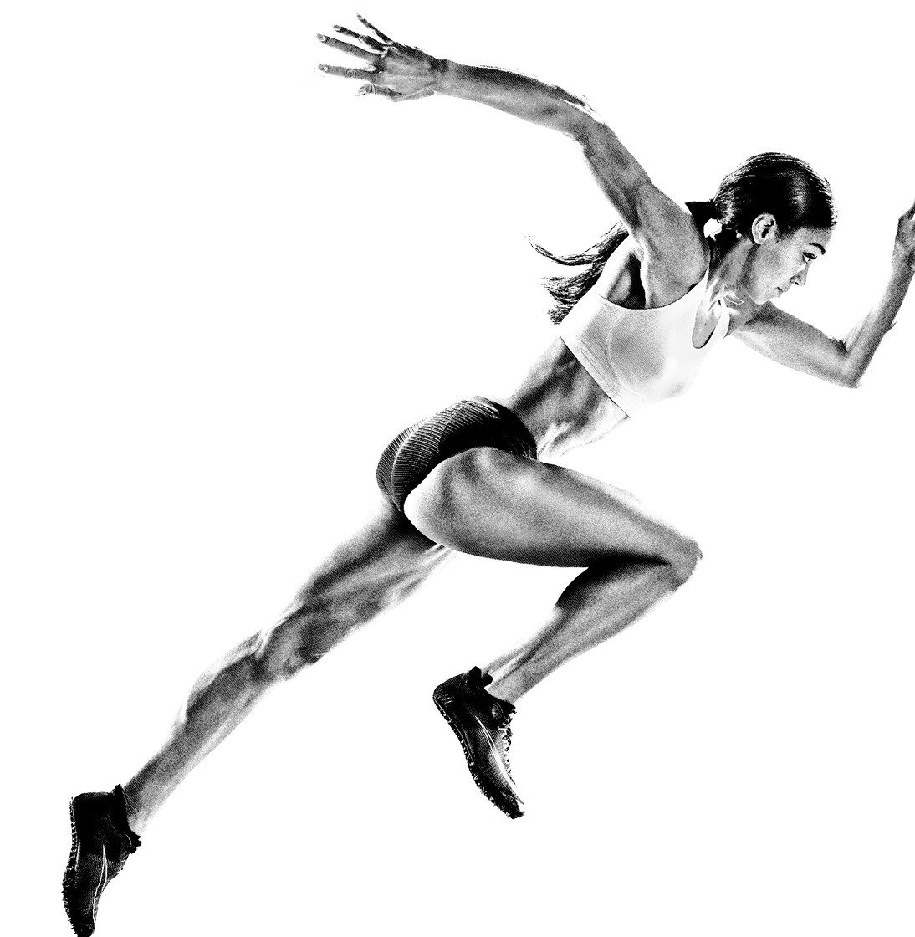
COMMONWEALTH MATCH UP!
Where the Commonwealth Games was held in 2022
How many people in the UK watched the Birmingham 2022 Games
A nation or territory in the Commonwealth that is in Asia
An athlete from Team England who won a medal in the Birmingham
2022 Games
The number of nations and territories in the Commonwealth
A Birmingham 2022 Commonwealth Games team sport
The name of the Birmingham 2022 Commonwealth Games mascot
Notes:
Teacher notes
Divide the class into two.
Give half of the class will be given a question card or two for a smaller group from the Commonwealth Match Up worksheet. The other half of the class will be given answer cards from the same worksheet.
Ask the class to match up their card with someone else in the group. There may be more than one answer to a question so they may form groups or pairs. Questions continue on the next slide.
In their groups, ask pupils to create a mind map or thought cloud of all the things they know already about the Commonwealth. Ask groups to feed back three things they have listed until there are no more new pieces of information left to share.
Answers:
Where the Commonwealth Games was held in 2022: Birmingham
How many people in the UK watched the Games in 2022: Nearly half the population
A nation or territory in the Commonwealth that is in Asia: Bangladesh, Brunei, India, Malaysia, Maldives, Pakistan, Singapore, Sri Lanka
An athlete from Team England who won a medal in the Birmingham 2022 Games: Grace Harvey, Katarina Johnson-Thompson, Adam Peaty
The number of nations and territories in Commonwealth: 72
A Commonwealth Games team sport: Wheelchair Basketball 3x3, Cricket T20, Rugby Sevens
The name of the Birmingham 2022 Commonwealth Games mascot: Perry
A type of swimming style: breaststroke, front crawl, backstroke, butterfly

Slide 6
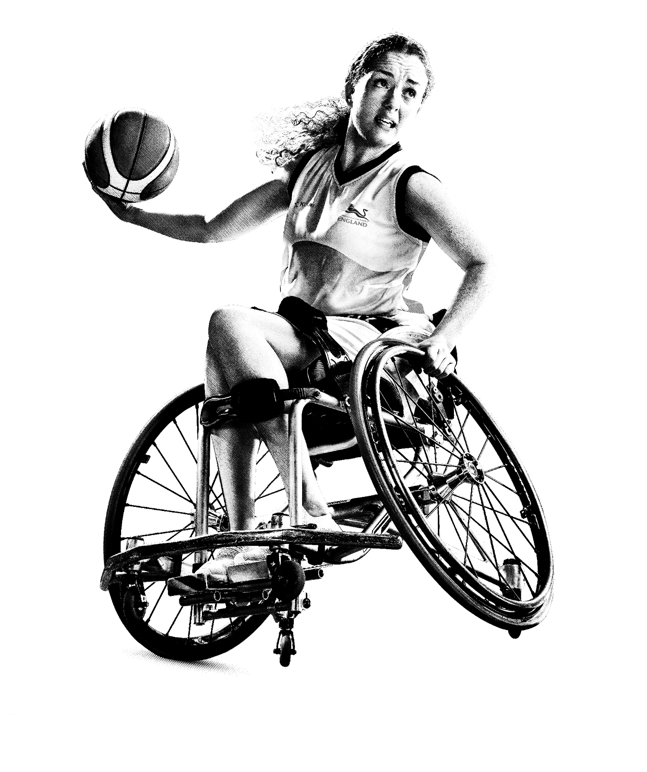
COMMONWEALTH MATCH UP!
A type of swimming style
A gymnastics event
The town where the Cycling Road Race was held
The number of people in a Hockey team
The record-breaking number of tickets sold for the Birmingham
2022 Games
The Head of the Commonwealth
A sports stadium where Athletics took place
A famous Commonwealth Games athlete from Jamaica
Notes:
Teacher notes
Answers:
A gymnastics event: floor, rhythmic, parallel bars
The town where the Cycling Road Race was held: Warwick
The number of people in a Hockey team: 10
The record-breaking number of tickets sold for the Birmingham 2022 Commonwealth Games: 1.5 million
The Head of the Commonwealth: King Charles III, during the Games however this was Queen Elizabeth II
A sports stadium where Athletics took place: Alexander stadium
A famous Commonwealth Games athlete from Jamaica: Usain Bolt, Shelly-Ann Fraser-Pryce

Slide 7
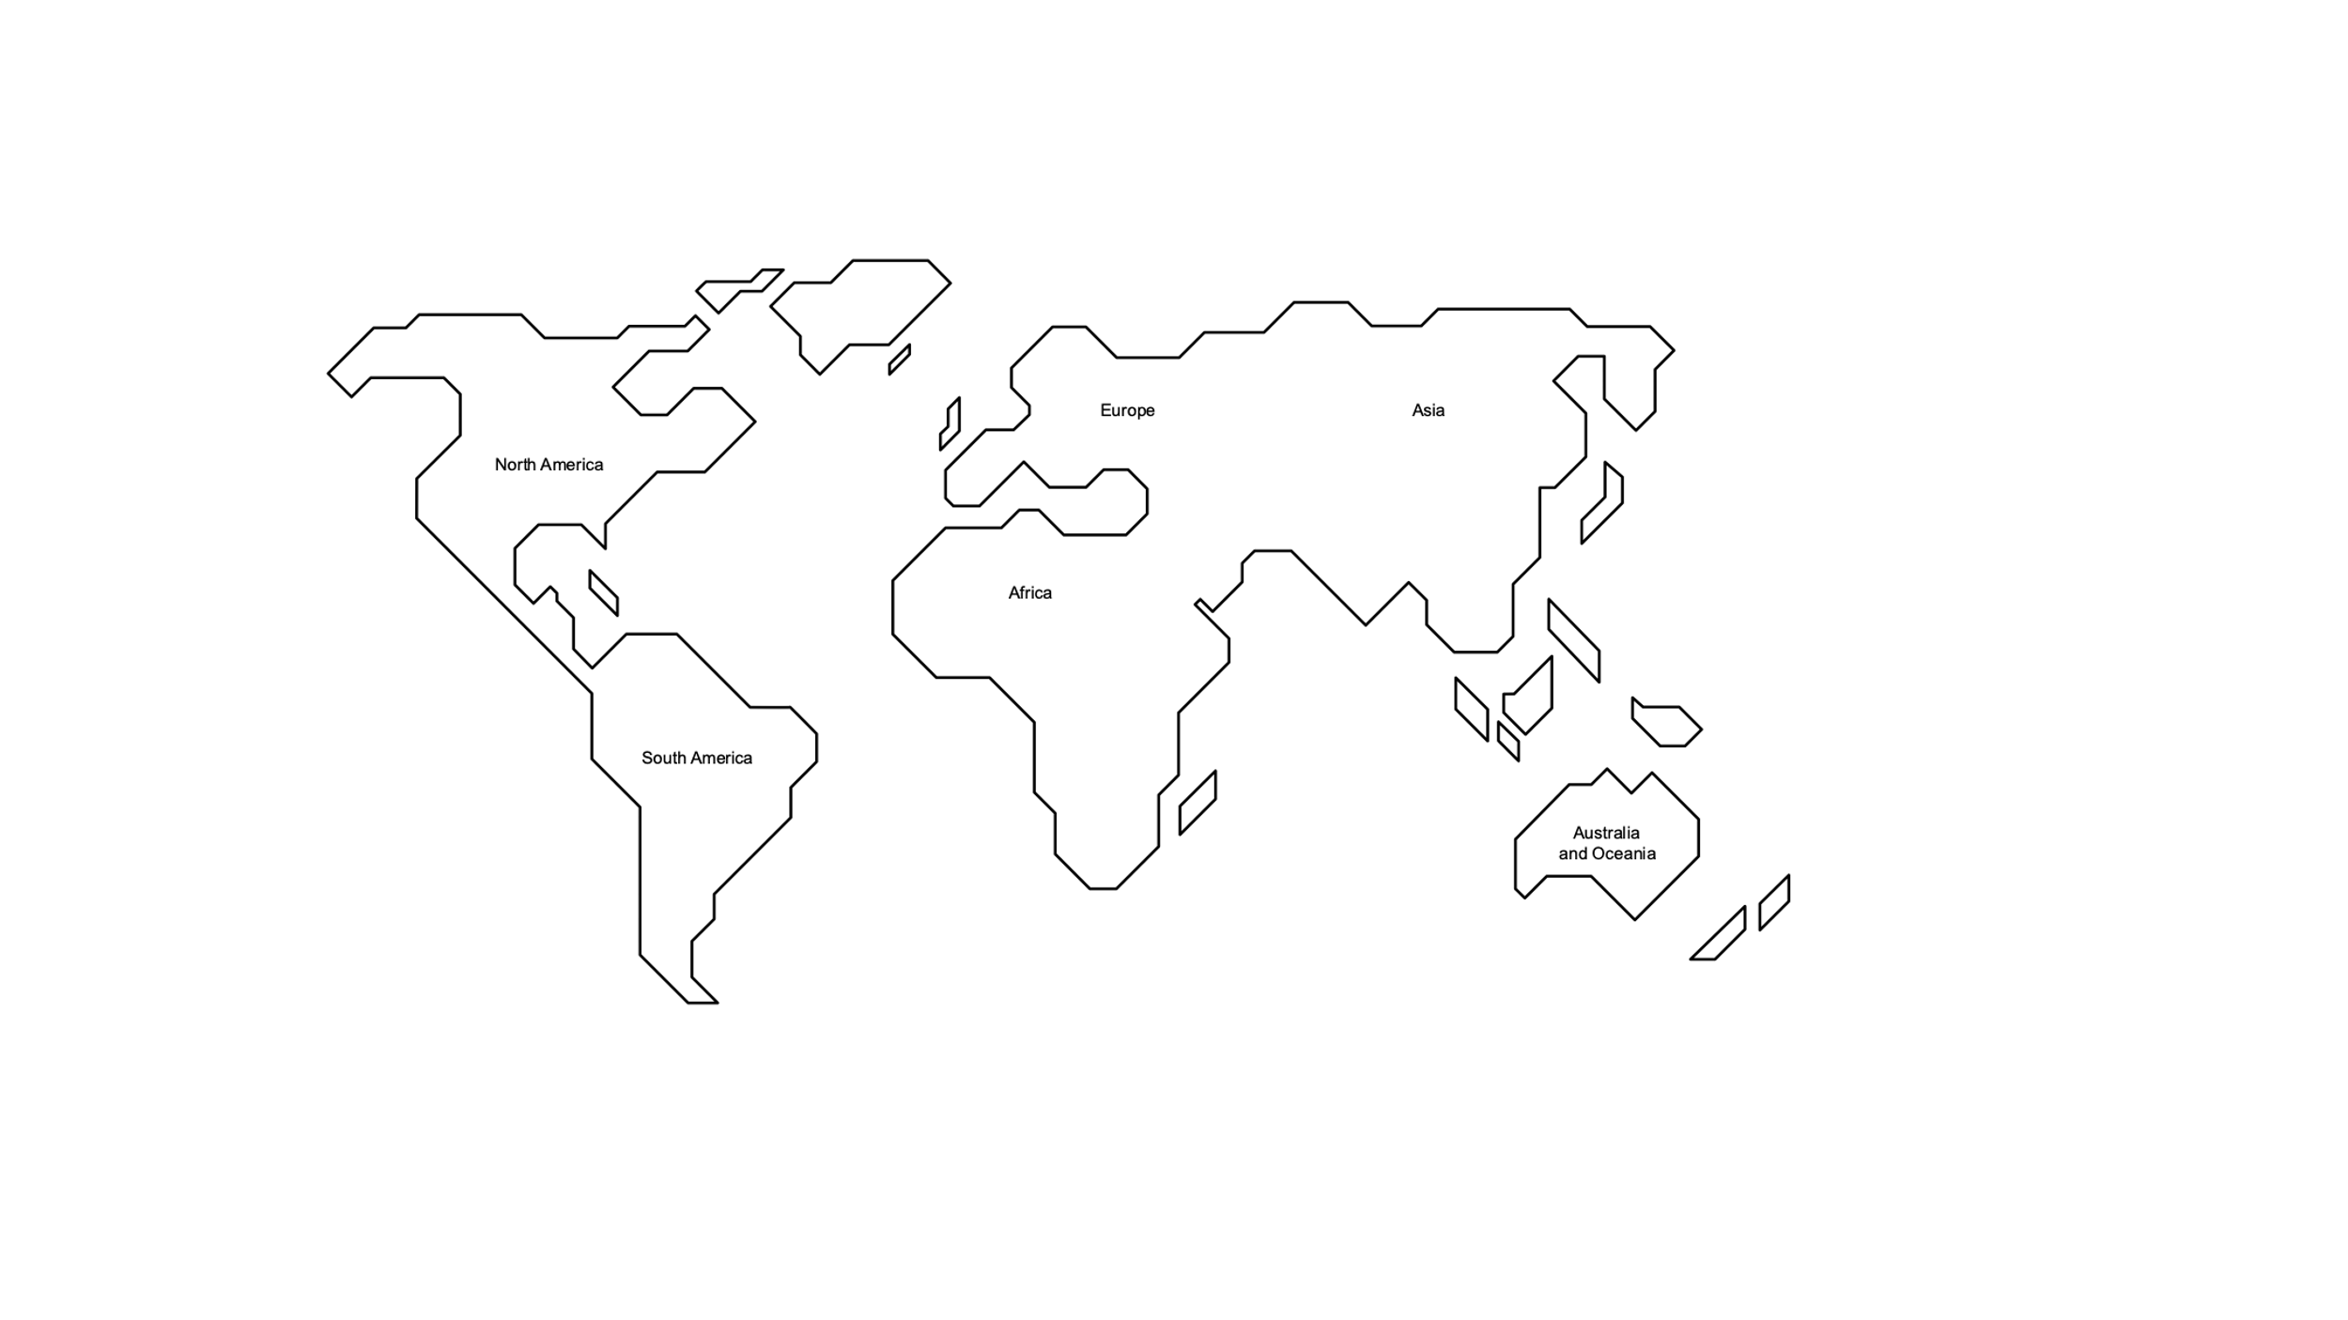



COMMONWEALTH MAP FACTS
There are 1.38 BILLION people living in India! It is the second most populated country in the world. Which do you think is the first?
Do you like cinnamon toast, or cinnamon bagels? Most of the world’s cinnamon comes from Sri Lanka.
The world’s largest, heaviest and smelliest flower grows in Malaysia. It is called the Rafflesia and it can grow up to 1 metre around and weigh up to 10kg. It smells like rotting meat, and it doesn’t have a stem, leaves or even a root!
In November 2021 Barbados elected its first President, Dame Sandra Mason. This means that the King is no longer the head of state there.
Jamaica’s most famous athlete is Usain Bolt, who holds the world records for the 100m, 200m and 4x100m relay.
There are 68 different languages spoken in Kenya. The official language is Swahili.
Australia is the overall champion of the Commonwealth Games: it has won a total of 2594 medals.
84% of Botswana is covered by sand from the Kalahari desert.
Canada has never not won a gold medal at the Commonwealth Games. The most it has ever won was 51 in Edinburgh 1986. The least it has ever won is just 1, at Cardiff 1958.
New Zealand has hosted the Commonwealth Games three times: in 1950, 1974 and 1990.
The UK has hosted the Commonwealth Games seven times: in London (1934), Cardiff (1958), Edinburgh (1970 and 1986), Manchester (2002), Glasgow (2014) and Birmingham 2022 was number seven!
South Africa’s nickname is ‘the rainbow nation’. Can you find out why?
Cyprus history goes back 11,000 years, which makes it one of the oldest civilisations in the Mediterranean.
Notes:
Teacher notes
Use this PowerPoint in presentation mode to view the map and facts.
Choose pupils to click on the interactive map to reveal facts and figures about different Commonwealth nations and territories.
Nations and territories included are:
Africa: Botswana, Kenya, South Africa
Asia: India, Malaysia, Sri Lanka
Caribbean and Americas: Canada, Barbados, Jamaica
Pacific: Australia, New Zealand, Tuvalu
Europe: Cyprus, Malta, United Kingdom

Slide 8
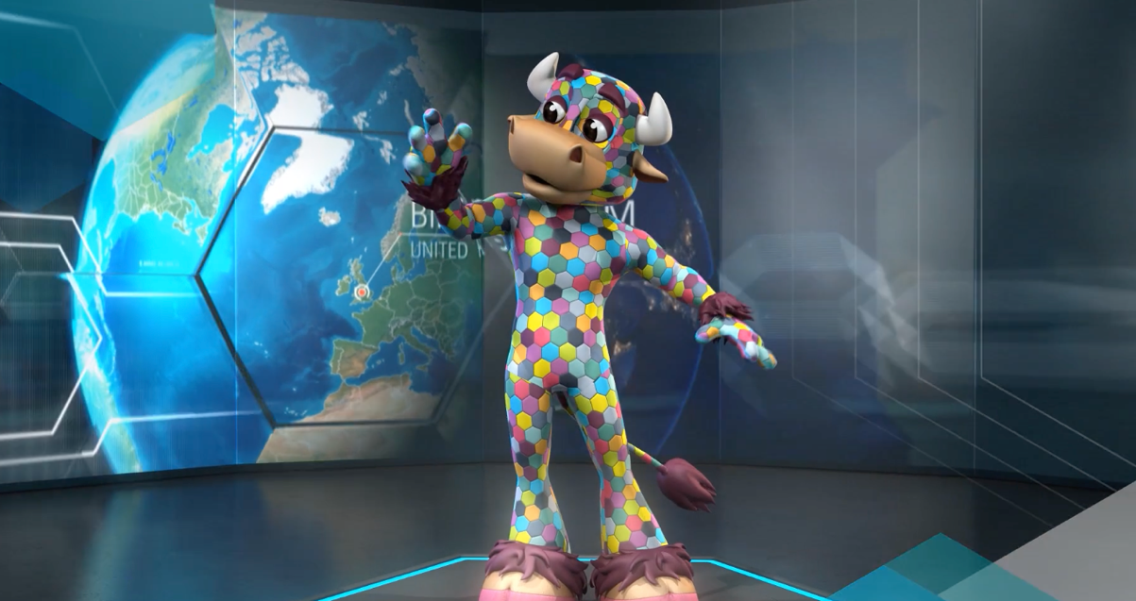
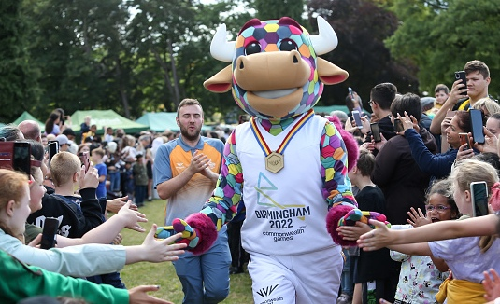
PERRY THE MASCOT
Found out more information on Perry’s features here: https://www.birmingham2022.com/mascot/features
Notes:
Teacher notes
Use this PowerPoint in presentation mode to view the video.
Show pupils the video about Perry the mascot, then have a look at the information about him to discuss his different features and what they represent:
His name
Why he’s a bull
His hexagons
His medal
His kit
Give pupils a Perry template and ask them to complete it in creative and colourful ways, using whatever kinds of art and/or found materials they choose (they could also complete their template using found materials at home). Use the completed templates to create a class or school display.

Slide 9
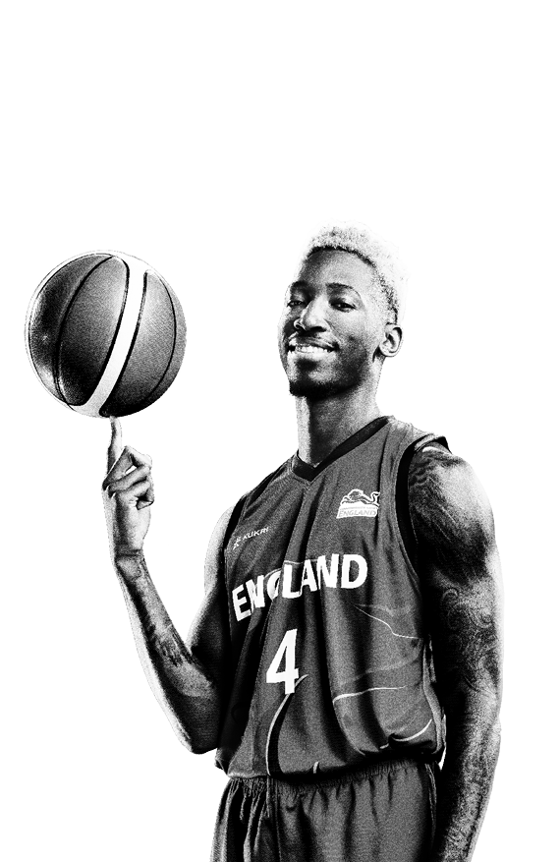
YOUR HOME LEARNING PROJECT
Find out about the Commonwealth nation or territory you have been given!
You might find out about: People Food Music Language Climate Commonwealth Games history Achievements from the Birmingham 2022 Commonwealth Games
What else can you discover?
Notes:
Teacher notes
Teachers should be aware of countries that pupils are researching because of political sensitivities. Teacher research is advised before giving pupils nations to research.
Assign pupils a different nation or territory which participated in the Commonwealth Games and ask them to complete an independent research project to find out more about their country. For example:
Food
Music
Language
Climate
Interesting facts
Commonwealth Games history
Achievements from the Birmingham 2022 Commonwealth Games
Encourage pupils to bring in their projects for an exhibition to show to the rest of the school or parents at an open evening.

