Slide 1



OUR HOME

Slide 2
OUR HOME
Overview: Pupils look at photos taken by people from across the Commonwealth of their favourite local places. Pupils discuss similarities and differences to their communities, and take their own photographs of places with meaning for them in their local area.
Learning objectives
Pupils will:
compare images of different Commonwealth nations and territories
consider which local places have meaning for them, and why it is special.
Learning outcomes
I can:
identify and discuss similarities and differences between places in different nations
identify a local place that means something to me
take a photo of my special place and describe why it is special.
Key words: locality; similarity; difference; urban; rural; meaningful.
Time required: 45 mins-1 hour (plus extra time for taking photos and preparing for a class or school walk if you choose to do so - see teacher notes on slide 7).
Resources: a large map of the world (if available); Commonwealth community photos with flipchart paper and pens; photographic equipment (camera/phone with camera/iPad etc).
Curriculum links: English, Geography, Art (see teacher notes below for more detail).
Notes:
Teacher notes
Curriculum links can be made to the following subjects and subject content:
Geography
Locational knowledge
Locate the world’s countries… concentrating on their environmental regions, key physical and human characteristics, countries, and major cities name and locate counties and cities of the United Kingdom, geographical regions and their identifying human and physical characteristics
Place knowledge
Understand geographical similarities and differences through the study of human and physical geography of a region of the United Kingdom, a region in a European country, and a region within North or South America
Human and physical geography
Describe and understand key aspects of:
Physical geography, including: climate zones, biomes and vegetation belts, rivers, mountains, volcanoes and earthquakes, and the water cycle
Human geography, including: types of settlement and land use, economic activity including trade links, and the distribution of natural resources including energy, food, minerals and water
Geographical skills and fieldwork
Use maps, atlases, globes and digital/computer mapping to locate countries and describe features studied
Art
Produce creative work, exploring their ideas and recording their experiences
English
Spoken language
Give well-structured descriptions, explanations and narratives for different purposes, including for expressing feelings maintain attention and participate actively in collaborative conversations, staying on topic and initiating and responding to comments
Writing – composition
All elements of this requirement may be covered

Slide 3
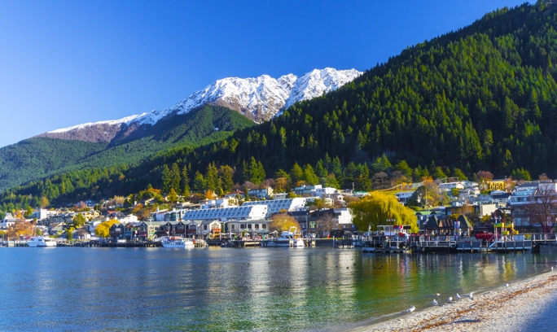
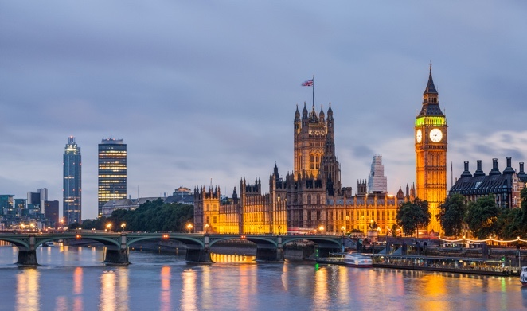
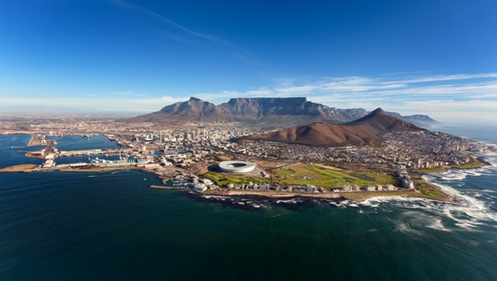
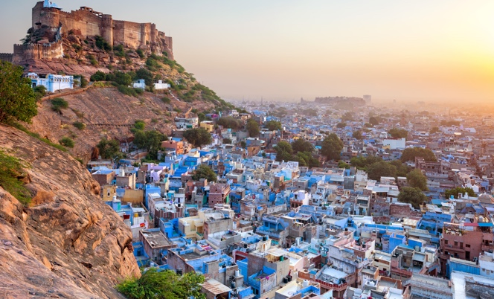
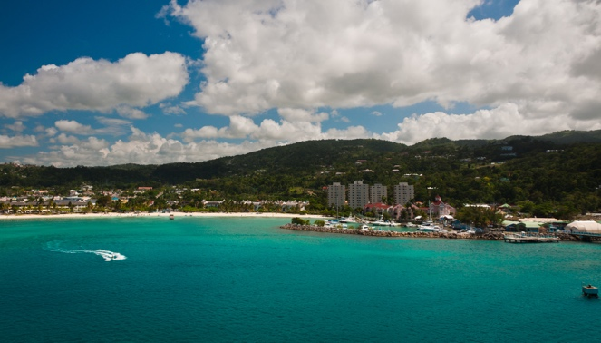
WHERE IN THE COMMONWEALTH?
New Zealand
England
South Africa
India
Jamaica
Notes:
Teacher notes
Show the photos one at a time and ask pupils to discuss in which Commonwealth nation or territory they think it was taken, and why (this should encourage them to make a considered guess, not a random one). If they cannot guess a country, ask them to try to guess on which continent it was taken (Europe; Africa; Asia; the Caribbean; the Americas; the Pacific).
Reveal the country – was anyone correct? If available, show pupils the country location on a world map.
From left to right answers are: New Zealand, England, South Africa, India and Jamaica.
Before moving on to the next image, ask pupils to describe the photo, using terminology such as:
Terrain
Climate
Physical features
Location

Slide 4
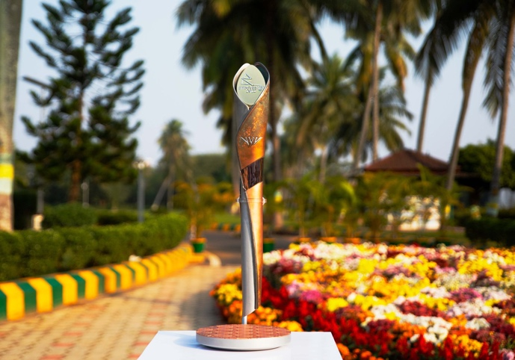
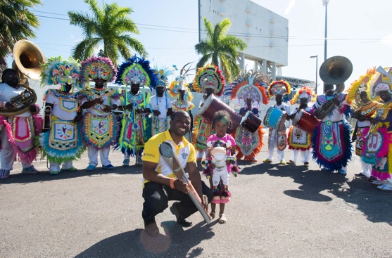

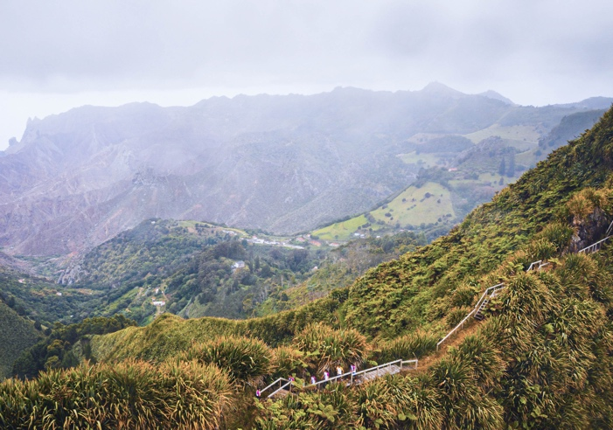
THEIR HOME
Look at the photos taken on
the 2022 Queen’s Baton Relay across the Commonwealth nations and territories.
Write down some similarities and differences with your community that you can see.
Notes:
Teacher notes
Divide the class into small groups. Ask each group to choose a photo on the slide taken in a Commonwealth nation. Using the flipchart paper and marker pens, ask them to write down any similarities with their local community that they can see on one side, and any differences on the other. After 3-5 minutes ask groups to choose a different photo and add anything to what has already been written by previous groups.
When every group has looked at each photo, discuss the similarities and differences that everyone found with the class. Discuss the photos using questions such as:
Was there anything you found interesting/unusual about the image?
What did you particularly like/not like?
Why do you think the photographer chose it as a special place for them (encourage them to use their imaginations to speculate here).
Go around the class and ask each pupil: If you met the baton bearer(s) who have taken the baton on the journey, what question would you ask them? Gather the questions together in a class list.

Slide 5
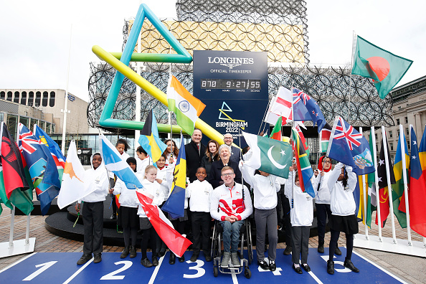
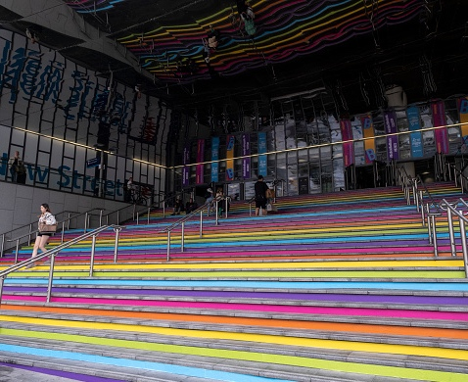
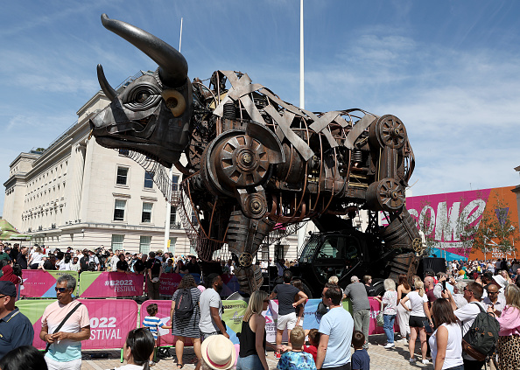
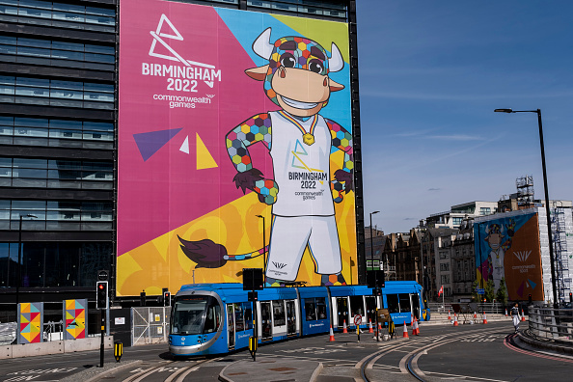
OUR HOME
Birmingham and places across the West Midlands were transformed in the run-up to and during the Birmingham 2022 Games.
Did you see any of these sights?
Notes:
Teacher notes
In the same groups as the previous slide, ask pupils to discuss whether they saw how the city centre of Birmingham was transformed during the Games.
Ask pupils to think about:
How it made them feel to see the city in person or on television or the internet
What they would like to see stay in the future
What they would have added to the city centre.

Slide 6

OUR HOME
Have a think about the special places in your community. What is special about them?
Write down some words and phrases that describe these special places and display them on a graffiti wall.
Notes:
Teacher notes
Provide pupils with a ‘Community wall’ on which to write or stick their special places words.

Slide 7

OUR HOME PHOTOGRAPHY PROJECT
The mechanical bull became a symbol to represent Birmingham during the Commonwealth Games. What is something that represents your home?
Take a photo of it and write a short description of the photo to tell us:
what it is
where it is
why it is a special place for you.
Notes:
Teacher notes
To extend the learning, ask pupils to take their own photos of a symbol of their hometown which is meaningful to them. They could use these to do a show-and-tell presentation, then create a class collage.
Alternatively, take pupils on a local walk so that they can take photos using school photographic resources. They could photograph anything they think is particularly interesting, beautiful, strange, special or representative of their area.

