Slide 1

BE A KINDNESS
CHAMPION

Slide 2
BE A KINDNESS CHAMPION
Overview: The Commonwealth Games are known as the ‘Friendly Games’. Pupils watch a film showing Commonwealth Games athletes, para-athletes and teammates supporting each other. They discuss acts of kindness towards others, what these look like and how they make others feel. They carry out acts of kindness in the run-up to the Birmingham 2022 Games.
Learning objective
Pupils will:
understand what kindness looks like, and how it makes people feel
Learning outcomes
I can:
identify acts of kindness
describe how being kind makes people feel
show kindness towards
other people

Slide 3
BE A KINDNESS CHAMPION
Key words
kindness; support; emotions; feelings
Time required
30–45 minutes initially, with varying times when carrying out and recording acts of kindness
Resources
Kind Acts worksheet; a small gift-wrapped box;
a Kindness box made out of found materials (available
in the classroom at all times for nominations); Kindness Champion certificate
Curriculum links
PSHE/RHE: identifying and naming feelings and emotions; understanding the effects of behaviour on others; personal health and mental wellbeing
Notes:
Teacher notes
Pre-prepare the gift-wrapped box in advance so that it looks as though something special is inside.
Have the Kindness box available in the classroom at all times for pupils to use to make nominations (these can be anonymous if they wish).

Slide 4


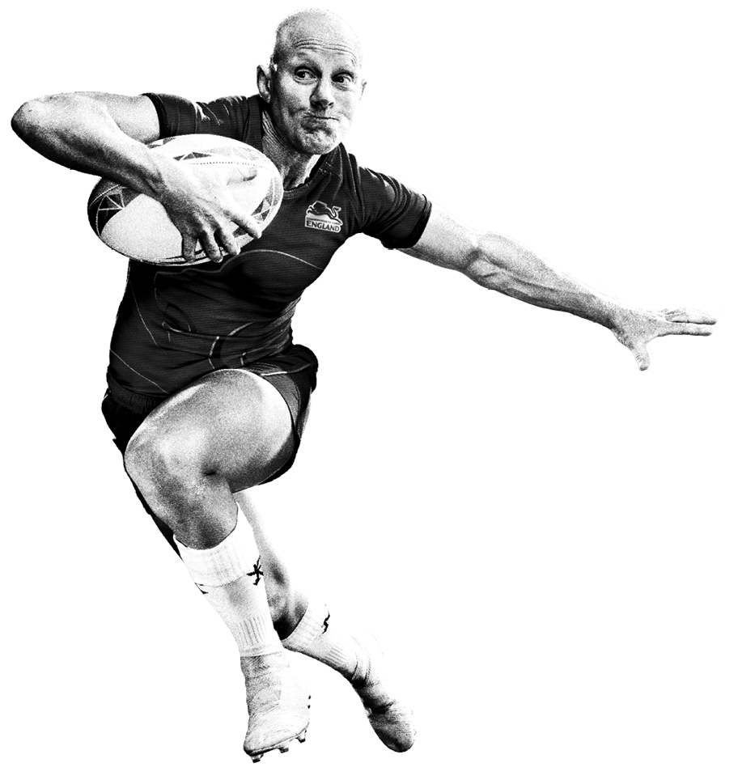

KINDNESS
Why do we do it?
How do we show it?
How does it make someone feel?
Notes:
Teacher notes
In pairs, pupils will create mind maps for the questions on the slide. Ask pairs to share their responses, then create a ‘Kindness vocabulary’ list, showing the following:
Things we can say
Things we can do
Ask pupils to share an experience from the past week when someone did something kind for them. How did it make them feel? Create a ‘Feelings of kindness’ list together.
Tell pupils that during the Birmingham 2022 Commonwealth Games there will be lots of people from other countries and nations, and from around the UK coming to Birmingham – how can we be kind to them while they are here?
Remind pupils of the Good luck challenge that they did with messages for athletes. How did that demonstrate kindness?

Slide 5


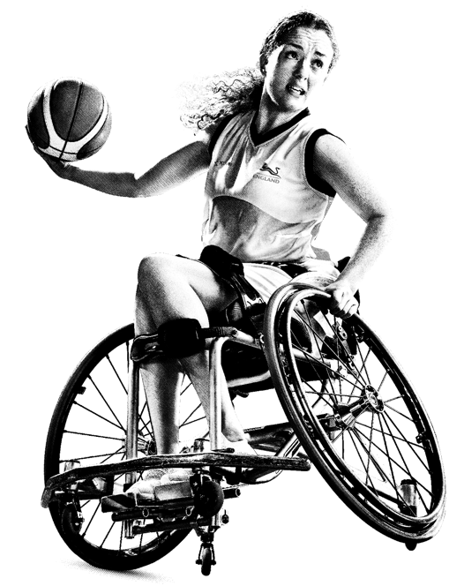

THE FRIENDLY GAMES
Notes:
Teacher notes
Explain to pupils that the Commonwealth Games are also known as the ‘Friendly Games’ because of how athletes come together from all over the world to showcase their sporting talents. Athletes also show kindness through sharing their knowledge and coaching each other, celebrating each other’s wins and personal bests and working as a team.
Ask pupils what they think the word inclusive means. Once pupils have a good understanding that being inclusive is including others in something they would like to do, ask them why they think it is kind to be inclusive.
Watch the film showing athletes and coaching staff demonstrate support and kindness to one another.
After they have watched the Kindness Champions film, discuss ways in which different athletes in the film demonstrated kindness. Ask pupils for ways we can be kind to each other. These could be ideas from Siobhan’s interview or their own ideas.
For the following activities, you will need enough space for pupils to sit in a circle, either on the floor or on chairs:
Half the class sit down in a circle, and the other half sit in the middle of the circle. Those who are in the circle should leave a space between them and the next person. In turn, each person around the circle should invite a person from the middle to sit next to them and say why, based on an act of kindness that they have shown (e.g. I would like Azhar to sit next to me because he helped me with my maths this morning; I would like Ella to sit next to me because she always smiles at me when I come in).
The whole class sits in a circle, and has an object to pass around (e.g. a juggling ball, a soft toy). When they have the object, a pupil completes a given sentence about kindness (e.g. Something kind I did today was…; Something kind X did this week was…; Something kind I am going to do this week is….; When someone is kind to me I feel…).
Pass a small gift-wrapped box around the circle and tell pupils that there is something very special inside. When they are holding the box pupils should say what is inside it, and who they are going to give it to (e.g. In this box there is a beautiful sparkling ring. I am going to give it to Ava). They should pass the box to that person with a smile, and the other person should thank them, then imagine a different object inside to give to someone else.

Slide 6
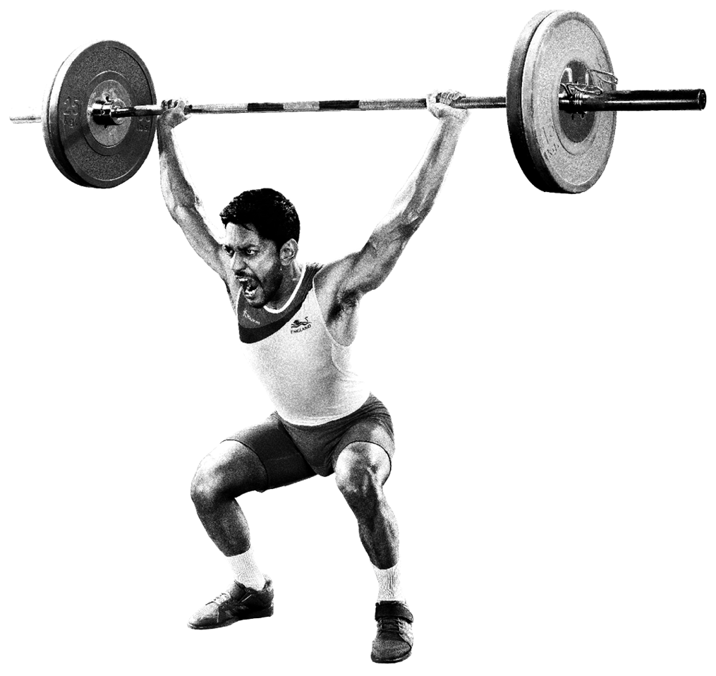


ACTS OF KINDNESS
Notes:
Teacher notes
Explain to pupils that acts of kindness are not necessarily big gestures and do not have to cost money.
Read a situation from the Kind Acts worksheet (or create examples of your own) and ask pupils to stand up if it applies to them. They should then change places with someone else who is standing. Ask those changing places to share their experience (e.g. I said thank you to my mum for helping me get ready this morning; Shanaz encouraged me when I was trying to spell a word).
Discuss how pupils felt when someone demonstrated kindness towards them in one of the activities. How did it feel for the person demonstrating kindness, as well the person receiving it? Why do pupils think it is so important to be kind to people, whether they are friends or people they don’t know?

Slide 7
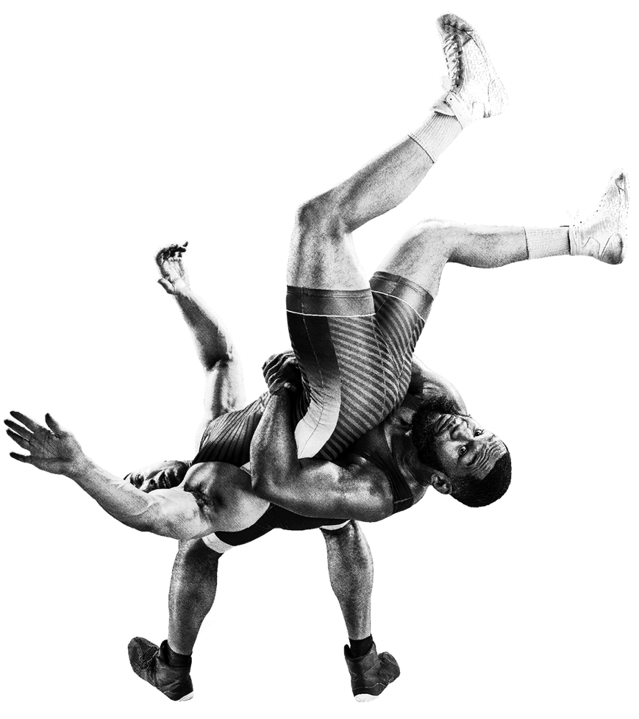

BE A KINDNESS CHAMPION!
Who could you show kindness towards?
How many acts of kindness can
you do before the end of term?
Use the Kindness Box for your
Kindness Champion nominations.
Can you achieve a Kindness
Champion certificate?
Notes:
Teacher notes
Tell pupils that their challenge for the rest of the term is to demonstrate as many acts of kindness towards people as possible.
Start by discussing everyone towards whom they could show kindness, e.g. family members, friends, classmates, teachers, other staff members etc. Then ask for examples of different things they could say or do (e.g. I could ask someone if they wanted to play with me at lunchtime; I could read my little brother a story before bedtime; I could smile and say hello to the old man who lives on my street).
Introduce the Kindness Box and tell them that if they witness someone being kind, they should write down their name and what they did and put it into the box. At the end of the week, you will read all the nominations and decide who deserves to receive Kindness Champion certificates (these could be given out in a class or whole-school assembly or used by the whole school as a focus for the term).
You could also create an Acts of Kindness display and encourage pupils to collect examples from their local community or the media – the list below gives some national examples, but there may be charities or organisations, or individual acts locally that pupils could find out about.
https://www.bbcchildreninneed.co.uk/wp-content/uploads/2020/10/t2-t-1575-ks2-random-acts-of-kindness-display-poster-display-poster-.pdf
https://actionforhappiness.org
https://www.smallactsofkindness.co.uk
https://www.randomactsofkindness.org/kindness-ideas
https://www.kindnessuk.com/world_kindness_day_kindness_day_uk.php
https://timeforkindness.co.uk/about/

