Slide 1

BRING YOUR VOICE

Slide 2
BRING YOUR VOICE!
Overview: Students learn what advocacy means, how it is shown by sports personalities around the world and how they can use their own voice to advocate for causes close to their hearts.
Learning objectives
Students will:
Understand how athletes use their platform to combat societal issues
Create a creative response to a change they want to see in the world
Learning outcomes
I can:
Explain what advocacy and voice mean
Explore the importance and significance of athlete voice during the Commonwealth Games
Make my own voice heard by outlining my own hopes for changing the world

Slide 3
BRING YOUR VOICE!
Key words
advocacy, change, society, humanity, equality, destiny
Time required
1 hour
Resources
Optional: Printed case studies (slides 11–13)
Pens, paper, art supplies for main task to make their creative response, e.g. clay, colouring pens, magazines, newspapers, found materials
Curriculum links
Citizenship: develop an interest in, and commitment to, participation in volunteering as well as other forms of responsible activity, that they will take with them into adulthood
Please make sure you use this PowerPoint
in presentation mode to use the
animation features on select slides.

Slide 4
LEARNING OUTCOMES
I can:
Explain what advocacy and voice mean
Explore the importance and significance of athlete’s voices during the Commonwealth Games
Make my own voice heard by outlining my own hopes for changing the world
Bring the Power by using your voice to outline your hopes for the changes you want to see in the world.

Slide 5


STARTER TASK
Task 1: Watch the Youth Voice film featuring young people from Birmingham and the West Midlands talking about their hopes for a future society.
As you are watching the film, jot down any ‘societal issues’ you hear mentioned.
Task 2: Discuss issues mentioned in the film with the class.
Extension task:
Are there any issues not mentioned in the film that you feel should be?
Notes:
Teacher notes
*Key word check – question pupils for understanding of the term ‘societal issues’. A societal issues is something that negatively affects people in their day-to-day lives.
Click through the slide in presentation mode to reveal tasks 1 and 2.
Task: Students watch video and make a note of any societal issues mentioned – they can feed these back to the class then add any others of their own.
You may need to give lower ability students some prompts or vocabulary ideas.

Slide 6
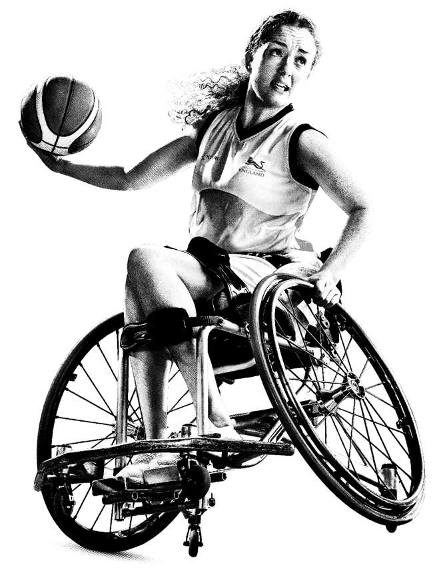


ADVOCACY
What does this mean?
THINK, PAIR, SHARE with the person next to you
Task: Volunteer your definitions to the class
*TIP –
‘advocates’ are often also called ‘activists’
Notes:
Teacher notes
*Key word check – question pupils for understanding of the word ‘advocacy’.
Task: Students spend a minute thinking about what the word ‘advocacy’ means before spending a further minute discussing their ideas with a partner and then feeding back to the class/teacher. The definition of advocacy is revealed on the next slide where students are asked to think of their own examples of advocates.
You may need to give extra support to students by giving them some prompts or vocabulary ideas.

Slide 7
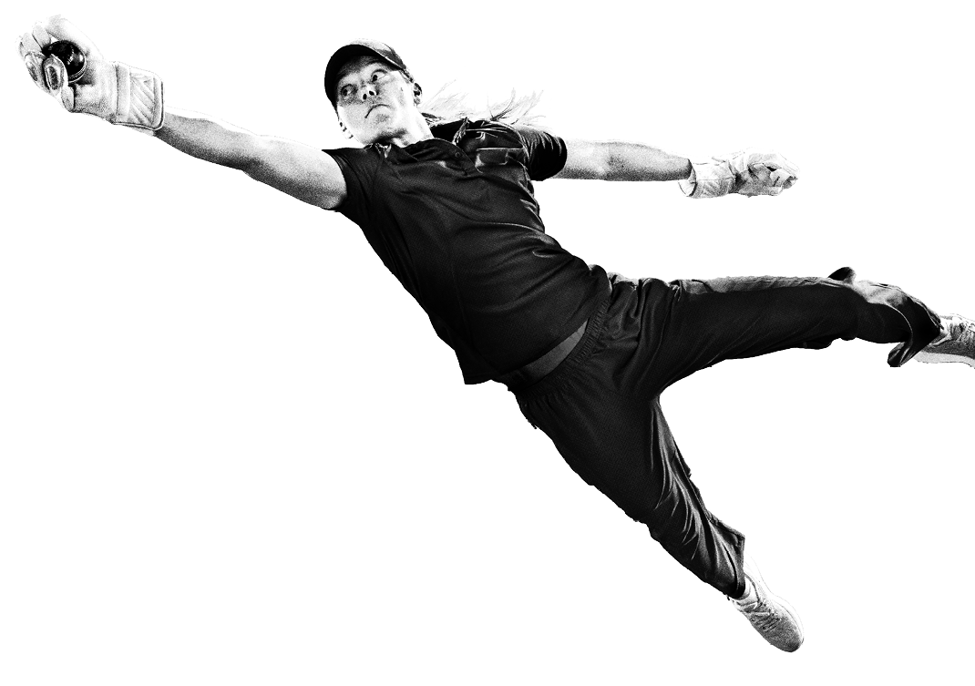
ADVOCACY
The definition is: ‘public support for a particular cause or policy’.
Can you think of any ADVOCATES for a particular cause?
Malala Yousafzai
Mahatma Gandhi
Rosa Parks
Advocate for girls receiving education
in her native country, Afghanistan.
Advocate for human rights and freedom.
American civil rights activist and advocate for race related issues.
Notes:
Teacher notes
Students add their own examples of those who have been advocates for a cause that they have heard of.

Slide 8
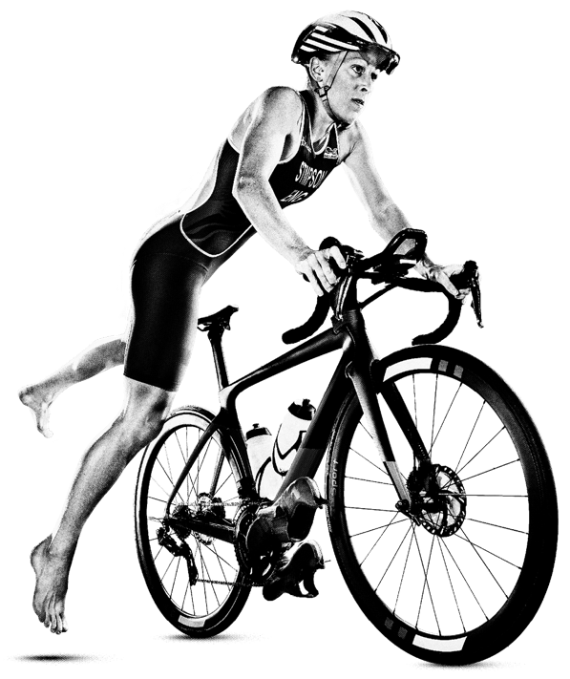

ADVOCACY
ADVOCACY is a powerful tool for raising awareness for societal issues,
and athletes are often considered as ideally placed to be advocates
for the issues that they support. Why do you think that this is?
Athletes have a global platform as they compete in large
globally recognised events
Athletes are often sponsored by large global organisations
who have great platforms for advertising and sharing awareness
Athletes are often considered ‘good’ role models
Athletes are often well travelled and therefore have a good
knowledge and understanding of the world and societal issues
Athletes have a vested interest in ensuring fairness and equality in the world – this will make the sporting world much more accessible for all!
Notes:
Teacher notes
Allow students to feed back before revealing ideas. Ideas will appear on the slide all at once on the second click.

Slide 9
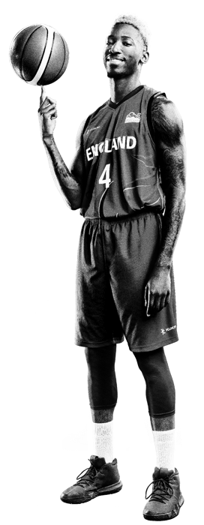
The Commonwealth Games Federation recognises that athletes are well placed to positively advocate for important issues and therefore have released guidance for athletes who wish to do so. They created 3 key guideline for athletes who are advocating for societal issues:
The Commonwealth Games Federation (CGF) recognises that athletes are:
  Inspirational leaders
  Agents of change
  Advocates for integrity
  Ambassadors for respect, impartiality and non-discrimination
The CGF is supportive of freedom of expression and trusts, respects and understands that athletes may want to make positive expressions of their values in line with the CGF values of Humanity, Equality and Destiny
Any such positive expressions of values are subject to the CGF Charter of Good Conduct
Notes:
Teacher notes
Read out the 3 guidelines to students. Tell the class they will be focusing on guideline number 2 (in bold).
Guidelines found here: https://thecgf.com/news/cgf-unveils-athlete-advocacy-guiding-principles-commonwealth-games

Slide 10
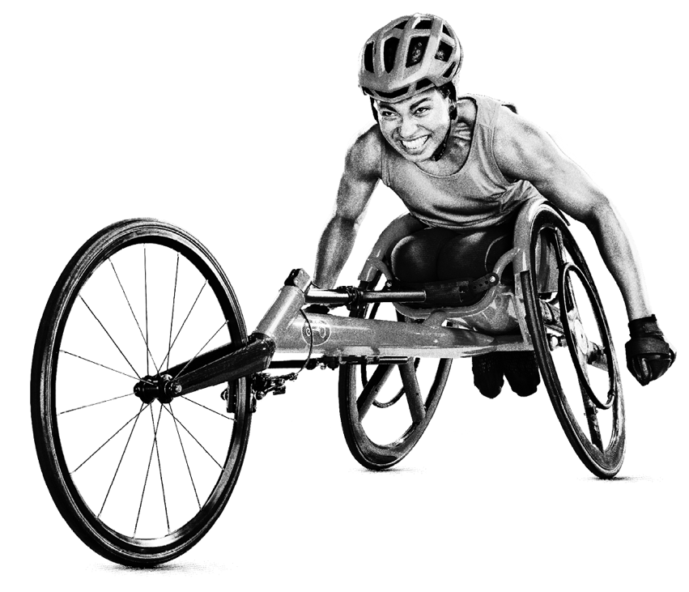
The CGF is supportive of freedom of expression and trusts, respects and understands that athletes may want to make positive expressions of their values in line with the CGF values of Humanity, Equality and Destiny
So what does this mean?
This means that the Commonwealth Games committee
are going to support athletes to be advocates for the
causes/issues that they wish to express.
Athletes at the Birmingham 2022 Commonwealth
Games will be allowed to show their support for societal
issues following the release of the Athletes Advocacy
Guidelines Principles which we have just looked at.

Slide 11
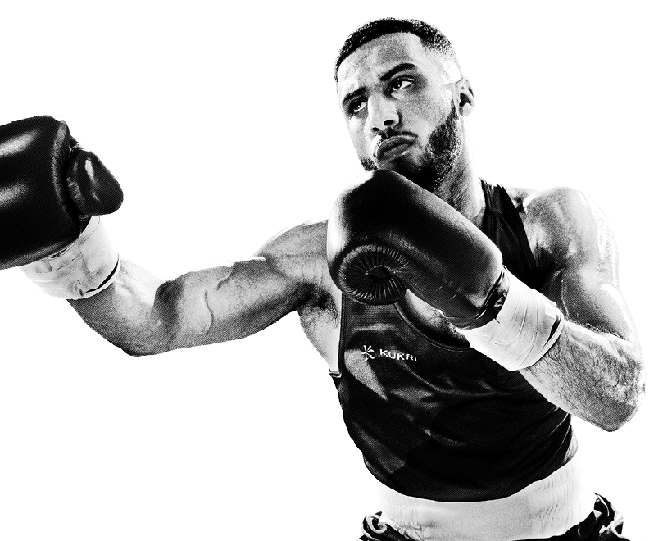
MAIN TASK: CASE STUDIES
Read through
the following case studies of three athletes who are advocates for societal issues.
Notes:
Teacher notes
As a class, or can be printed and given to students – read through case studies.

Slide 12

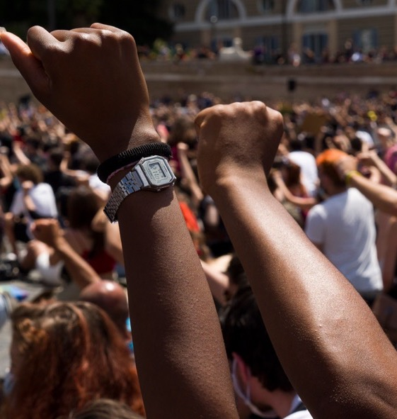
CASE STUDY 1:
COLIN KAEPERNICK
Colin Kaepernick is a former American football quarterback and an American civil rights activist. In his career he protested the unjust treatment of black people in the country.
Kaepernick began to kneel at the beginning of games when the national anthem was played. His actions inspired other players to take the knee with him. This is now a global protest used at many sporting events to show advocacy for social justice and equality.
He also donates a large proportion of his salary to charity.
Notes:
Teacher notes
As a class, or can be printed and given to students – read through case studies.

Slide 13

CASE STUDY 2:
MEGAN RAPINOE
Megan Rapinoe is an American soccer player who
has competed in numerous global tournaments.
As well as being a celebrated soccer player, Rapinoe
is an advocate for numerous LGBTQ+ organisations.
She has been involved in multiple causes including
the Black Lives Matter movement, where she showed
her support by taking the knee during the national
anthem before a game.
She has also been widely recognised for her work for the LGBTQ+ community and gender equality on and off the pitch.
Notes:
Teacher notes
As a class, or can be printed and given to students – read through case studies.

Slide 14
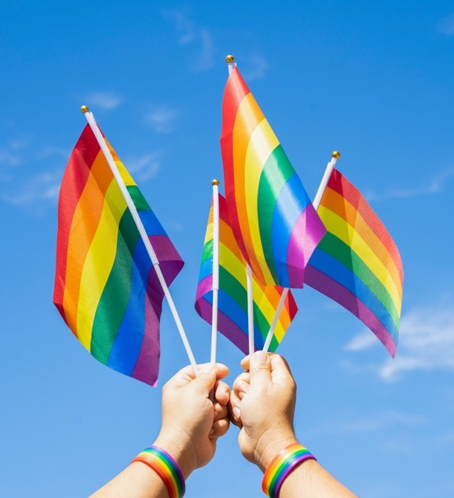
CASE STUDY 3:
TOM DALEY
Tom Daley is an English diver, Olympian and
gold medalist.
Daley is an advocate for LGBTQ+ rights and equal treatment of people of all sexualities across the globe.
He advocates to make the world a more inclusive
and accepting place and to create change in attitudes around the world.
He has received an OBE for his services to advocating for LGBTQ+ rights, as well as charity
work and his diving career.
Notes:
Teacher notes
As a class, or can be printed and given to students – read through case studies.

Slide 15
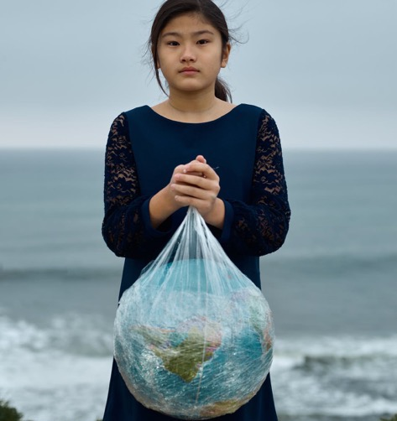
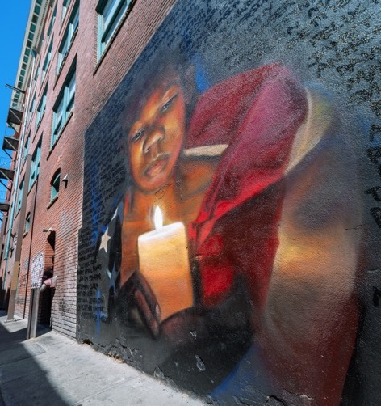
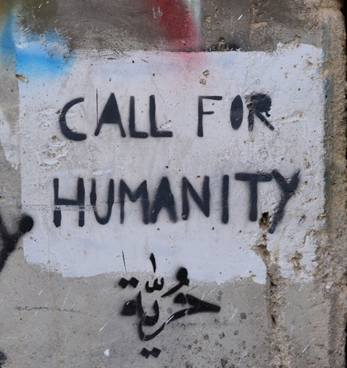
Art is a way that activists/advocates get their messages across to people. Here are some examples:
Notes:
Teacher notes
Show students the advocacy art examples and ask them to think about why art is used to get people thinking about societal issues.

Slide 16
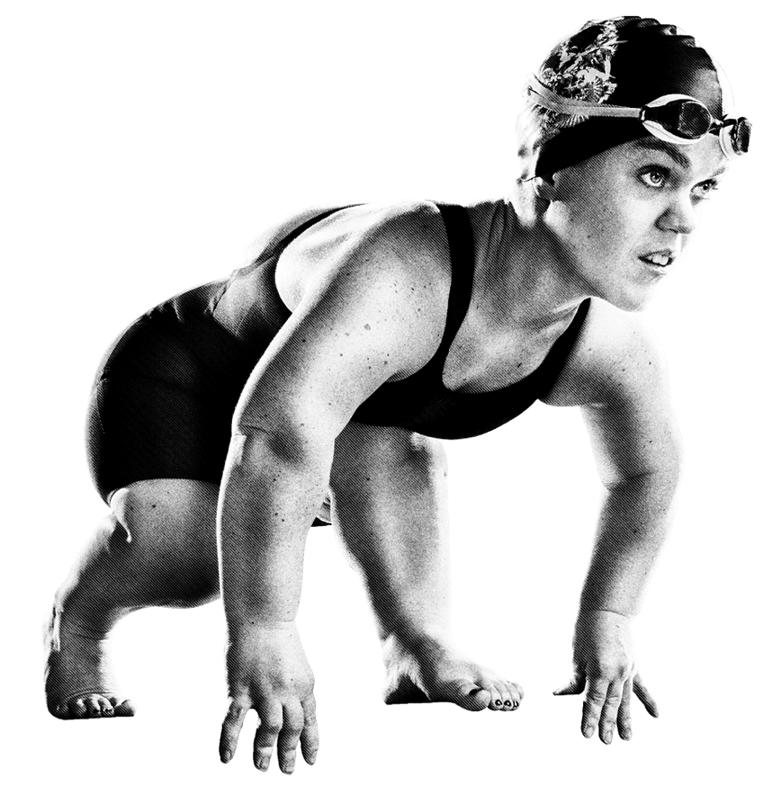
MAIN TASK: CASE STUDIES
Your task is to work on your own creative response to an issue
that is close to your heart.
It could be a poem, a song, poster, piece of art, collage, sculpture etc.
Notes:
Teacher notes
Examples of issues from the starter task could be left on the board. Also pupils have the option to work in pairs or groups for this task.
For more support
Students could use the 3 examples that they have learnt about in this session.

Slide 17
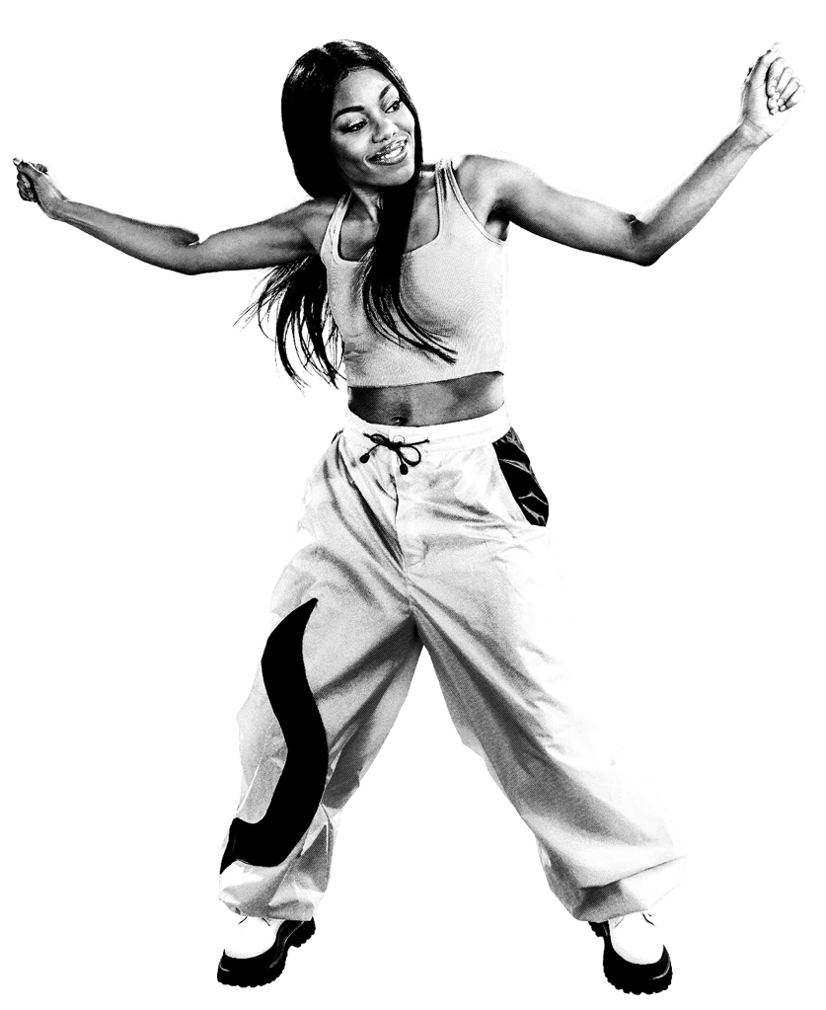

SHARE
Would anyone like to share their idea or art work with the class?
It is important to remember that we all have different ideas of what societal issues are, and which are the most important to us, depending on our own personal opinions.
Remember, we must give our classmates the respect we would like ourselves.

