Slide 1

ONE WORLD, ONE PLANET

Slide 2
ONE WORLD, ONE PLANET
Overview: Pupils learn about the aim of the Birmingham 2022 Commonwealth Games to be sustainable and environmentally friendly. They explore the impact of climate change on the natural world across the Commonwealth and make their own pledges to help protect
the planet.
Learning objective
Pupils will:
learn about the impact of climate change and human behaviour on the natural world
Learning outcomes
I can:
explain how human behaviour impacts
our environment
identify potential risks to the natural world from climate change and human behaviour
explain how we can all help to protect
our planet

Slide 3
ONE WORLD, ONE PLANET
Key words
Environment; climate change; recycle; reuse; sustainable
Time required
45 minutes–1 hour
Resources
Junk modelling materials (pre-prepared);
Birmingham 2022 pledge worksheet
Please make sure you use this
PowerPoint in presentation mode
to use the animation features on
select slides.
Curriculum links
PSHE - Core theme 3:
Living in the Wider World/Shared Responsibilities
That there are different kinds of responsibilities, rights and duties at home, at school, in the community and towards the environment
Geography
Describe and understand key concepts of:
Human geography
Physical geography
Science
Living things and their habitats (non-statutory guidance):
human impact (positive and negative)
on the environment (Y4)
Notes:
Teacher notes
Ahead of this activity, ask pupils to collect and bring in items they would normally have thrown away at home e.g. yoghurt pots, disposable containers, egg boxes. They should make sure these are clean and have not contained meat.
Younger pupils should use slide 3 as an introduction, whereas older pupils should use slide 4.

Slide 4
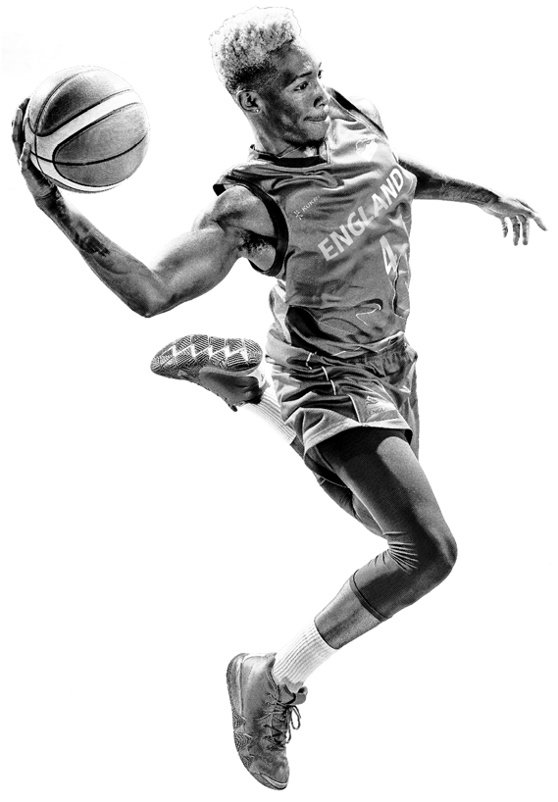

HUMANS AND OUR PLANET
1. Which of these things can harm the planet?
  Using plastic water bottles once
  Jumping up and down lots of times
  Leaving a car engine running when it’s parked
  Cycling and walking to school
2. Which of these things can help the planet?
  Leaving all the lights on at night
  Cycling and walking to school
  Chopping down trees and building roads
  Planting trees
Notes:
Teacher notes
This introductory slide should be used with younger pupils. Responses can be used to evaluate pupils’ prior knowledge and level of understanding.
Do the quiz with the class, then reveal the answers, answers are revealed once all four options are on screen. Ask them if they know why the particular things they have identified can harm or help the planet. For example:
1a) Plastic takes years and years to rot away (biodegrade), so we should reuse or recycle plastic bottles.
1c) Leaving car engines running when they’re not driving pollutes the air.
2b) Not driving short distances means there is less air pollution (and is healthier for your body).
2d) Trees are like giant lungs – they give off oxygen so we can all breathe cleaner air.

Slide 5
HUMANS AND OUR PLANET
What are some of the ways that humans hurt the planet?
What are some of the ways that humans can help the planet?
Notes:
Teacher notes
This introductory slide should be used with older pupils.
Ask pupils to work in pairs or small groups to create concept maps that answer the two questions on the slide.
Take feedback. These concept maps can be used to both introduce the topic and evaluate pupils’ prior knowledge and level of understanding.

Slide 6
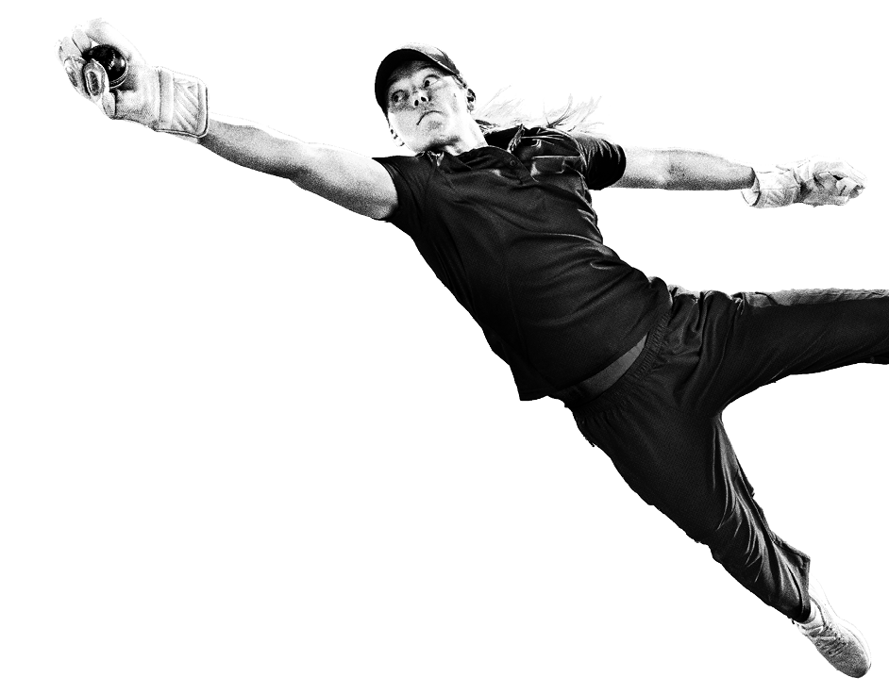

CLIMATE CHANGE
What is climate change (global warming)?
Why is it a problem?
What can we do?
Notes:
Teacher notes
Ask if anyone knows what ‘climate change’ means, and give a definition (e.g. Climate change means that the planet is slowly getting warmer and warmer. We know that it’s happening because of extreme changes in the weather or the temperature.)
Ask pupils why they think that climate change is a problem. You could give some examples such as:
Warmer temperatures makes ice melt in Antarctica, which means that sea levels rise, which can mean that land gets flooded
Some animals can’t survive in extreme temperatures, so they might die out
Pollution in the atmosphere creates more illnesses related to breathing, such as asthma
Ask pupils what kinds of things we can do together and individually to help prevent climate change, and make a list of responses (e.g. recycle/reuse/reduce packaging, refuse plastic bags in shops, walk short distances instead of driving etc.).

Slide 7
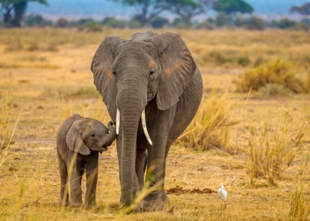
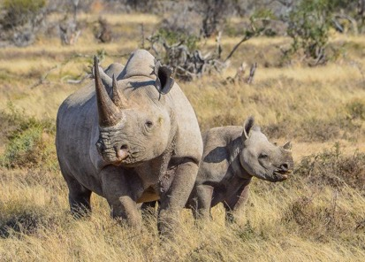
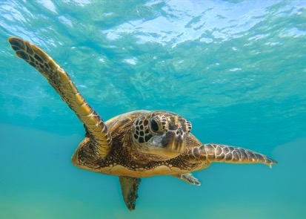
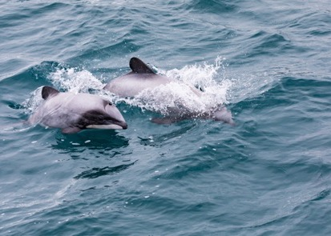
ANIMALS IN DANGER OF EXTINCTION
Black rhino found in Namibia
African elephant found in Ghana
Hector’s dolphin
found in New Zealand
Green turtle found
in the Pacific Ocean, Indian Ocean and Caribbean Sea
Notes:
Teacher notes
Explain to pupils that these are just some animals which are in danger of extinction or whose populations are going down because of climate change.
Information from the WWF website: https://www.worldwildlife.org/species/directory?direction=desc&sort=extinction_status
For more challenge, pupils may want to do their own research into the different animals (and others) using the list on the WWF site: https://www.worldwildlife.org/species/directory?direction=desc&sort=extinction_status. This also gives information about why these species are important, and why it matters that they are dying out.

Slide 8
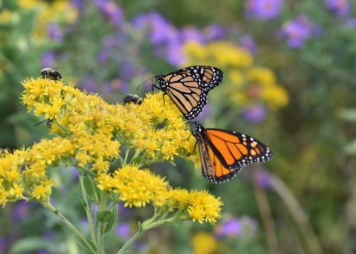
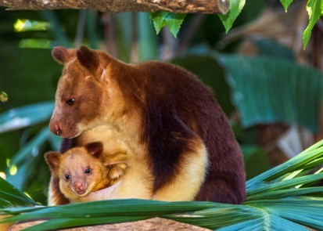
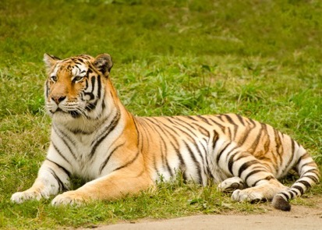
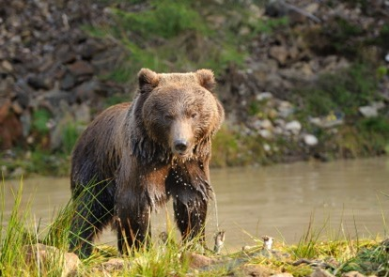
ANIMALS IN DANGER OF EXTINCTION
Tree kangaroo found in Papua New Guinea
Monarch butterfly found in Canada
Continental tiger found in India and Malaysia
Brown bear found in Canada
Notes:
Teacher notes
Information from the WWF website: https://www.worldwildlife.org/species/directory?direction=desc&sort=extinction_status
For more challenge, pupils may want to do their own research into the different animals (and others) using the list on the WWF site: https://www.worldwildlife.org/species/directory?direction=desc&sort=extinction_status. This also gives information about why these species are important, and why it matters that they are dying out.

Slide 9
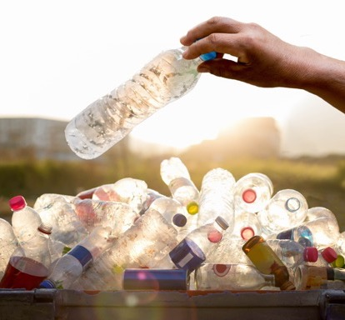
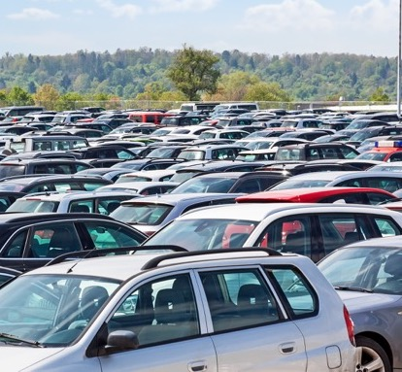
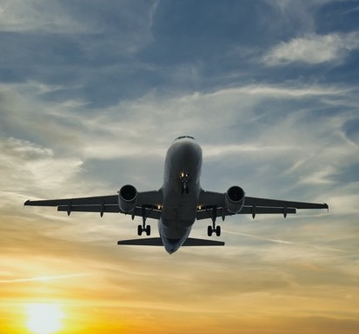
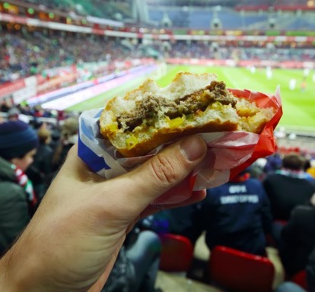
“WE’RE ALL PLAYING FOR ONE PLANET, REGARDLESS OF WHAT TEAM OR LEAGUE WE’RE ON.”
Notes:
Teacher notes
Ask pupils how a big sporting event like the Commonwealth Games could cause problems for the environment. Use the images on the slides as prompts.
The title is a quote from an interview on the Recycle and Win programme, to encourage fans to be sustainable in and out of the arena. Ask pupils what they think the quote means and why they think climate change can affect sports.

Slide 10
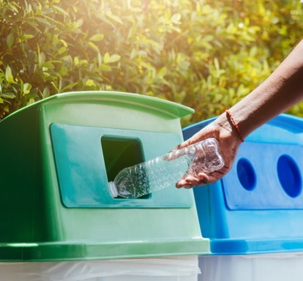
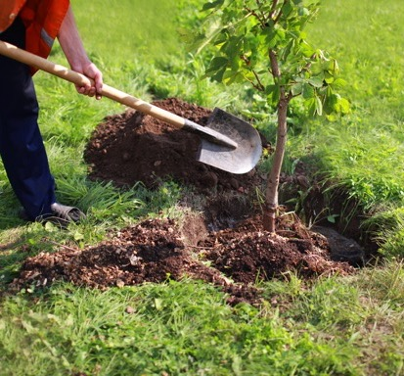
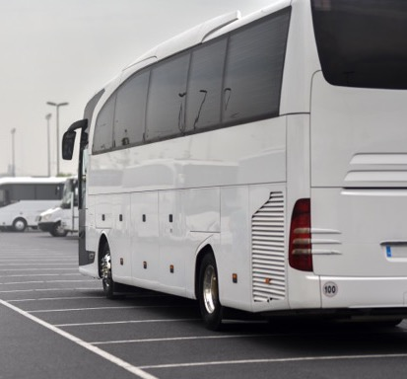
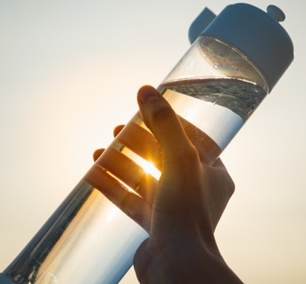
“WE’RE ALL PLAYING FOR ONE PLANET, REGARDLESS OF WHAT TEAM OR LEAGUE WE’RE ON.”
Notes:
Teacher notes
Explain that Birmingham 2022 has made a pledge (a promise) to make the Commonwealth Games as environmentally friendly as possible.
Show the images as examples of different ways in which they are trying to do this. (You can find more detail at https://www.birmingham2022.com/about-us/our-purpose/our-legacy/sustainability/)
Examples include:
Planting 2,022 acres of forest and 22 ‘tiny forests’ in local urban areas
Clearing plastic from 22 miles of canals
Aiming to send no waste to landfill but to hire, reuse or recycle instead
Reducing single-use plastic
Providing free public transport to the Games across the West Midlands region

Slide 11
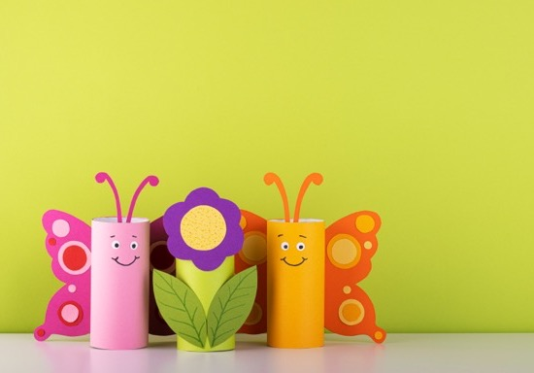
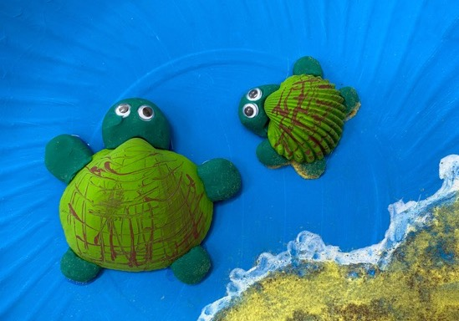
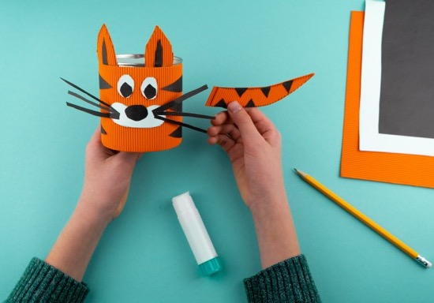
JUNK ANIMALS
Notes:
Teacher notes
Ask pupils to use the packaging and material that has been collected to create a junk model of an endangered animal (they could use the animals shown on slides 6 and 7 or do some research to find images themselves). They can use these to create a table display and present their work to younger children in KS1 to make them aware of the importance of looking after the natural world.

Slide 12
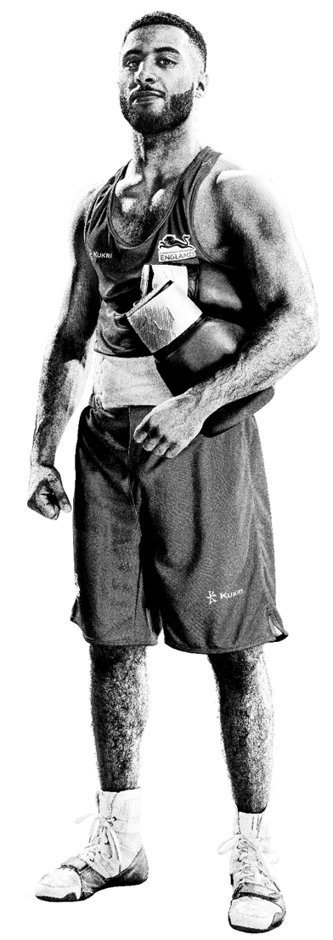
MY BIRMINGHAM 2022 CLIMATE PLEDGE
A pledge means a promise.
What one thing will you promise to do to help our planet?
Write your Birmingham 2022 climate pledge so everyone can see it.
Notes:
Teacher notes
Ask pupils to make a promise to do one thing that can help slow down climate change. They can use the Climate pledge worksheets as a template, and then you can share the class’s ideas in a display or on Birmingham 2022 social media by using the hashtags #BringThePower and #B2022

