Slide 1

MAKE A DIFFERENCE!

Slide 2
MAKE A DIFFERENCE!
Overview: Pupils learn about what social action means, and see examples of local social action projects that have taken place in Birmingham and the West Midlands. In small groups, pupils plan their own project or campaign to help effect positive change in their local community.
Learning objectives
Pupils will:
learn about social action, what it means and what it can achieve
plan their own local social action project
Learning outcomes
I can:
describe what social action is
identify changes and differences that taking social action can make
plan a social action project on a local issue

Slide 3
MAKE A DIFFERENCE!
Key words
social action; change; difference; community; citizenship
Time required
1 hour (with additional time if teachers choose to develop the project further)
Resources
Social action projects diamond 9 worksheet; workbooks or paper, pencil or pens
Curriculum links
PSHE: Living in the Wider World;
Non-statutory PoS for Primary Citizenship
Please make sure you use this
PowerPoint in presentation mode
to use the animation features on
select slides.

Slide 4

WHAT IS SOCIAL ACTION?
Social action is about people coming together to help improve their lives and solve the problems that are important in their communities.
Notes:
Teacher notes
Ask the class if anyone knows what ‘social action’ means. Help pupils come to an understanding by asking them what ‘social’ means (e.g. people all together) and what ‘action’ means (e.g. doing something), then putting the two meanings together (e.g. people doing something together). Explain that ‘social action’ is all about people working together to improve things for everyone, then click to reveal the government description.
Ask pupils which words or phrases they think are really important in the description, and help them see words like ‘people’ ‘together’ ‘improve’ ‘solve’ ‘communities’ (click again and these words will be highlighted). Can pupils think of any examples of social action locally or in school?

Slide 5
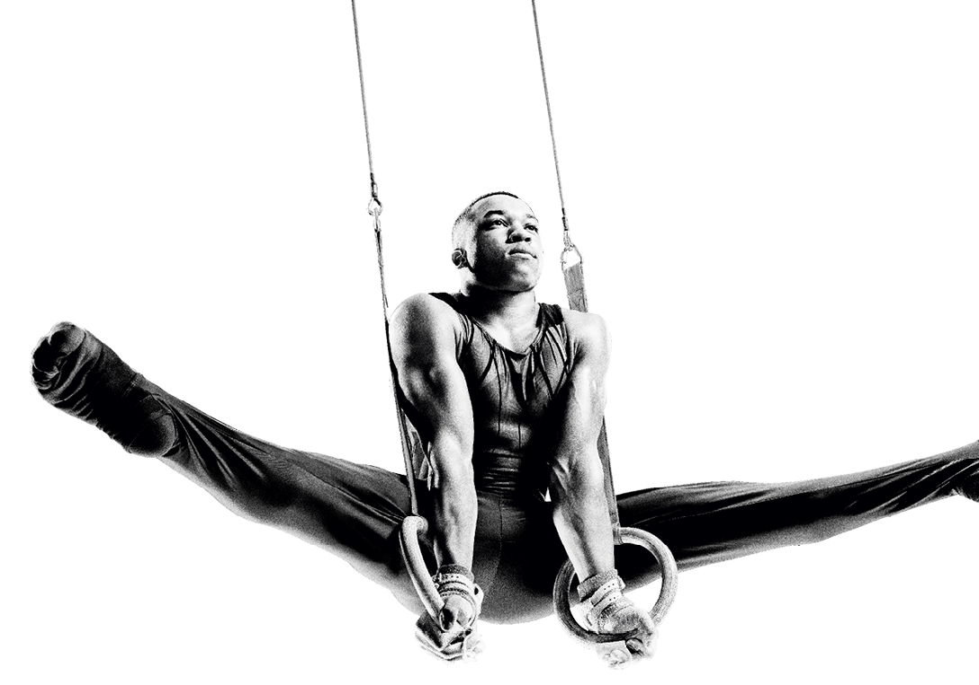

IF I HAD ONE WISH…
If I had one wish to
make my community
better, I would wish for…
If I had one wish to make my
world better, I would wish for …
Notes:
Teacher notes
Hand out paper or ask pupils to complete the sentences with words or a drawing (or both) in their books. What one thing would they wish for for their community and for the world, as part of their own social action?

Slide 6
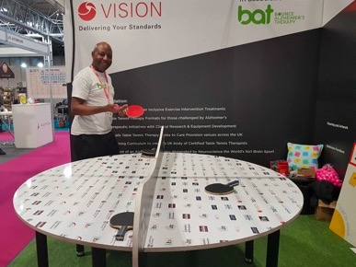
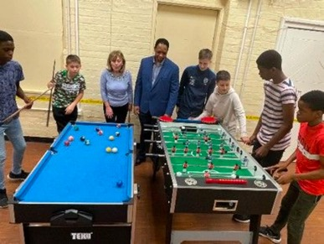

UNITED BY BIRMINGHAM 2022
Bat (Bounce
Alzheimer’s
Therapy) and Chat
is a programme
which provides
table tennis Therapy Tables to the West Midlands to help those with dementia and other cognitive disabilities.
Sporting Futures CIC provides a range of activities such as football, dodgeball, table tennis, pool and air hockey to engage young people.
The WASUP project has written a book for primary schools to spread awareness of the dangers of plastic pollution in schools.
Notes:
Teacher notes
The slide shows real life examples of projects supported by or connected to the Birmingham 2022 Commonwealth Games. Read through the examples on the slide together.
In pairs or small groups of three or four, pupils will complete the social action projects diamond 9 worksheet activity using the Social action diamond 9 cards, putting the projects into order depending on which they think is most beneficial to least. Ask groups for feedback, and for the reason they placed their projects where they did (remind them that there is no overall right or wrong answer for this activity).

Slide 7
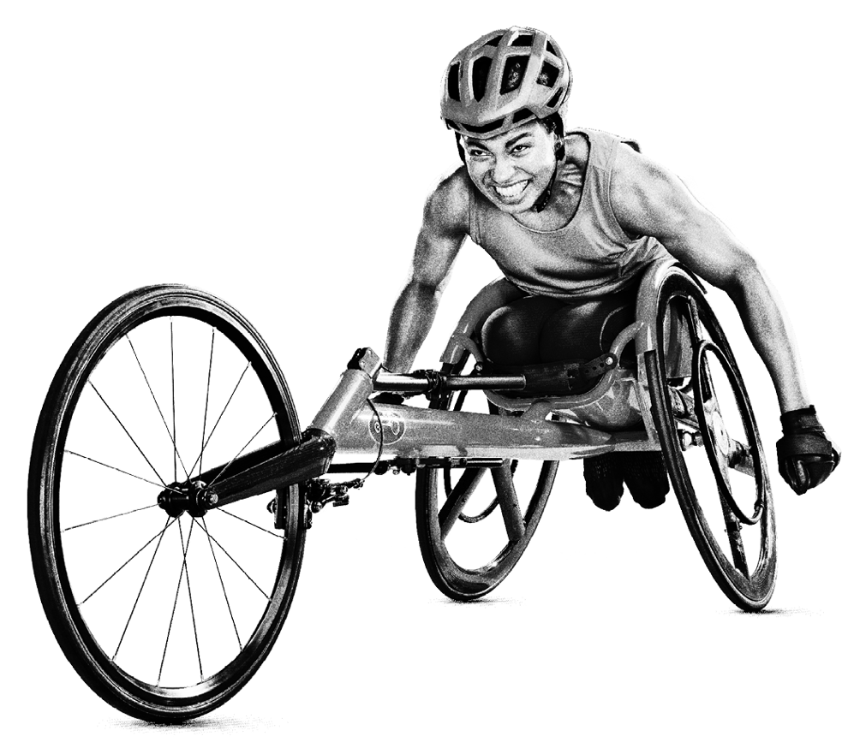
OUR SOCIAL ACTION PROJECT
What social action would you like to see happen?
Design your own social action project!
  Identify a local issue.
  Who does it affect?
  How could you make
  a difference?
Notes:
Teacher notes
In groups, pupils will think of a social action project that they would like to see. They should then write or create a brainstorm of their social action project to present to the rest of the class.
For more support
Pupils can use the social action examples worksheet to support them with project ideas.

Slide 8
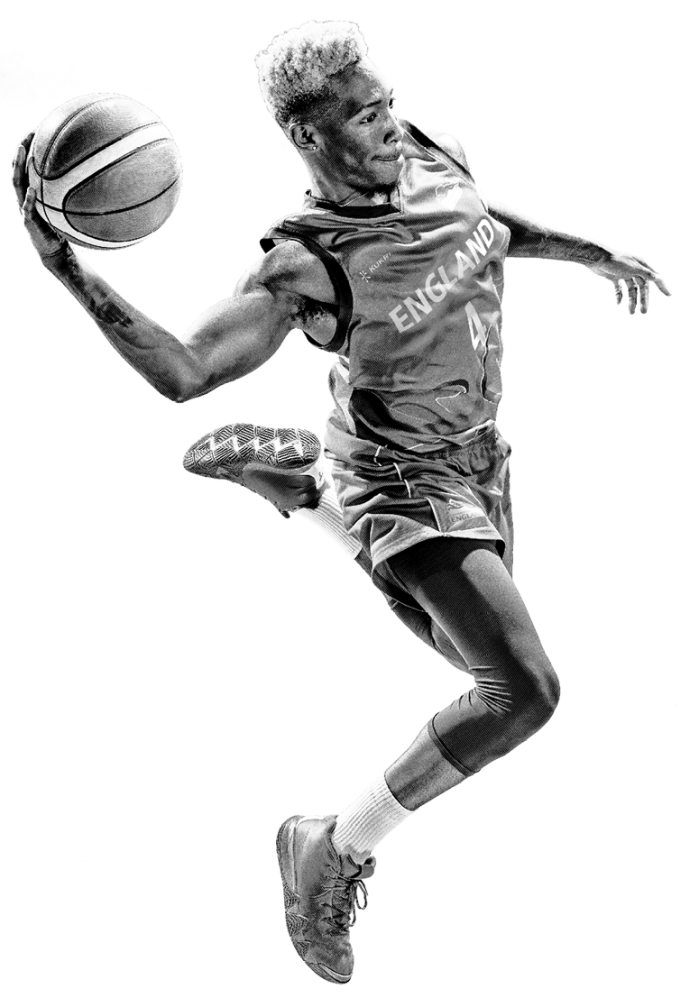

TWO STARS AND A WISH
Listen to the different social action
project ideas.
What two stars would you give them?
What wish would you give to make them even better?
Why not try putting your project into action?
Notes:
Teacher notes
Ask pupils to present their social action project ideas to the rest of the class. Others give constructive feedback using ‘two stars and a wish’.
Further challenge
Pupils can take their projects forward and carry them out with support, either within or outside of school.

