Slide 1

SCHOOL FESTIVAL
Festival Pack

Slide 2
OVERVIEW
Bring the Power
Bring the Power is the youth programme of the Birmingham 2022 Commonwealth Games. The programme aims to put children and young people at the heart of this exciting festival of sport and culture.

Slide 3
OVERVIEW
Festival Pack
This resource includes bite-size activities to enable pupils to Bring the Power of the Games to their school and community and create excitement around the Games.
The resource can be used flexibly across age ranges (KS1/2), and subjects.
This pack is an adaptable resource aimed
at primary school pupils.
It includes a range of activities geared towards planning a ‘Festival Day’ to get ready for the Birmingham 2022 Commonwealth Games.
You can choose to do as many or as few activities as you feel is appropriate for the theme of your Bring the Power School Festival Day.
The more exciting the day, the more chance you have of winning some Bring the Power: School Festival rewards (see slides 22-24 for details).
The pack also includes teacher notes
and printable worksheets and resources.

Slide 4
OVERVIEW
Using this presentation
The slides and slide notes include the vocabulary and subject knowledge you’ll need to use this presentation with confidence.
Slides 2-4: Overview for teachers.
Hidden slides will not display in presentation mode.
Slides 4-24: Slides to use with pupils.
Slide notes contain further guidance
for teachers.
Time required
Activities vary between 10-30 minutes.
You can choose the activities you feel
most suitable for your school and pupils.
Developed with teachers
This resource has been developed in partnership with practising teachers.

Slide 5
POLITICAL IMPARTIALITY
Please refer to the Political impartiality in schools guidance: www.gov.uk/government/publications/political-impartiality-in-schools/political-impartiality-in-schools
Schools should use their discretion when deciding on the use of specific resources
and activities.

Slide 6
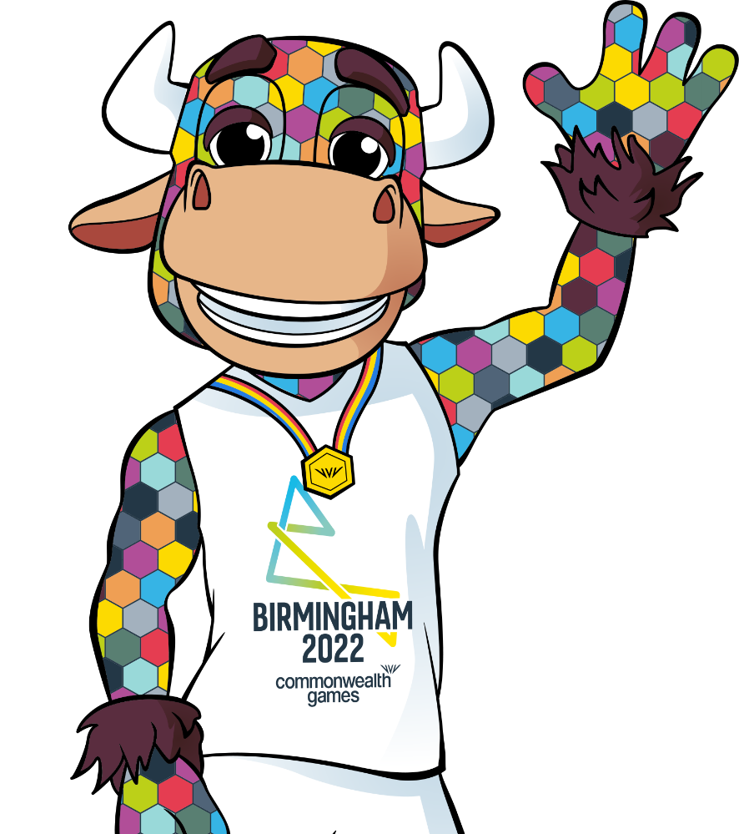
BRING THE POWER!
The Birmingham 2022 Commonwealth Games
is coming to Birmingham this summer – and
we want you to be a part of it!
The Games will run from 28 July - 8 August 2022
What is Bring the Power?
Bring the Power is the official youth programme
of the Birmingham 2022 Commonwealth Games.
We want children and young people to get closer
to the Games and take the lead in planning events as part of this Bring the Power: School Festival.
Notes:
Bring the Power is Birmingham 2022 Commonwealth Games’ youth programme. The programme aims to make children and young people part of this exhilarating festival of sport and culture.
‘Bring the Power’ is about inspiring young people to create their own legacy as part of the events, and this resource is designed to give young people tools and ideas to create their own events which Bring the Power of the Games to their school.
When the ‘Bring the Power’ programme and brand was created with young people, the themes they wanted to be at its heart were:
• Diversity and inclusion - showcasing and supporting all different types of people
• Aspiration - ideas, inspiration and passion and supporting young people on their journey
• Opportunity - collaboration, new experiences and creating a brighter future

Slide 7

BRING THE POWER!
What might Bring the Power mean to your school community?
Over to you!
We want you to host events and activities which
Bring the Power to your school and community.
In this pack you can find lots of ideas to plan, run
and decorate your very own activities to get ready
for the Birmingham 2022 Commonwealth Games!
Some of these activities are geared towards assemblies or displays, but most of them can be used as part of
a special Bring the Power: School Festival Day!
Notes:
Bring the Power is Birmingham 2022 Commonwealth Games’ youth programme. The programme aims to make children and young people part of this exhilarating festival of sport and culture.
‘Bring the Power’ is about inspiring young people to create their own legacy as part of the events, and this resource is designed to give young people tools and ideas to create their own events which Bring the Power of the Games to their school.
When the ‘Bring the Power’ programme and brand was created with young people, the themes they wanted to be at its heart were:
• Diversity and inclusion - showcasing and supporting all different types of people
• Aspiration - ideas, inspiration and passion and supporting young people on their journey
• Opportunity - collaboration, new experiences and creating a brighter future

Slide 8


EVENT PLANNER
FESTIVAL PLANNING!
Start by deciding what kind
of festival or event you want to organise at your school.
Then use the Festival planning worksheet
to help you get started!
Make sure your festival
will ‘Bring the Power’ of
the Birmingham 2022 Commonwealth Games
to your school!
Event theme ideas:
Assembly
Music festival
Food festival
Birmingham 2022 Commonwealth Games sports day
Mini Games event
Unity day
Lunchtime sports club
Spoken word event
Story time event
School fete
Notes:
Teacher notes:
You will need: Festival planning worksheet
Instructions:
Print and distribute the Festival planning worksheet as an aid to plan your Bring the Power School Festival day to celebrate the Birmingham 2022 Commonwealth Games.
Pupils can be split into groups and different roles assigned (project manager, designer, marketing lead).
Signpost pupils to the relevant slide linked to the Event theme ideas listed on this slide:
Assembly (Slide 10)
Music festival (Slide 11)
Spoken word event (Slide 12)
Mini Games event (Slide 13)
Lunchtime sports club (Slide 14)
Unity day (Slide 15)
Food festival (Slide 16)
Story time event (Slide 17)
Birmingham 2022 Commonwealth Games sports day
School fete
Please note: worksheets are optional and pupils can create their own event plan using pens and paper.

Slide 9


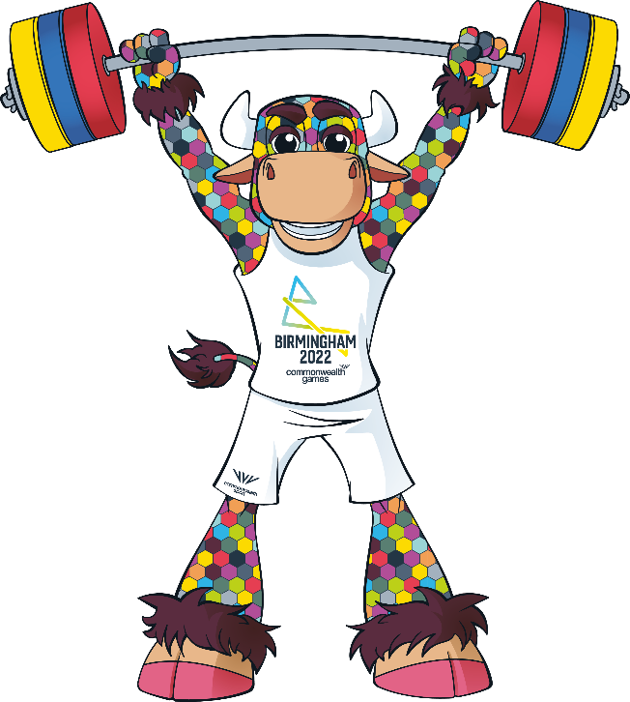

DECORATE FOR THE GAMES!
Jazz up your festival events by creating Birmingham 2022 Commonwealth Games themed decorations.
Design posters to advertise your events
to put up around school and the local community.
Make them clear,
bright, colourful and
eye-catching so that everybody reads them.
Make colourful bunting out of paper or fabric
to hang around your school grounds.
Colours could
represent the flags of
the competing nations and territories.
Use these at your:
Sports day
Sports festival
School fete
Or as part of your own event!
Make badges, hats or sashes for event attendees to wear.
Notes:
Teacher notes:
You will need: Decorate for the Games worksheet (templates of bunting, badges, Perry), art supplies/paper to create your own resources
Subject area: Art
Instructions:
Print and distribute the Decorate for the Games worksheet.
Encourage pupils to create their own posters and decorations.
Support pupils where required.
Remind pupils to add all the details required - a brief description of the event, who it is for and the date and time it is to be held.
Please note: worksheets are optional and pupils can create their own decorations.

Slide 10
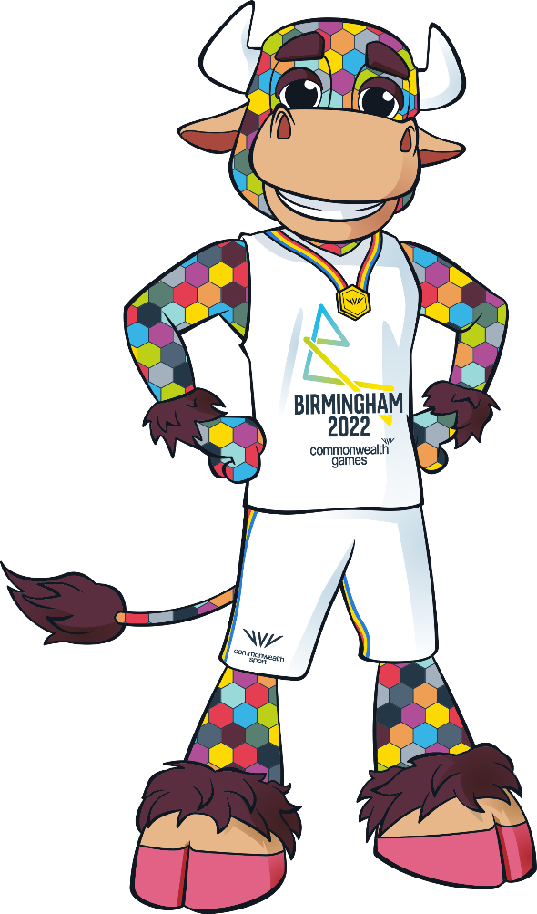
DESIGN A MASCOT!
Perry fun facts:
He is named after
Perry Barr – an area
of Birmingham which
is home to the athletics stadium.
He is a bull because
of the history of Birmingham’s Bull
Ring Market and Shopping Centre.
He is colourful, cheeky and kind!
This is Perry. He is the official mascot of the Birmingham 2022 Commonwealth Games.
Design a mascot to represent your school.
It could be:
an animal, a person or even a made up creature!
wearing your uniform or your school colours.
The mascot you create can be the mascot for your Bring the Power: School Festival or Sports day.
Pop it on your posters or bunting to advertise your event. You could even dress someone up in the mascot costume!
Notes:
Teacher notes:
You will need: Paper, pencils and colouring materials
Subject area: Art
Instructions:
Introduce the pupils to Perry.
More information can be found on the Birmingham 2022 website: https://www.birmingham2022.com/mascot
Draw attention to the reasoning behind each of his features.
Discuss the fact that mascots represent a team or event and are supposed to bring unity, support and good luck.
The task is to design a mascot for school so think about what makes your school unique and try to incorporate it into the mascot design.
The designs could be labelled to point out the thinking behind each chosen feature.
Challenge: Pupils can write a description of their mascot character and justify their choice of features.

Slide 11
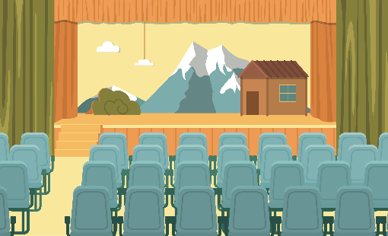
CREATE A BRING THE
POWER THEMED ASSEMBLY!
Teach your school, teachers, friends and family all about the Birmingham 2022 Commonwealth Games in a fun presentation.
Create a presentation sharing facts about:
Nations and territories
Sports
History
Host nations and territories
Athletes
Practise presenting with your friends
and you’ll be ready to perform to your audience in no time!
You could…
decorate the stage and assembly area with bunting and artwork
share your athlete, sport and nation fact file work with your audience!
Think about…what do you want your audience to know? How can you make it interesting and visual for the audience?
Notes:
Teacher notes:
You will need: PowerPoint or other presentation software, internet, hall or other assembly space, an audience!
Subject area: Sport, History, Drama
Instructions:
Split your class into groups and give them an area of the Birmingham 2022 Commonwealth Games to research then create a powerpoint about.
Encourage them to include pictures, text and interesting slide designs.
Practise presenting the powerpoints to the class then perform to an audience in a special assembly.
Parents can be invited in to share the experience too.
Support:
Encourage pupils to use the other activities in this pack as material in their presentation or as decoration (the bunting template, the athlete/country fact file).
Pupils can use the Festival planning worksheet to help them plan their Assembly.
Political impartiality:
Please refer to the Political impartiality in schools guidance: www.gov.uk/government/publications/political-impartiality-in-schools/political-impartiality-in-schools
Schools should use their discretion when deciding on the use of specific resources and activities.

Slide 12

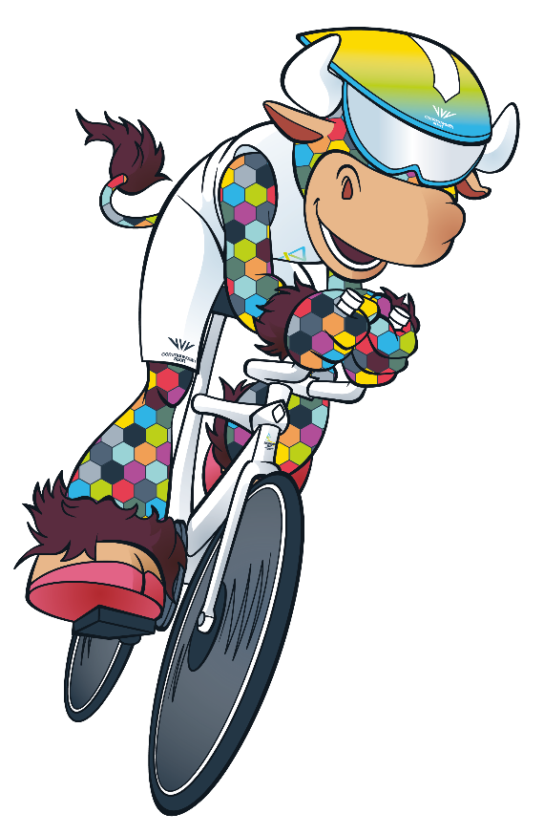



MAKE A BRING THE POWER
MUSIC PERFORMANCE
The nations and territories competing in the Birmingham 2022 Commonwealth Games
come from all over the world. Each nation
has different musical traditions.
Listen to music from some of the different nations and territories.
Find out about the style of music and the instruments used to create it.
You could…
clap along to the beat of the music
play percussion instruments along with the track.
Create and share your musical performance with your school community at your own assembly or create your own music festival.
Notes:
Teacher notes:
You will need: Internet and speakers to play music
Subject area: Music, Geography
Instructions:
Listen to samples of music from some of the competing nations (such as India, Ghana, Jamaica) discuss the sounds and the instruments.
Explain that the music they are listening to isn’t the ONLY music played in the nations.
Clap along or play along to the music, listening to the beat and keeping in time.
As a school you may wish to allocate different nations to each class. Each class could then share the musical traditions they have found out about with the school community in a themed assembly.
Support:
Pupils can use the Festival planning worksheet to help them plan their Music festival.
Tip for adapting for SEND pupils/students/schools: Feel the vibrations from the music.
Political impartiality:
Please refer to the Political impartiality in schools guidance: www.gov.uk/government/publications/political-impartiality-in-schools/political-impartiality-in-schools
Schools should use their discretion when deciding on the use of specific resources and activities.

Slide 13
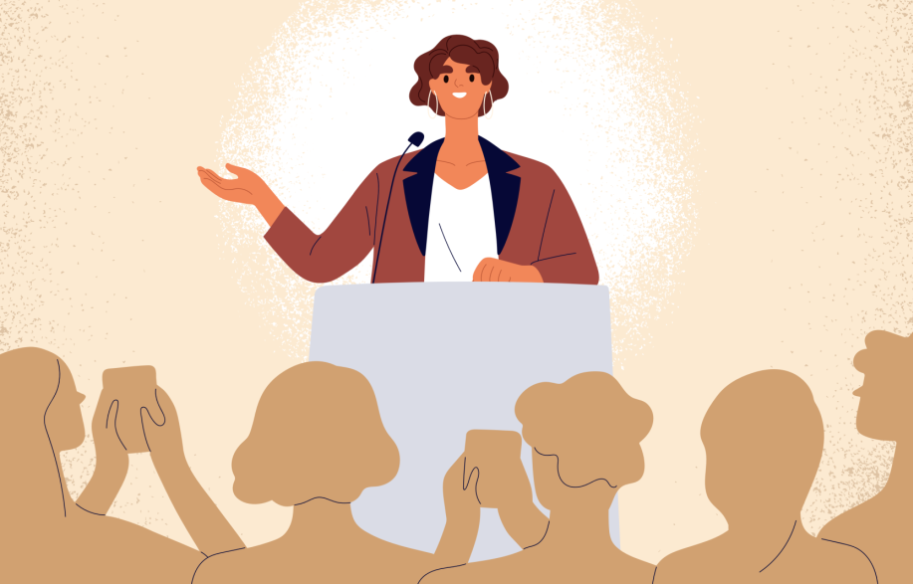
WRITE A WINNER’S SPEECH
When athletes are successful in competitions
they are often interviewed after their event.
Imagine you are one of these athletes and
write a ‘winner’s speech’.
What sport have you just competed in?
How do you feel?
What have you done to prepare for this day?
Who would you like to thank?
What hopes do you have for the future?
Use these speeches whist running your own assembly or hold a Bring the Power spoken word event!
Notes:
Teacher notes:
You will need: Winner’s speech template
Subject area: English, Citizenship, Drama
Instructions:
Print and distribute the Winner’s speech template.
Pupils are to write a ‘winner’s speech’.
Encourage them to empathise with athletes and think of the emotions they may feel if they perform well in the Games.
Pupils should think of emotive language to write their own speech from the perspective of an athlete which can be performed in lessons, an assembly or at a school fete.
Support:
Pupils can use the Festival planning sheet to help them plan their Commonwealth Games spoken word event.
Please note: worksheets are optional and pupils can create their own winner’s speech.

Slide 14
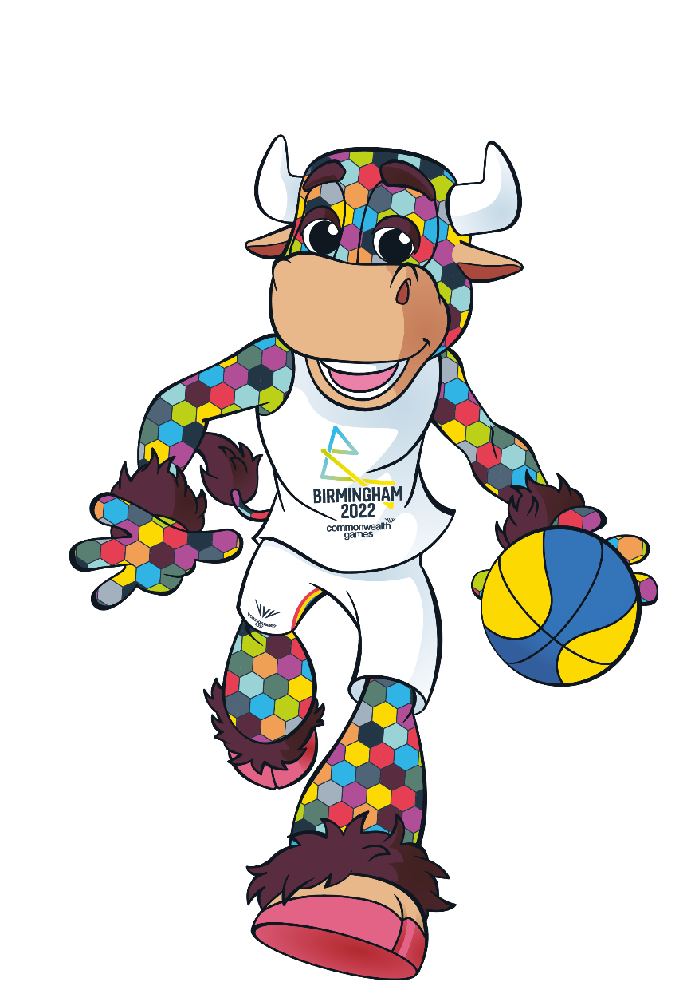

HOLD A
MINI-GAMES EVENT!
Compete against friends in your class during PE or against other groups in a larger Mini-Games event!
Choose one of the sports of the Birmingham 2022 Commonwealth Games.
Invent a ‘mini’ version
of the sport and
create your
own rules.
Would you like to join a new sports club? Speak to your PE teacher about what enrichment activities are running this year!
Notes:
Teacher notes:
You will need: Access to internet, sports equipment as required
Subject area: PE
Instructions:
Help pupils research the sports of the Birmingham 2022 Commonwealth Games: https://www.birmingham2022.com/sports
Pupils might like to try this in groups to think about how they would create a mini version of their chosen sport.
Challenge: pupils could choose more than one sport and hold a multi sport event!
Support:
Pupils can use the Festival planning worksheet to help them plan their Mini-Games Event.

Slide 15
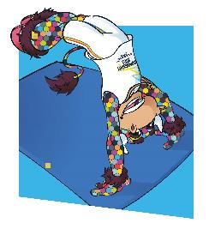
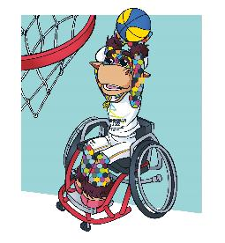
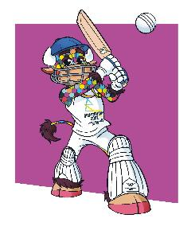
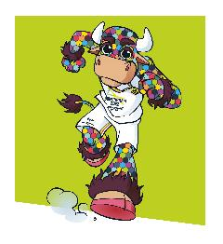
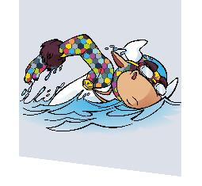
ORGANISE A LUNCHTIME SPORTS CLUB!
Need some ideas?
Athletics - set up a start and finish line and encourage pupils to race, have a go at long jump, high jump or throwing far.
Cricket - practise bowling and batting with a partner
Netball/basketball - practise throwing
and catching.
Why not set up a lunchtime sports activity club to give younger children a taste of the Birmingham 2022 Commonwealth Games sports.
Sort out a day and time with a teacher and promote your new club’s details to the rest of the school.
Remember to think carefully about the equipment you will need for each session.
Notes:
Teacher notes:
Age range: upper KS2
Subject area: PE
Instructions:
Upper KS2 pupils can plan and lead a lunchtime sports club for younger year groups.
Note: this will need to be cleared with staff in school.
Guide pupils towards appropriate sports for younger pupils to take part in.
Support:
Pupils can use the Festival planning worksheet to help them plan their Lunchtime Sports Club.
Guide pupils on promoting their event, This could be in a letter or as a notice in assembly.

Slide 16

BRING THE POWER UNITY DAY!
Hold a Bring the Power Unity Day in your school to celebrate the diversity (differences) across the competing nations and territories.
Here are some ideas to help you plan the day:
Come to school dressed in the team or flag colours
of one of the nations
Learn about and celebrate the different languages spoken
Create nation or territory fact files
Listen to music from the different nations
Make flags
Look at world maps and plot the competing nations
Try foods from the different nations
Notes:
Teacher notes:
Subject area: Geography, Languages
Instructions:
As a school decide on the activities you would like to include on Unity Day.
Have a day off timetable and focus on celebrating the diversity of the nations competing in the Birmingham 2022 Commonwealth Games.
Support:
Pupils can use the Festival planning worksheet to help them plan their Unity Day.
Political impartiality:
Please refer to the Political impartiality in schools guidance: www.gov.uk/government/publications/political-impartiality-in-schools/political-impartiality-in-schools
Schools should use their discretion when deciding on the use of specific resources and activities.

Slide 17
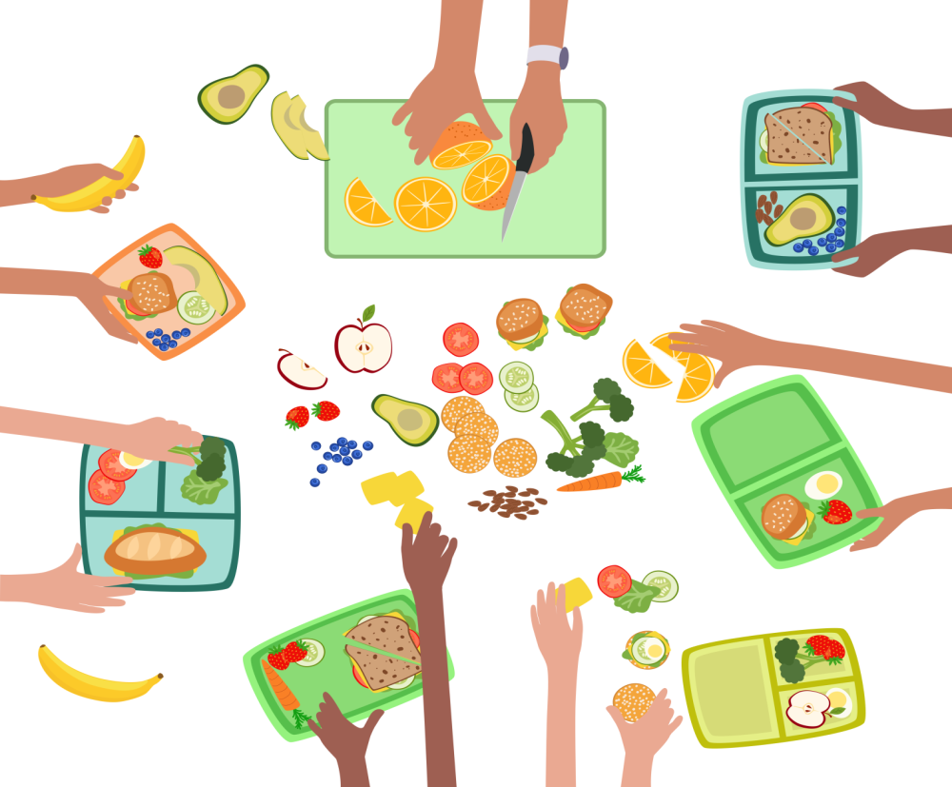
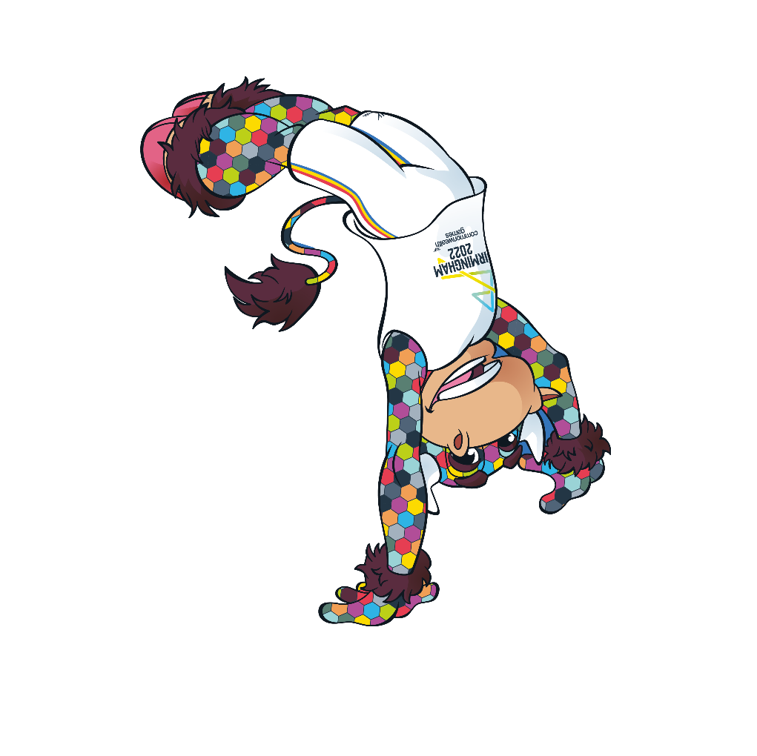

HEALTHY SNACKS
You could make:
a smoothie
a porridge bar
a fruit salad
or vegetable sticks!
Food is FUEL for our bodies.
It is really important that athletes eat a good balanced diet.
It’s not just athletes who need
to make sure they eat well balanced meals - we all do!
Make some delicious, healthy fruit and vegetable snacks!
Share your snacks at your Unity or Sports Day or create your own food festival!
Notes:
Teacher notes:
Subject area: food tech, PE
Instructions:
Use this slide as a springboard for discussion into the food groups - fruit, vegetables, carbohydrates, protein, fats.
Athletes need lots of foods rich in vitamins and minerals, as well as foods that give them energy!
Discuss what a balanced diet looks like (try to avoid using words such as ‘treat’ foods which can be triggering).
Then discuss ideas for healthy snacks which would give athletes lots of energy!
Sources of information:.
https://www.bbcgoodfood.com/howto/guide/healthy-eating-what-young-children-need,
https://www.nhs.uk/live-well/eat-well/how-to-eat-a-balanced-diet/eight-tips-for-healthy-eating/,
https://www.nhs.uk/healthier-families/
Support:
Pupils can use the Festival planning worksheet to help them plan their Food Festival.
Tips for adapting for SEND pupils/students/schools - you could bring in some fruits, vegetables, pulses etc for pupils to explore foods in a sensory manner.

Slide 18
THE DAY PERRY VISITED OUR SCHOOL!
Imagine Perry (the mascot for the Birmingham 2022 Commonwealth Games) has visited your school!
Write a short story about what Perry got up to while he was there!
Hold a Story Time event to share these stories with friends and family.
Set up a cosy area to get your audience comfy in your school library or classroom.
Notes:
Teacher notes:
Subject area: English, geography,
Instructions:
To help pupils think about ‘Perry’s visit’ to school you could start by thinking about the school day and school building.
Remind pupils of story structure and allow them the chance to plan out their story before they write it in a complete format.
Ask pupils: Is there anything in your local area that you would like to show Perry?
More information about Perry: https://www.birmingham2022.com/mascot
He is strong, kind and a little bit cheeky!
Support:
Pupils can use the Festival planning worksheet to help them plan their Story Time event.
Ask pupils to think about:
How did he arrive?
What was he wearing?
What did he do?
What did he see?
What was he like?
What did he eat for lunch?
What games did he want to play?
Was he well behaved?
Tips for adapting for SEND pupils/students/schools: Provide writing aids such as sound mats, finger spacers and others as required.

Slide 19







MAKE A FLAG!
Flag facts:
During the opening and closing ceremonies of the Games, teams carry their nation’s flag.
Each team’s kit has its nation’s flag on it.
Look at the flags of the competing Birmingham 2022 Commonwealth nations and territories.
Now create your own flag.
On a piece of paper or card, sketch out the design then colour it in with paint or felt tips.
Once dry, attach it to a straw or a thin piece
of balsa wood and wave it in the air!
Use your flags at your sports day or other sports events.
Wave them as you cheer on your friends!
Notes:
Teacher notes:
You will need: Pictures of flags of the competing nations, paper/card, paint, oil pastels, felt tips, straws, balsa wood
Subject area: Geography, Art
Instructions:
Look at the flags of the Commonwealth nations competing in the Birmingham 2022 Commonwealth Games.
Discuss them - do the children recognise any?
Provide the art materials and let the children create their own flags.
Wave the flags at your school sports events or create a fabulous Bring the Power Birmingham 2022 Commonwealth Games display in school.
Political impartiality:
Please refer to the Political impartiality in schools guidance: www.gov.uk/government/publications/political-impartiality-in-schools/political-impartiality-in-schools
Schools should use their discretion when deciding on the use of specific resources and activities.

Slide 20

RESEARCH AN ATHLETE!
Over the years there have been hundreds of Commonwealth Games champions. Choose an athlete and find out:
Which sport do they compete in?
Which nation do they compete for?
You can find out any other facts about
their careers and draw their picture too!
Here are three well known champions
you could choose:
Usain Bolt
Claudia Fragapane
Adam Peaty
Share with your school in a themed assembly or at your Unity Day.
Pictures could be displayed in a themed art gallery for your friends and family to view in the run up to the Games.
Notes:
Teacher notes:
You will need: Internet access, Athlete Profile worksheet.
Subject area: PE, English
Instructions:
Print and distribute the Athlete Profile worksheet.
Find images of the three athletes on the whiteboard (Usain Bolt, Claudia Fragapane, Adam Peaty).
Show pupils the images and ask them if they recognise them and discuss which sports they may compete in.
Ask pupils to research athletes who have competed at the Commonwealth Games and select one to write a profile about.
Allow children time to research their athlete.
This could also be set as a homework challenge for pupils to carry out and share with their families.
Support:
Pupils can choose one of the three examples on the board.
Please note: worksheets are optional and pupils can create their own athlete profile.
Political impartiality:
Please refer to the Political impartiality in schools guidance: www.gov.uk/government/publications/political-impartiality-in-schools/political-impartiality-in-schools
Schools should use their discretion when deciding on the use of specific resources and activities.

Slide 21











CREATE A NATION FACT FILE!
There are 72 nations and territories competing in the
Birmingham 2022 Commonwealth Games.
Choose one from this slide and create a fact file about it.
Australia
Tonga
Canada
Singapore
South Africa
Kenya
Indaia
Cyprus
Malaysia
This is a great Unity Day activity!
Jamaica
England
Barbados
Notes:
Teacher notes:
You will need: Internet access, Nation Fact file worksheet
Subject area: Geography, English
Instructions:
Print and distribute the Nation Fact file worksheet.
Look at a map of the world with your class. Do the children know where they live? Can they point to it on the map?
Talk about the nations and territories taking part in the Birmingham 2022 Commonwealth Games and read the names of some of them out.
Children could be invited to put their hands up if they have heard of them before.
Give them a choice of nations and ask them to choose one to research.
Ask them to research their nation or territory’s continent, languages spoken, population, weather of the nation or territory they choose and write the answers in their Nation Fact file worksheet. They can also plot their nation or territory on the world map.
Nation’s flags included on screen are: Australia, Tonga, Canada, Singapore, South Africa, India, Kenya, Cyprus, Malaysia, Jamaica, England and Barbados.
Support:
Adapt the worksheet to include more or less information for different pupil abilities.
Give pupils a nation for which information is readily available such as England and Australia.
Give pupils some links for them to use in their research e.g. https://www.britishcouncil.org/
Challenge:
Ask pupils to produce their own fact file without the worksheet.
Political impartiality:
Please refer to the Political impartiality in schools guidance: www.gov.uk/government/publications/political-impartiality-in-schools/political-impartiality-in-schools
Schools should use their discretion when deciding on the use of specific resources and activities.

Slide 22
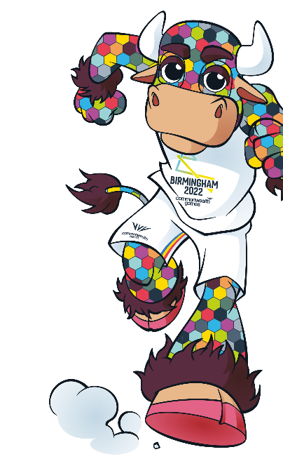










CREATE A SPORT FACT FILE!
Lots of sports will be played at the Birmingham 2022 Commonwealth Games.
Choose one from the list and create a fact file about it.
You could…
present your findings
in an assembly
create a display
set up an information
stall at your school fete
include it in your
Unity Day
set up a sports festival
to try out some
of them with
your friends.
Diving, Swimming
and Para Swimming
Gymnastics:
Rhythmic and Artistic
Athletics and Para Athletics
Boxing
Badminton
Cricket T20
Hockey
Judo
Basketball 3x3 and Wheelchair Basketball 3x3
Beach Volleyball
Notes:
Teacher notes:
You will need: Internet access, Sport Fact File worksheet
Subject area: PE, English
Instructions:
Print and distribute the Sports Fact file worksheet.
Find images of the sports on the whiteboard: https://www.birmingham2022.com/sports
Show pupils photographs of the sports on the whiteboard.
Ask them if they have ever seen them before and discuss.
Ask pupils to research sports that are played at the Commonwealth Games and select one to write a fact file about.
Allow children time to research their chosen sport.
This could also be set as a homework challenge for pupils to carry out with their families.

Slide 23

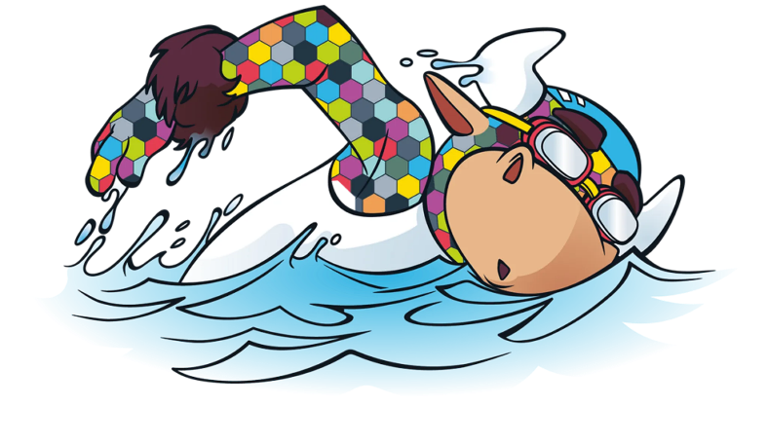
SHARE YOUR PLANS TO WIN A BRING THE POWER FESTIVAL BOX!
Be one of the first ten schools in your region to share your event plans and you could win
a Bring the Power Festival Box!
Filled with bunting, banners, posters and button badges, this box has all the accessories you'll need to kickstart your event.
Simply share your plans using our online form for the chance to win.
Notes:
Teachers should share their school’s Festival Day plans by 24 June 2022 using the online form: https://www.birmingham2022.com/power/schools/school-festival
If your school is in Birmingham or the West Midlands (Herefordshire, Shropshire, Staffordshire, Warwickshire or Worcestershire), then be one of the first 100 schools to submit your School Festival Day plans. If your school is in one of the eight other English regions (East Midlands, East of England, London, North East, North West, South West or South East), be one of the first 10 schools in each region to submit your school’s School Festival Day plans.
*Eligibility criteria. Terms and conditions apply Internet access & email address required. Enter by visiting https://www.birmingham2022.com/power/schools/school-festival & entering details requested by 23:59pm 24 June 2022. 1 entry per school. 1 x School Festival Box to be won. T&Cs apply – see https://www.birmingham2022.com/terms-and-conditions/btp-school-festival-day-competition Promoter: Birmingham Organising Committee for the 2022 Commonwealth Games Ltd.

Slide 24
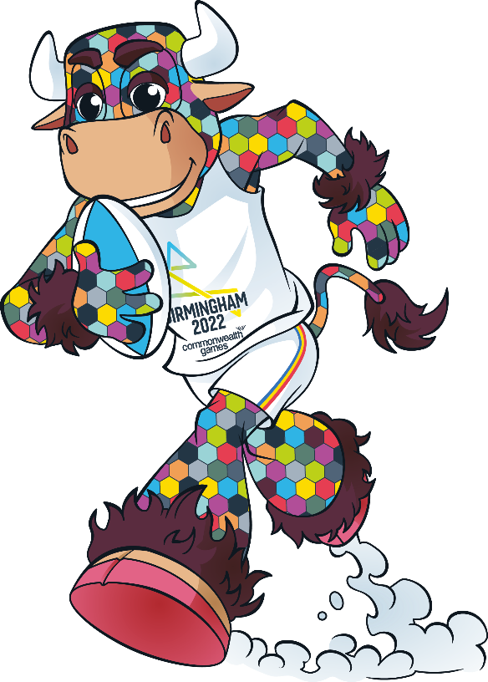
WIN REWARDS!
We would love to hear how you are Bringing the Power to your school. There are lots of ways to win exciting rewards!
Ask your teacher to share your activities on social media using:
#BringThePower
#B2022
Each week we will be giving
away posters, branded kit
and messages from athletes!
Virtual athlete visits
Teachers, share pictures
and videos of your Festival Day on social media to have the chance of winning an athlete visit
for your school.
#BringThePower
#B2022
Notes:
Terms and conditions apply: https://www.birmingham2022.com/terms-and-conditions/

Slide 25
WIN PERRY’S JOURNEY TO THE GAMES KIT*
Share your Perry
journey using:
#BringThePower
#B2022
Do you want to share Perry’s journey to the Games?
Request a Perry kit via an online form.
Once you have your Perry kit, share how you are introducing Perry to your community and preparing him for the Commonwealth Games by:
trying different sports
learning about different teams
living the values of humanity equality
and destiny.
Be one of the first teachers to make a request via the online form to win a Perry kit! There are 100 kits available.
Share your Perry journey using:
#BringThePower
#B2022
Notes:
Go to: https://www.birmingham2022.com/power/rewards/perrys-journey
*Eligibility criteria. Open to schools in England only. Internet access & email address required. Enter by visiting [https://www.birmingham2022.com/terms-and-conditions/btp-perrys-journey]. 1 entry per school. Win 1 x Perry kit per school. 50 kits available for Birmingham & West Midlands, 50 kits available for the rest of England. First come first served. Giveaway ends once stock runs out. T&Cs apply – see https://www.birmingham2022.com/terms-and-conditions/btp-perrys-journey Promoter: Birmingham Organising Committee for the 2022 Commonwealth Games Ltd.

Slide 26





