Slide 1

SCHOOL FESTIVAL
Introductory Assembly

Slide 2
OVERVIEW
Bring the Power
Bring the Power is the youth programme for the Birmingham 2022 Commonwealth Games. The programme aims to put children and young people at the heart of this exciting festival of sport and culture.

Slide 3
OVERVIEW
Learning objectives
To know what the Commonwealth Games is
To know some of the nations and territories taking part
To understand ways to Bring the Power of the Games to school
To understand the significance and the importance of the Commonwealth Games
To understand how to become involved
with the Birmingham 2022 Commonwealth Games and be a part of its legacy
Age group
11-14 years (KS3)
Time required
30 minutes
Please make sure you use this PowerPoint
in presentation mode to use the animation features on select slides.

Slide 4
POLITICAL IMPARTIALITY
Please refer to the Political impartiality in schools guidance: www.gov.uk/government/publications/political-impartiality-in-schools/political-impartiality-in-schools
Schools should use their discretion when deciding on the use of specific resources
and activities.

Slide 5
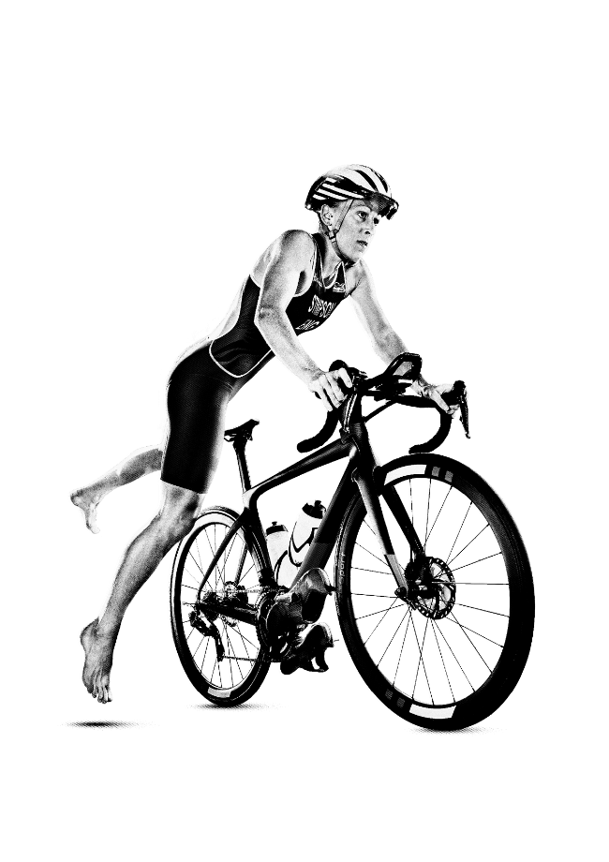






WHAT IS THE COMMONWEALTH GAMES?
The Commonwealth Games is a multi-sports competition that takes
place every four years.
It is often referred to as the Friendly Games because the event is renowned for inspiring athletes to compete in the spirit of friendship.
The last Commonwealth Games was held in Gold Coast Australia in 2018.
This year the Games are being held in Birmingham, England.
Notes:
Teacher notes:
Before reading this slide, ask students if they have ever heard of the Commonwealth Games. Do they know what it is? Ask for suggestions from the group.
Birmingham 2022 will be the largest event ever staged in the history of Birmingham and the West Midlands.
Para sport is full integrated into the Commonwealth Games and, for the first time in global multi-sport event history, more medals will be awarded to women than men.

Slide 6
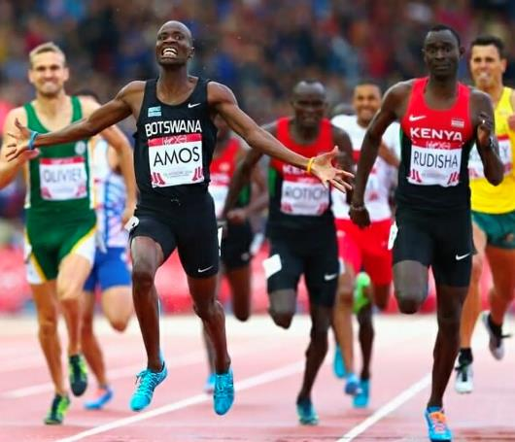
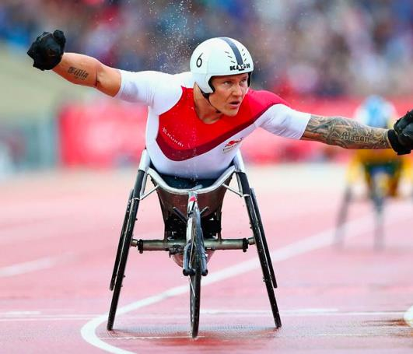
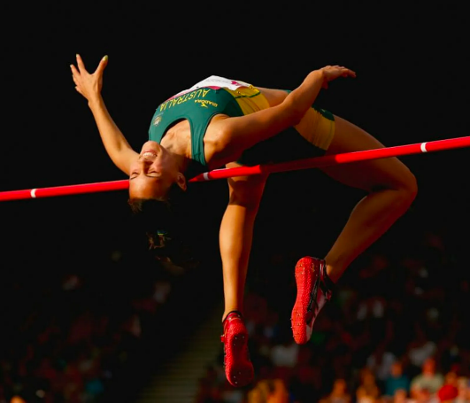
BIRMINGHAM 2022
COMMONWEALTH GAMES
The Commonwealth Games is coming to Birmingham and the West Midlands this summer.
The Games will run from 28 July - 8 August 2022.
It will be watched by 1.5 million spectators live in the venues and over
1 billion people will watch the Games on TV or online!

Slide 7
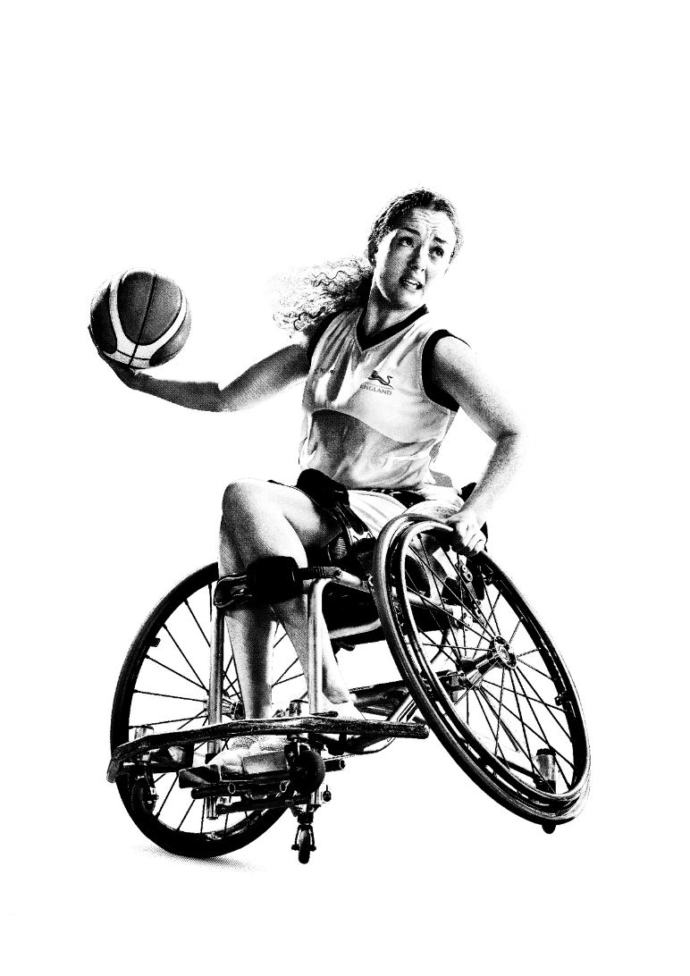


BIRMINGHAM 2022
COMMONWEALTH GAMES

Slide 8
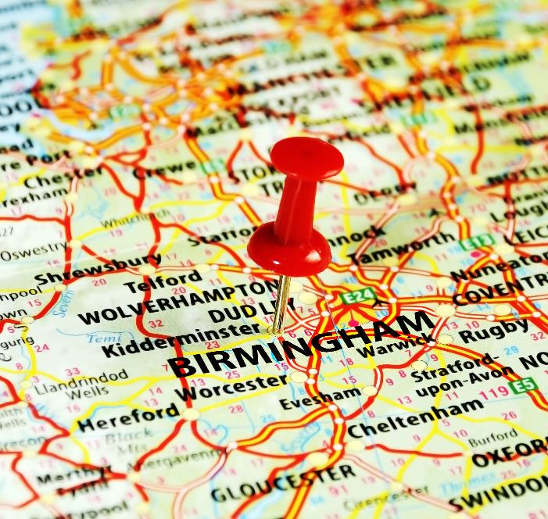
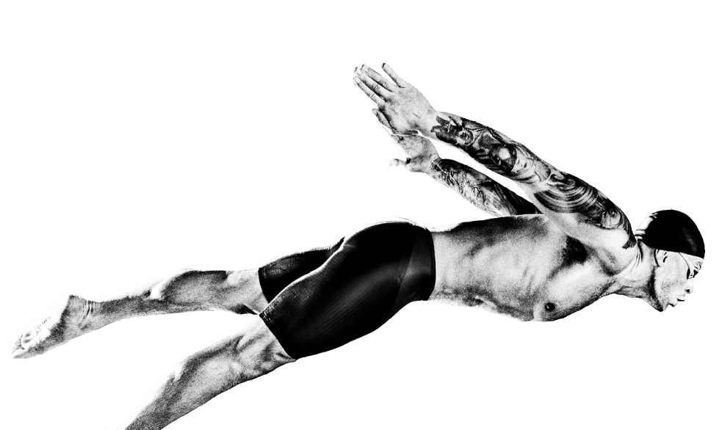
WHERE IS BIRMINGHAM?
Birmingham is a major city in the West Midlands.
Birmingham is one of the greenest cities in England. It has around 600 parks!
It is Europe’s youngest
city with over 40% of the
population aged under 25.
Notes:
Teacher notes:
This slide is not necessary when delivering the lesson in Birmingham or the immediate surrounding areas.
Discuss Birmingham with the young people. What do they know about the city? Has anybody visited the city?

Slide 9
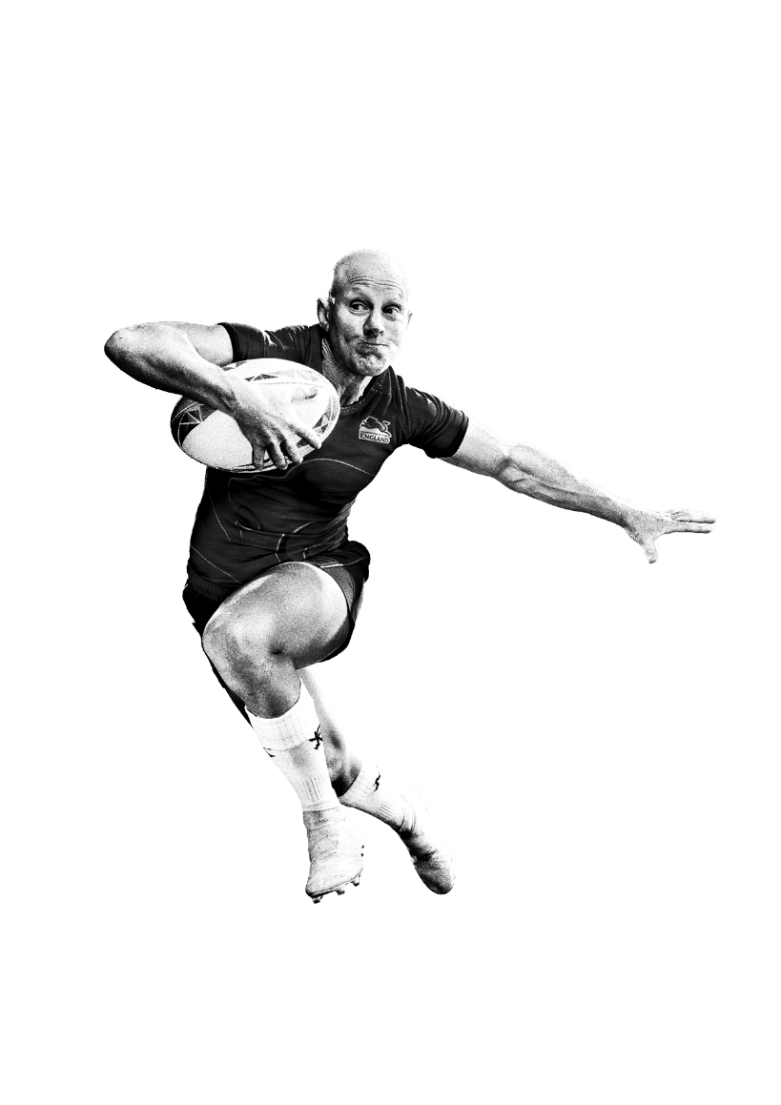
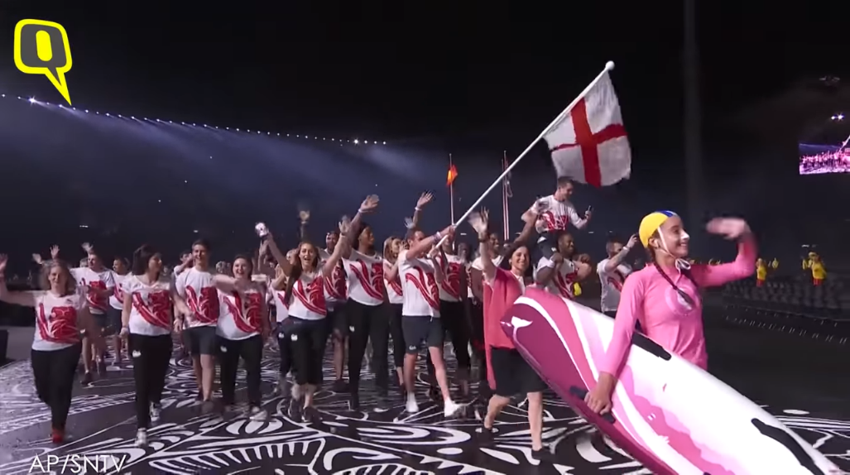
WHO TAKES PART?
Over 6500 athletes and officials from 72 nations and territories will take part in the Birmingham 2022 Commonwealth Games.
Notes:
Teacher notes:
Ask students if they know what the Commonwealth is and ask for volunteers, before showing the definition. Further explanation and discussion points can be found here: http://www.youngcommonwealth.org/
To create some interaction with the audience, ask students to locate certain countries on the map of the world.
What is the Commonwealth?
The Commonwealth of Nations is a voluntary group of nations that work together and support each other in different ways. Its roots go back to the British Empire but today any nation can join. It's home to almost one-third of the world's population.

Slide 10












WHO TAKES PART?
Here are the names of some of the nations taking part. Have you heard of them all?
Do you know where in the world they are?
Australia
Tonga
Canada
Uganda
Gibraltar
Ghana
Jamaica
India
Cyprus
Malaysia
England
Barbados
Notes:
Teacher notes:
Students put their hands up when the nations are read out if they have heard of them before.
Display a world map on a whiteboard or print out a version large enough for students to see.
Ask volunteer up to the front to point out where they think a nation is located.
Point out each nation on a world map one at a time, prior research may need to be done beforehand.
Challenge: ask students to name which nations you feel have the Queen on their bank notes (33 different countries have this with Canada the first in 1935), or when do you think they joined the Commonwealth …. 30s, 40s, 50s, 60s, 70s, 80s, 90s, 00s. In the 30s and 40s the Queen Elizabeth had not ascended the throne yet, but in 1935 she was featured on a Canadian bank note at 8 years old.

Slide 11
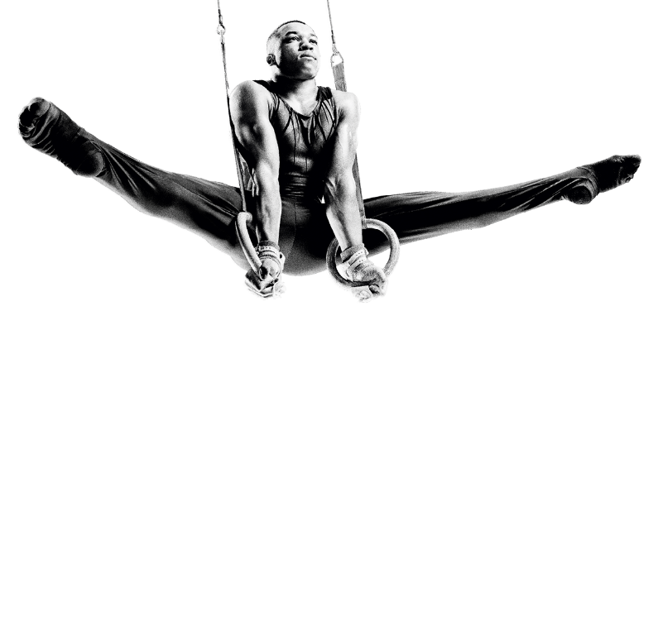
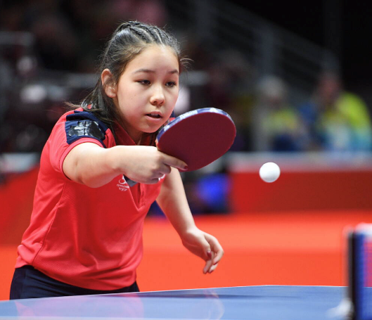
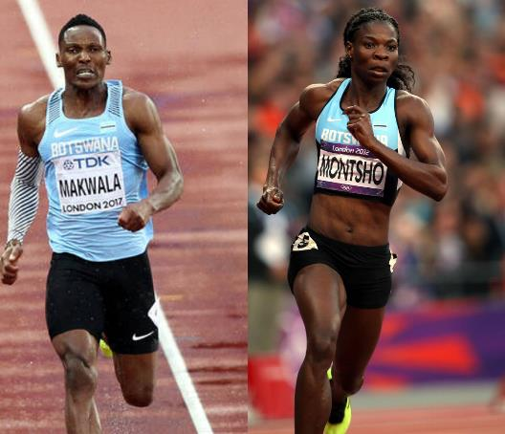
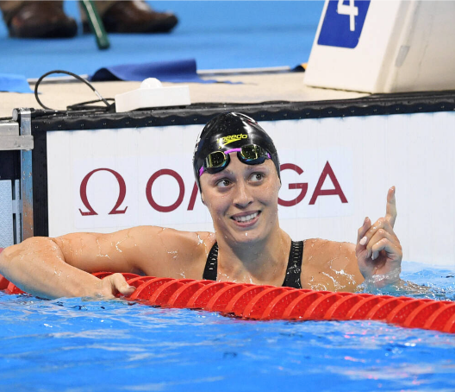
WHO TAKES PART?
Name: Anna Hursey
Country: Wales
Sport: Table tennis
Special fact: At just 11 years old, Anna was the youngest competitor in the Gold Coast 2018 Commonwealth Games.
Name: Amantle Montsho and Isaac Makwala
Country: Botswana
Sport: 400m
Special fact: For the first time ever, the 400m men and women’s events were won by athletes of the same country (Gold Coast 2018 Commonwealth Games).
Name: Sophie Pascoe
Country: New Zealand
Sport: Para swimming
Special fact: Sophie is a
Para swimmer and is New Zealand’s most decorated Para swimmer ever.
Notes:
Teacher notes:
Explain to students that athletes come from all over the world to compete in the Commonwealth Games.
This slide shows some of the stars of the last Commonwealth Games, in 2018, hosted by Australia’s Gold Coast. The Commonwealth Games is notable for having an integrated para sports programme.
Name: Anna Hursey
Country: Wales
Sport: Table tennis
Special fact: At just 11 years old, Anna was the youngest competitor in the Gold Coast 2018 Commonwealth Games.
Name: Amantle Montsho and Isaac Makwala
Country: Botswana
Sport: 400m
Special fact: For the first time ever, the 400m men and women’s events were won by athletes of the same country (Gold Coast 2018 Commonwealth Games).
Name: Sophie Pascoe
Country: New Zealand
Sport: Para swimming
Special fact: Sophie is a Para swimmer and is New Zealand’s most successful Para swimmer ever.
Ask students they can name any other successful athletes from sports which are part of the Commonwealth Games and whether they know any facts about them.

Slide 12

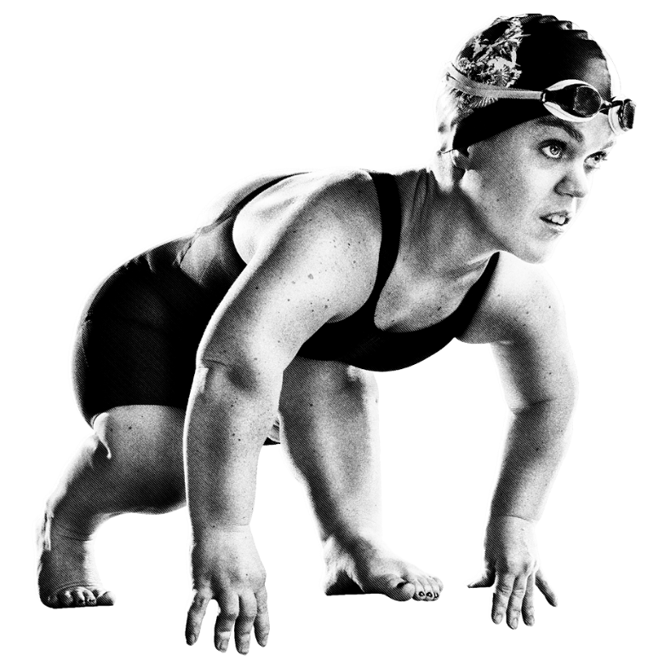
GAMES TIMELINE
12
28 July: Begin with a spectacular opening ceremony with music and dancing.
The teams parade
in the stadium in front of a crowd.
11
10
9
8
8 August: End with
a closing ceremony.
7
6
5
4
The Games last for 12 days
3
2
1
Notes:
Teacher notes:
Run students through a timeline of how the Games will happen over the 12 days.
Display this walk through of the Games events happening at Birmingham 2022 this year: https://www.birmingham2022.com/news/2499951/daily-sport-schedule-announced-

Slide 13
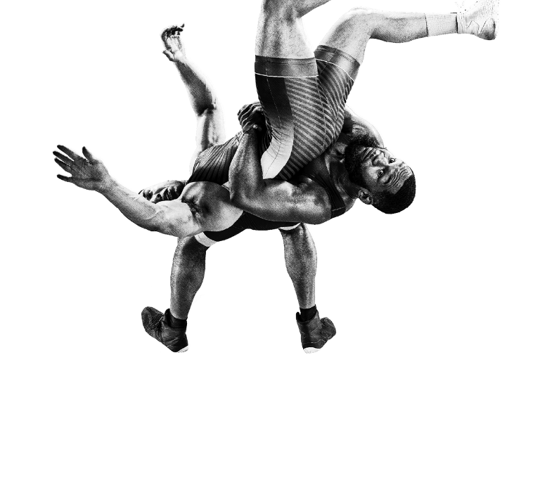






SPORTS
These are the sports from the Birmingham
2022 Commonwealth Games.
Which ones have you played?
Which ones would you like to try?
Swimming and Para Swimming
Diving
Athletics and Para Athletics
Badminton
Beach Volleyball
Wrestling
Cycling - Mountain Bike, Road Race, Track and Para Track, Time Trial
Basketball /
Wheelchair Basketball
Boxing
Cricket T20
Artistic Gymnastics
Notes:
Read out some of the sports on the slide.
Ask students whether there are any sports here they had not heard of before. Can any of their peers describe them?
How could you do this? Which of these sports would they most like to try themselves?
If time allows, students could play a game where they have to describe a Commonwealth Games sport without naming it, for their peers to guess.

Slide 14
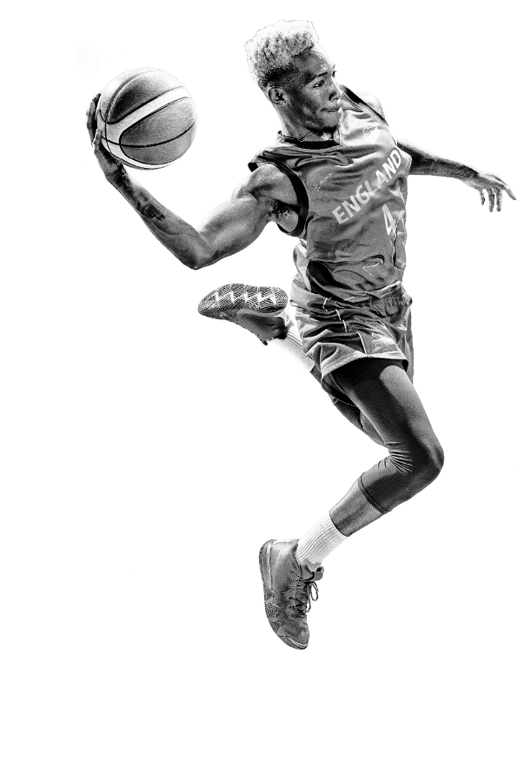









SPORTS
These are the sports from the Birmingham
2022 Commonwealth Games.
Which ones have you played?
Which ones would you like to try?
Rhythmic Gymnastics
Hockey
Judo
Lawn Bowls and Para Lawn Bowls
Netball
Rugby Sevens
Table Tennis and Para Table Tennis
Squash
Triathlon and Para Triathlon
Weightlifting /
Para
Powerlifting
Notes:
Read out some of the sports on the slide.
Ask students whether there are any sports here they had not heard of before. Can any of their peers describe them?
How could you do this? Which of these sports would they most like to try themselves?
If time allows, students could play a game where they have to describe a Commonwealth Games sport without naming it, for their peers to guess.

Slide 15
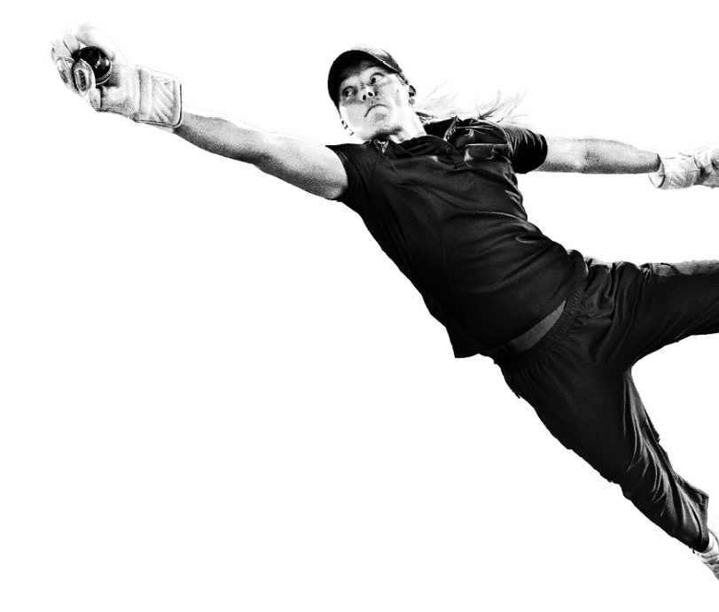
COMMONWEALTH GAMES
FEDERATION VALUES
Humanity
Equality
Destiny
Celebrating
our diverse Commonwealth countries and recognising that we are part of
a global family
Every person
is equal through participation
in sport
Creating our
own destiny and working hard to achieve our goals
Notes:
Teacher notes:
Read out the three words on the slide: Humanity, Equality and Destiny.
Ask for volunteers to call out definitions of each word and consider what they could mean in the context of the Commonwealth Games before they are revealed above
Explain that these are The Values of the Commonwealth Games.
Ask students and/or class to answer the question of How does your school community show these values?
Read out the vision of the Birmingham 2022 Commonwealth Games:
“Through a festival of thrilling, fast-paced sport, exhilarating culture and dynamic business, the 2022 Commonwealth Games will make a world of difference for everyone throughout the West Midlands and beyond. This momentous event is a chance to celebrate a global community and our human potential.”
How might students demonstrate these in their participation in sport and more widely in their own lives?

Slide 16
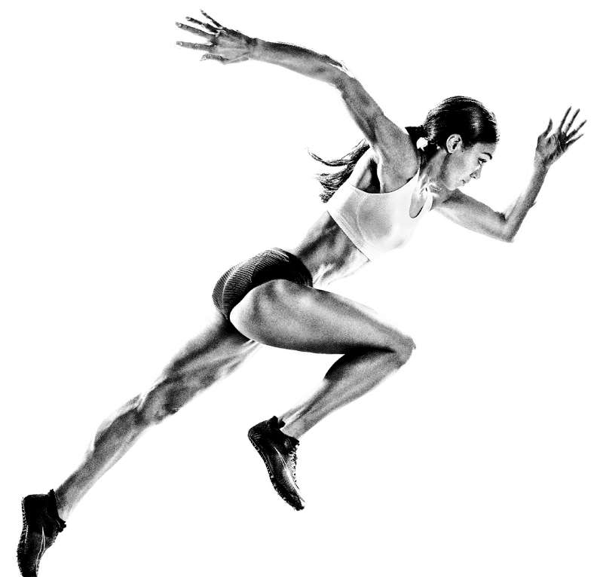
HOW CAN YOU GET INVOLVED?
There are lots of ways you can get involved in the Birmingham 2022 Commonwealth Games
and share the excitement of the event and Bring the Power of the Games to your school!
Hold a Bring the Power Birmingham 2022 themed festival day
Why not give your annual sports day
a Bring the Power Birmingham 2022 Bring the Power theme?
You could dress in the colours of the flags of the countries competing, give
out medals on a podium or try out
some of the Birmingham 2022 sports with your class.
Share your plans with us to win an exclusive Bring the Power festival box.
Look out for the
Queen’s Baton Relay
In the run-up to the Games, the Queen’s Baton Relay is travelling around the country. Look at the map of its journey to see if it is
coming to a town or
city near you!
Notes:
Information on the Queen’s Baton Relay route around England can be found here: https://www.birmingham2022.com/queens-baton-relay/route/england

Slide 17
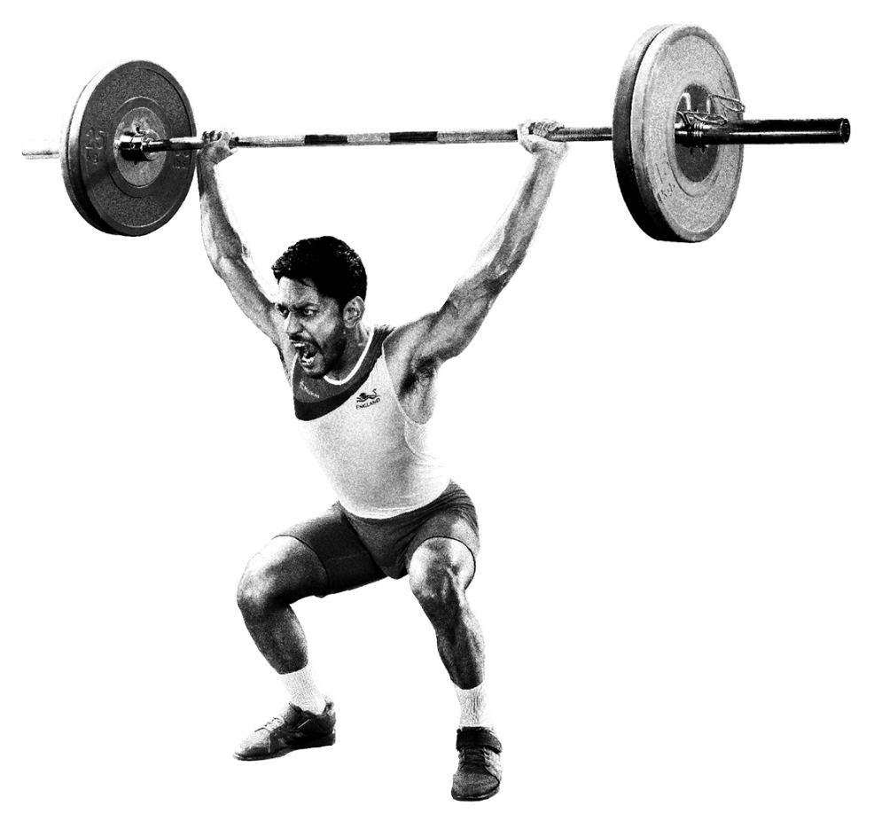
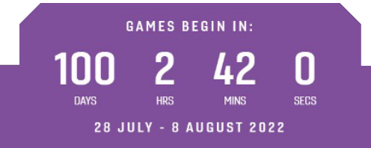
HOW CAN YOU GET INVOLVED?
Decorate your school
Use the resources in the Bring the Power festival pack or design your own bunting, flags and posters to decorate your school building and grounds.
This will help get your school and community into the spirit of the Games!
Count down with
the countdown clock!
Go to the Birmingham 2022 website to see the clock count down to the start of the Games.

Slide 18
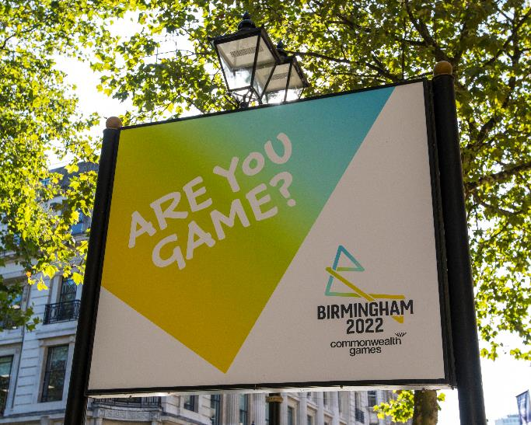
HOW CAN YOU GET INVOLVED?
Watch the Games!
Tune into the coverage of the Games on the TV and cheer on your favourite teams and competitors.
Or if you are really lucky you might be able to get tickets to watch the sports live in the venues!
Get active with your friends and family!
Talk to your family and friends about Birmingham 2022. Are there any sports you would all like to try?
Give them a go together!

Slide 19

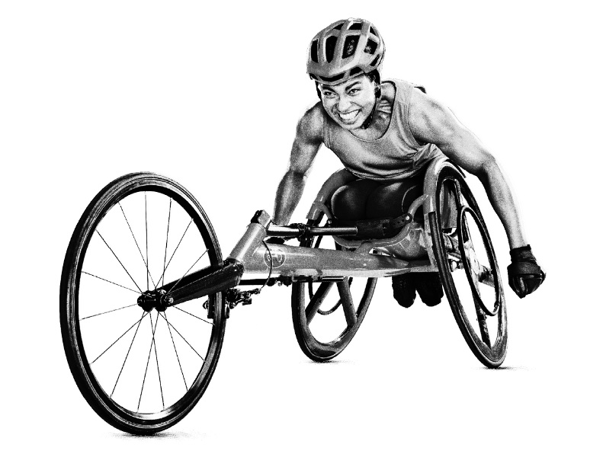
SHARE YOUR PLANS TO WIN A BRING THE POWER FESTIVAL BOX!
Be one of the first ten teachers in your region to share your event plans and you could win a Bring the Power Festival Box!
Filled with bunting, banners, posters and button badges, this box has all the accessories
you’ll need to kickstart your event.
Simply email your plans to
nationalyouth@birmingham2022.com
or complete our online form for the
chance to win.
Notes:
Teachers should complete the online form by 24 June 2022 to submit their school’s plans: https://www.birmingham2022.com/power/schools/school-festival
If your school is in Birmingham or the West Midlands (Herefordshire, Shropshire, Staffordshire, Warwickshire or Worcestershire), then be one of the first 100 schools to submit your School Festival Day plans. If your school is in one of the eight other English regions (East Midlands, East of England, London, North East, North West, South West or South East), be one of the first 10 schools in each region to submit your school’s School Festival Day plans.
*Eligibility criteria. Terms and conditions apply Internet access & email address required. Enter by visiting https://www.birmingham2022.com/power/schools/school-festival & entering details requested by 23:59pm 24 June 2022. 1 entry per school. 1 x School Festival Box to be won. T&Cs apply – see https://www.birmingham2022.com/terms-and-conditions/btp-school-festival-day-competition Promoter: Birmingham Organising Committee for the 2022 Commonwealth Games Ltd.

Slide 20
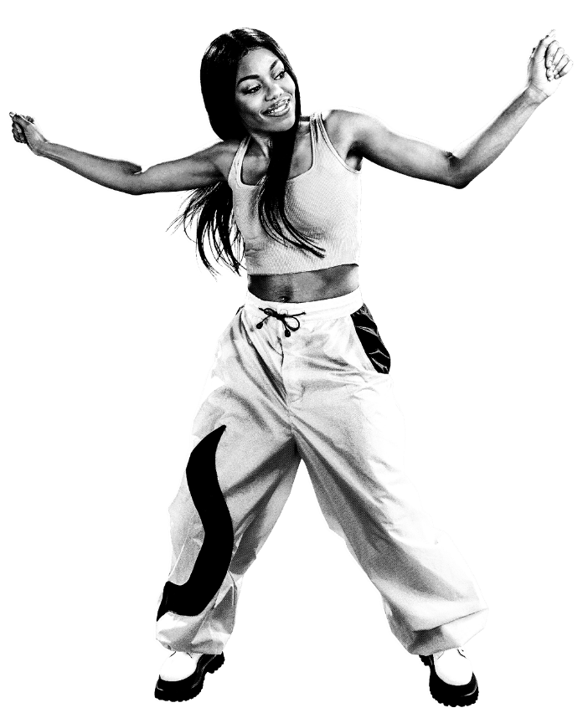
KEEP IN TOUCH AND WIN REWARDS!*
We would love to hear how you are Bringing the Power to
your school and there are lots of ways to win exciting rewards!
Ask your teacher to share your activities on social media using:
#BringThePower
#B2022
Each week we will be giving away posters, branded kit
and messages from athletes!
Virtual athlete visits
Teachers, share pictures
and videos of your Festival on social media to have
the chance of winning an
athlete visit to your school.
#BringThePower
#B2022
Notes:
Terms and conditions apply: https://www.birmingham2022.com/terms-and-conditions/
* Eligibility criteria. Open to schools and youth groups in England only. Enter by either registering and downloading any of our educational resources, submitting a school festival day plan or using the hashtags #bringthepower and #B2022 on social media. Internet access & email address required. Winners selected at random. Four winners selected each week: two from Birmingham and the West Midlands, and two from the rest of England. Weekly prize draw. Entries do not roll-over. New social media posts must be posted each week to be entered. 1 entry per school/youth group per week. Ends 23:59pm 7 August 2022 inclusive. T&Cs apply – see www.birmingham2022.com/terms-and-conditions/btp-festival-resources. Promoter: Birmingham Organising Committee for the 2022 Commonwealth Games Ltd.

Slide 21

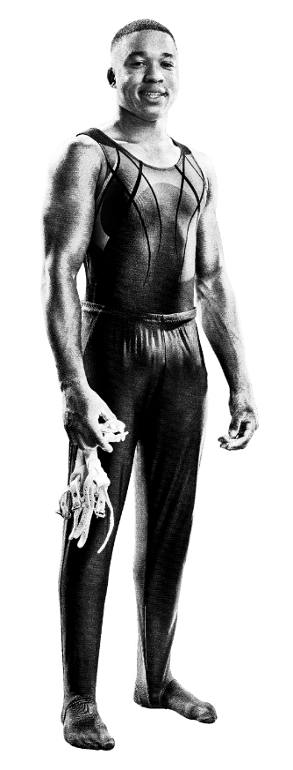
WIN PERRY’S JOURNEY TO THE GAMES KIT
Do you want to share Perry’s journey to the Games?
Be one of the first teachers to make a request via the online form to win a Perry kit! There are 100 kits available.
Share your Perry journey using:
#BringThePower
#B2022
Once you have your Perry kit, share how you are introducing Perry to your community and preparing him for the Commonwealth Games by:
trying different sports
learning about different teams
living the values of humanity equality and destiny.
Notes:
Go to: https://www.birmingham2022.com/power/rewards/perrys-journey
*Eligibility criteria. Open to schools in England only. Internet access & email address required. Enter by visiting [https://www.birmingham2022.com/terms-and-conditions/btp-perrys-journey]. 1 entry per school. Win 1 x Perry kit per school. 50 kits available for Birmingham & West Midlands, 50 kits available for the rest of England. First come first served. Giveaway ends once stock runs out. T&Cs apply – see https://www.birmingham2022.com/terms-and-conditions/btp-perrys-journey Promoter: Birmingham Organising Committee for the 2022 Commonwealth Games Ltd.

Slide 22
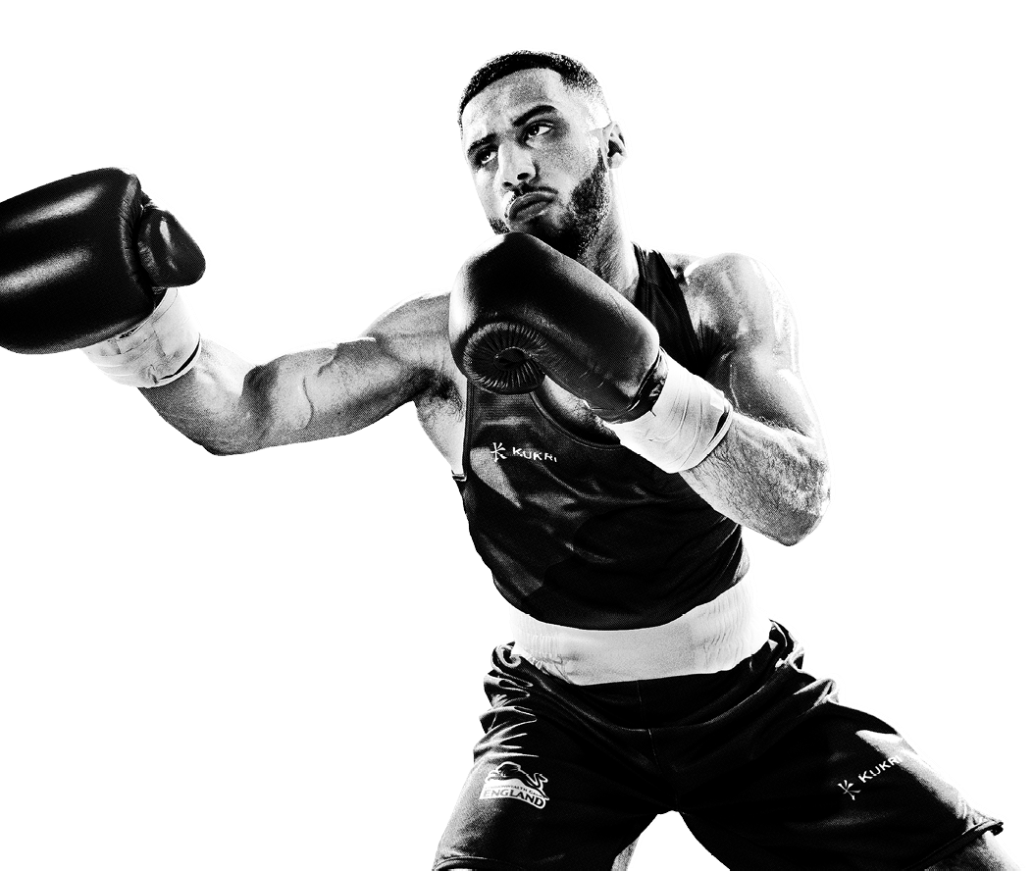
HOW ARE YOU GOING TO GET INVOLVED?
Bring the Power of the Birmingham 2022 Commonwealth Games to your school with our Bring the Power School Festival Pack!

Slide 23





