Slide 1




WORKSHOP (KEY STAGE 3)
Notes:
Introduction and learning objectives (1-min)
Teacher notes:
Tell students they are about to take part in an interactive session about the Birmingham 2022 Commonwealth Games.
CLICK ON TO NEXT SLIDE

Slide 2

TEACHER NOTES
AUDIENCE: Key Stage 3 students (aged 11–14)
TIME: Approx. 90-minutes
TEACHER RESOURCES: PowerPoint slides, 8 x Hometown Hero posters (download separately)
STUDENT RESOURCES: 6 sets of indoor cricket equipment - (plastic ball and wickets) or similar
PREPARATION: Review the slides and teacher notes, print and prepare workshop resources
CURRICULUM LINKS
PSHE Association Programme of Study, Health & Wellbeing: We are all unique; recognising and demonstrating personal strengths builds self-confidence, self-esteem and good health and wellbeing
PSHE Association Programme of Study, Living in the Wider World: Strengths, interests, skills, qualities and values and how to develop them

Slide 3
TEACHER NOTES (CONTINUED)
LESSON CONTENT:
Learn key facts about the Birmingham 2022 Commonwealth Games including: dates, venue locations and key sustainability credentials
Physically and mentally warm up and learn about some of the sports involved in the Birmingham 2022 Commonwealth Games
Learn about some of the Hometown Heroes (community champions) who are active in the Birmingham and West Midlands region. Understand their similarities and differences
Understand the skills and attributes that community champions and athletes use to develop and bring about change
Explore positive actions in relation to our own communities
Call to action

Slide 4
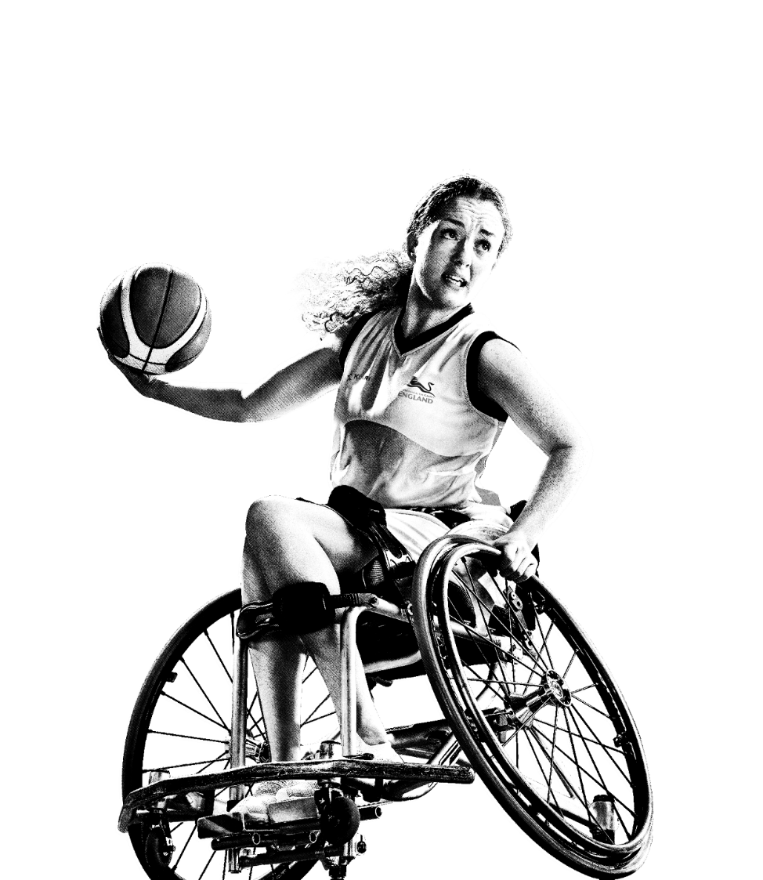

WE CAN
CHANGE
OUR WORLD
KS3
Notes:
Introduction to Finding Common Ground (1 min)
Teacher notes:
In the We Can Change Our World workshop the students will find out some key facts about the Birmingham 2022 Commonwealth Games, including where the Games will take place and some of the sports that are played. The students will explore some of the region’s ‘Hometown Heroes’ – local social activists and changemakers who are making a difference in their local area. In groups the students will explore the skills and attributes required to bring about social change. They will think about what is unique about these individuals and what unites them. The students will be using their analytical, critical and teamworking skills alongside creativity and innovation.
CLICK ON TO NEXT SLIDE

Slide 5
BIRMINGHAM 2022 COMMONWEALTH
GAMES FACTS & KEY INFO
WHEN?
28th July to 8th August 2022
WHAT?
An international multi-sport event involving athletes from the Commonwealth of Nations
Often referred to as the Friendly Games
With the exception of 1942 and 1946, has taken place every four years
WHERE?
The Birmingham 2022 Commonwealth Games
is a West Midlands celebration with Birmingham at its heart.
Notes:
Key facts about the Birmingham 2022 Commonwealth Games (6 mins)
Teacher notes:
Use the following slides (5-9) to tell your students some key details and a little about the mission of the Birmingham 2022 Games. Edit the slides to highlight the information that is most relevant to your students.
Further information about the Birmingham 2022 Commonwealth Games can be found at: www.birmingham2022.com
When?
The Commonwealth Games will be taking place between Thursday 28th July and Monday 8th August 2022
What?
The Commonwealth Games is often referred to as the Friendly Games. It is an international multi-sport event involving athletes from the Commonwealth of Nations. The event was first held in 1930, and, with the exception of 1942 and 1946, has taken place every four years since then.
Where?
The Birmingham 2022 Commonwealth Games is a West Midlands celebration with Birmingham at its heart.
CLICK ON TO NEXT SLIDE

Slide 6

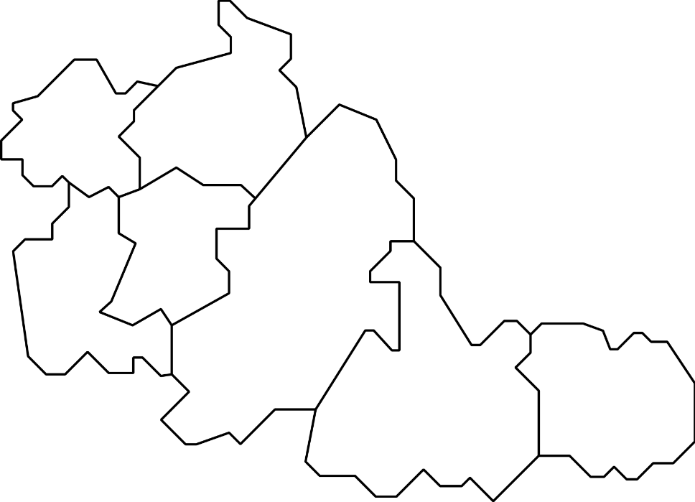
WEST MIDLANDS
ALEXANDER STADIUM
SMITHFIELD
LEE VALLEY VELOPARK
WALSALL
WOLVERHAMPTON
EDGBASTON STADIUM
LONDON
SANDWELL
DUDLEY
BIRMINGHAM
COVENTRY STADIUM
AND ARENA
SOLIHULL
COVENTRY
SANDWELL
AQUATICS CENTRE
Notes:
Key facts about the Birmingham 2022 Commonwealth Games (6 mins) Cont.
Teacher notes:
Where?
The venues being used for the Games stretch across the entire region
Highlighted on screen are just a few of the venues:
Alexander stadium (This is the main arena for the Games - home to the opening and closing ceremonies and the Athletics & Para Athletics events)
Coventry Stadium and Arena (Rugby 7s will take place in Coventry Stadium, Judo and Wrestling will take place in the Arena)
Edgbaston Stadium (This world-famous venue for Cricket will be home to Cricket T20)
Sandwell Aquatics Centre (This is a brand new venue constructed especially for the Birmingham 2022 Commonwealth Games. It will be home to Aquatics events)
Smithfield (This is a temporary Birmingham City Centre venue – home to Beach Volleyball, Basketball and Wheelchair Basketball)
Lee Valley Velopark in London (This is the venue for some cycling events – this is the only venue located outside of Birmingham and the West Midlands. Mountain biking will take place in the region – in Cannock Chase Forest)
CLICK ON TO NEXT SLIDE

Slide 7
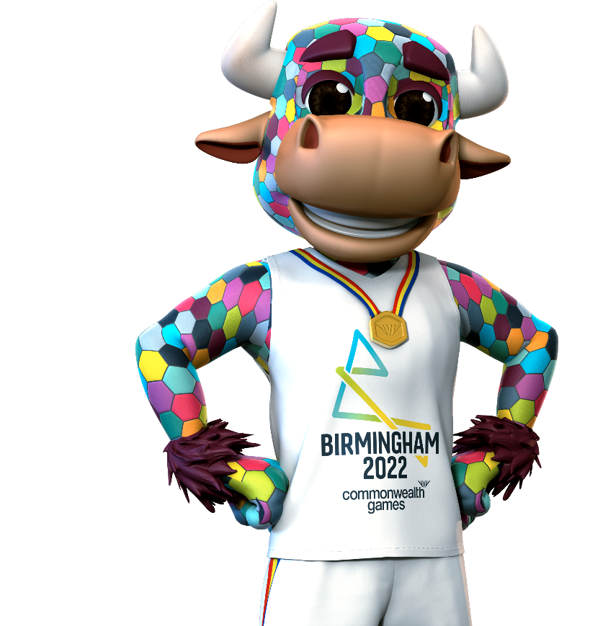
BIRMINGHAM 2022 COMMONWEALTH
GAMES FACTS & KEY INFO
VISION
Through a festival of thrilling, fast-paced sport and exhilarating culture, the Birmingham 2022 Commonwealth Games will make a world
of difference for everyone throughout the West Midlands and beyond.
This momentous event is a chance to celebrate a global community and our human potential.
Notes:
Key facts about the Birmingham 2022 Commonwealth Games (6 mins) Cont.
Teacher notes:
Vision
Birmingham 2022 has a clear vision:
A festival of thrilling, fast-paced sport and amazing cultural events!
The Birmingham 2022 Commonwealth Games will make a world of difference for everyone across the West Midlands and beyond.
The Birmingham 2022 Commonwealth Games is a chance to bring the Commonwealth nations together and celebrate our human potential.
CLICK ON TO NEXT SLIDE

Slide 8

COMMONWEALTH NATIONS
INDIA
CANADA
EUROPE
ASIA
NORTH AMERICA
NAURU
AFRICA
JAMAICA
SOUTH AMERICA
NEW ZEALAND
AUSTRALIA AND OCEANIA
NIGERIA
MOZAMBIQUE
KENYA
Notes:
Key facts about the Birmingham 2022 Commonwealth Games (6 mins) Cont.
Teacher notes:
Commonwealth Nations
Nations and territories from all over the world will be coming to Birmingham and the region to compete in the Birmingham 2022 Commonwealth Games including:
Canada, India, Jamaica, Nauru, Nigeria, Mozambique, Kenya and New Zealand!
CLICK ON TO NEXT SLIDE

Slide 9





COMMONWEALTH GAMES MISSION
BRING PEOPLE TOGETHER
BE A CATALYST FOR CHANGE
PUT US ON THE GLOBAL STAGE
HELP THE REGION TO GROW AND SUCCEED
IMPROVE HEALTH AND WELLBEING
Notes:
Key facts about the Birmingham 2022 Commonwealth Games (6 mins) Cont.
Teacher notes:
Mission
The Birmingham 2022 Commonwealth Games has a 5-point mission:
Bring people together These Games will embrace and champion the youth, diversity, humanity and pride of the region and the Commonwealth.
Be a catalyst for change Transform and strengthen local communities, working together to deliver new and improved homes, facilities and transport links.
Put us on the global stage Deliver an unforgettable, global Games in partnership, on time and on budget to showcase the best of Birmingham, the West Midlands and the Commonwealth.
Help the region to grow and succeed Drive sustainable growth and aspiration; creating opportunities through trade, investment, jobs, volunteering and skills.
Improve health and wellbeing Inspire, engage and connect communities and athletes to realise their full potential and live happier, healthier lives.
CLICK ON TO NEXT SLIDE

Slide 10

BIRMINGHAM 2022 COMMONWEALTH
GAMES FACTS
FACTS
First Games to award more medals to
women than men
First Commonwealth Games to create a carbon neutral legacy
Our bold ambition - we will deliver the most sustainable Commonwealth Games since the event began nearly a century ago
Notes:
Key facts about the Birmingham 2022 Commonwealth Games (6 mins) Cont.
Teacher notes:
The Birmingham 2022 Commonwealth Games will also achieve a number of firsts:
Facts
Birmingham 2022 will be the first Commonwealth Games to award more medals to women than men. In this Games there are more events where female athletes can win medals.
Birmingham 2022 will be the first Commonwealth Games to create a carbon neutral legacy.
Birmingham 2022’s bold ambition is to deliver the most sustainable Commonwealth Games since the event began nearly a century ago.
The seven pillars of sustainability
In fact, the Birmingham 2022 Commonwealth Games’ approach to sustainability has seven areas of focus covering:
1. ACCESSIBILITY
2. EQUALITY, DIVERSITY AND INCLUSION
3. JOB CREATION AND SOCIAL VALUE
4. HUMAN RIGHTS
5. CARBON AND AIR QUALITY
6. CIRCULAR ECONOMY PRINCIPLES TO MINIMISE WASTE
7. CONSERVATION
Further information and a film about sustainability and the Birmingham 2022 Commonwealth Games can be found at: www.birmingham2022.com/about-us/our-purpose/our-legacy/sustainability/
Once you have introduced your students to some key facts about the Birmingham 2022 Commonwealth Games, they will be ready to take part in a series of fun and active learning activities
The following slides contain games and activities that you can explore with your pupils. Activity instructions and explanations can be found in the notes section of each slide.
CLICK ON TO NEXT SLIDE

Slide 11


FUN CRICKET!
CRICKET
Notes:
Warm-up: Fun Cricket! (10 mins)
Teacher notes:
TIME: 10 mins
PURPOSE OF ACTIVITY: A fun physical and mental warm-up focusing on collaboration and teamwork
RESOURCES: 6 sets of toy cricket equipment including plastic ball and wicket
SET-UP: Place the wickets (one per team) at one end of the space and corresponding ball for each wicket at the other. Approx. 8-10 metres from wicket to ball.
ACTIVITY INSTRUCTIONS:
First split the students into 6 equal teams. Agree at the outset to all follow the rules of fair play, sportsmanship and safety.
Ask the teams to line up in groups opposite their wickets, so that the teams are on one side of the space and their wickets are opposite them on the other.
GAME 1
1. Give the teams the following instructions: When I say go. As a team you need to hit the wicket with your ball. But…
No one in the team can move unless the ball is in the air. The person who throws the ball must not be the person who catches the ball. Everyone must touch the ball at least once. The winning team will be the one who touches the wicket first and is all sitting on the floor! Go!
2. After all the teams have hit their wickets the game is over.
GAME 2
1. Place one wicket set in the centre of the room and ask everyone to form a large circle around it.
2. Explain: Okay, new game. Everyone stand in a large circle around this wicket in the centre. We are now all one team! Here are the rules:
Again we need to touch the wicket with the ball. But…
We need to pass the ball across the circle counting as we go. Everyone must touch the ball once, you are not allowed to touch it twice! If the ball drops to the floor we must start again! The last person to have the ball must throw it at the wicket to end the game! Go!
3. After the group have completed the task and hit the wicket the game is over.
CLICK ON TO NEXT SLIDE

Slide 12






STOP, START, SPORT!
AQUATICS
BASKETBALL
LAWN BOWLS &
PARA LAWN BOWLS
CRICKET
CYCLING
TABLE TENNIS
Notes:
Alternative warm-up: Stop, Start, Sport (10 mins)
Teacher notes:
TIME: 5-10 mins
PURPOSE OF ACTIVITY: A fun miming activity to split the participants into groups
RESOURCES: None
SET-UP
Ask the students to stand freely in the space in front of you.
ACTIVITY INSTRUCTIONS:
Explain to the students: There are many fantastic sports being played at the Birmingham 2022 Commonwealth Games including: Aquatics, Basketball 3x3, Lawn Bowls & Para Lawn Bowls, Cricket T20 and Cycling. Today we are going to have a bit of fun with some of them!
Invite the students to move freely around the space until you call Stop! Then everyone freezes. When you call Go! everyone should start moving again.
Explain that when you call Weightlifting! the students should mime lifting up a heavy weight. The students then continue to move around and you should test them on this new instruction - Stop! - Weightlifting! - Go!
The game continues with you adding in as many Commonwealth Games sports as you wish. The game becomes fast, frantic and fun.
To add a new challenge you can swap Stop! and Go! around - when you say Go! students should Stop and when you say Stop! students should Go. Hopefully the students will get into a fun muddle - making mistakes together, physicalising the different sports and realising that today will be fun and informal.
Commonwealth Games sports to choose from:
Aquatics, Athletics, Badminton, Basketball 3x3, Beach Volleyball, Lawn Bowls, Boxing, Cricket T20, Cycling, Gymnastics, Judo, Hockey, Netball, Rugby Sevens, Squash, Table Tennis, Triathlon, Weightlifting, Wrestling.
CLICK ON TO NEXT SLIDE

Slide 13
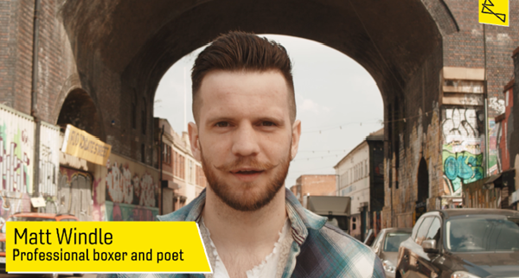
HOMETOWN HEROES
Notes:
Hometown Heroes Activity (15 mins)
Teacher notes:
TIME: 15 mins
PURPOSE OF ACTIVITY: Students learn about local heroes from the Birmingham and West Midlands local community
RESOURCES: Hometown Heroes film, Hometown Heroes information sheets (See downloadable PDF sheets)
ACTIVITY INSTRUCTIONS:
Show the Hometown Heroes film (Online video embedded on this slide)
https://www.youtube.com/watch?v=iqbPGVxa3SY
CLICK ON TO NEXT SLIDE

Slide 14
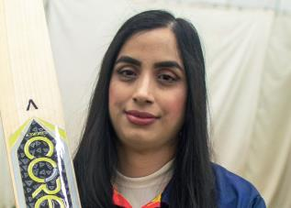
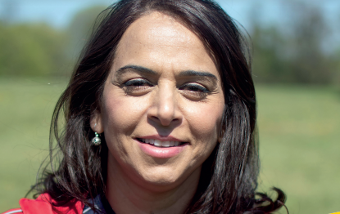
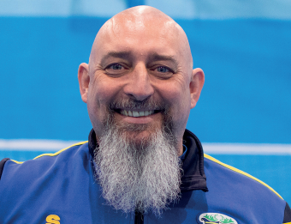
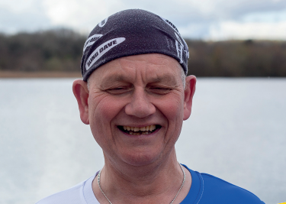
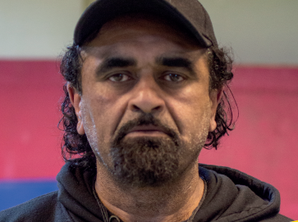
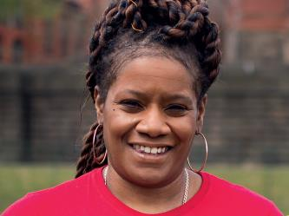
HOMETOWN HEROES
Notes:
Hometown Heroes Activity (15 mins) Cont.
Teacher notes:
TIME: 15 mins
PURPOSE OF ACTIVITY: Students learn about local heroes from the Birmingham and West Midlands local community
RESOURCES: Hometown Heroes film, Hometown Heroes information sheets (See downloadable PDF sheets)
ACTIVITY INSTRUCTIONS:
Distribute the Hometown Heroes information sheets (one per team)
Give each team 5 minutes to familiarise themselves with their hero’s details. Suggest that they each individually take responsibility for remembering 1-2 pieces of information about their hero.
Pair each of the teams and in their pairs number them Team one and Team two.
Instruct the pairs to act as ‘critical friends’ to one another: Team one presents the key information about their Hometown Hero to Team two. Team two should then ask clarifying questions and draw comparisons to their own Hometown Hero (skills, attributes, achievements etc.) The teams then swap over in their pairs. Team two presents the key information about their Hometown Hero to Team one, who ask clarifying questions etc.
After approximately 5 minutes, bring all of the groups together and sit them in a large circle.
Lead a discussion - What makes a hero? Ask the students:
What have you found out about these individuals? (Encourage the students to share some information about their Hometown Hero with the wider group)
Do all of the heroes have the same attributes or abilities?
Did you notice any of the same words coming up again and again?
Are they all from the same background?
What qualities do you think they share?
What unites them?
CLICK ON TO NEXT SLIDE

Slide 15
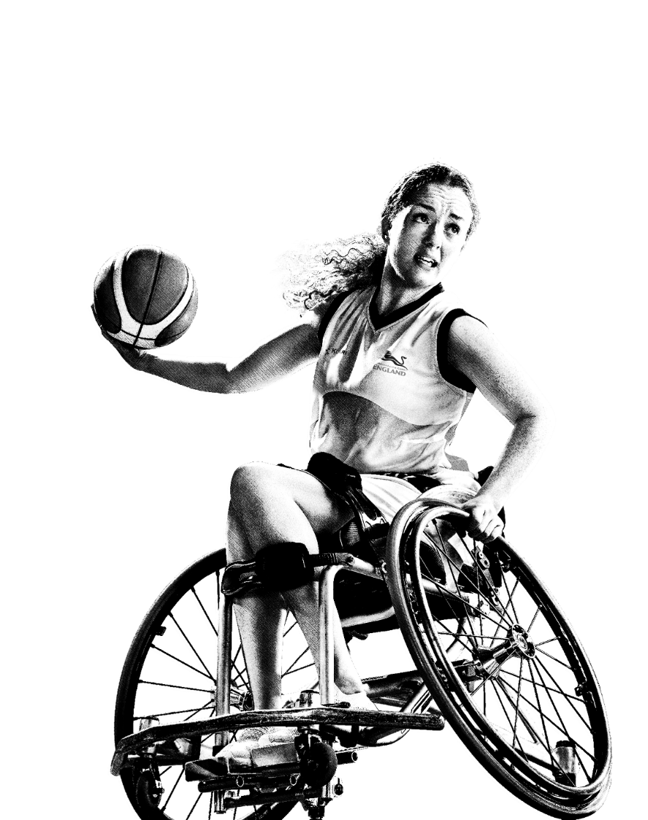
WALK THE LINE
MAKING A CHOICE
Notes:
Walk The Line Activity (15 mins)
Teacher notes:
TIME: 15 mins
PURPOSE OF ACTIVITY: Students explore their values and the issues that are important to them. They identify areas that they would like to change.
RESOURCES: None
ACTIVITY INSTRUCTIONS:
Ask the students to gather in the centre of the room. Explain that you are going to ask them a series of questions. Agree some ground rules to help students to share their views, express opinions and consider those of others, without attracting negative feedback. For example, it is okay for us to disagree with another person’s point of view but we will not judge, make fun of, or put anybody down. We will not make assumptions about people’s values, attitudes, behaviours, identity, life experiences or feelings.
Explain that you are going to ask them a question with two definite answers. They must choose one option. For example: Do you prefer dogs or cats?
Those students who prefer dogs should go to one side of the room, those students who prefer cats should go to the other. Students must make a definitive, binary choice, even they don’t have a strong opinion either way. They are not allowed to stay in the middle.
3. Continue asking similar questions and invite the students to choose a side. Questions could include:
Day or night?
Marvel or DC?
City or countryside?
Summer or winter?
Tea or coffee?
Films or books?
Aquatics or Athletics?
Chocolate or crisps?
Comment on the changing dynamics in the room. Draw the students’ attention to when there is just one or two students on one side (ask them how it feels and congratulate them for having their own opinions). Ask students to notice the changing allegiances: Some things we have in common with our friends (e.g. most of you prefer summer) but some things make us stand out as individuals and that is really important.
After 8–10 questions (enough to make the group feel comfortable with taking up and sharing their own preferences) introduce a new dynamic to the activity. Instead of making binary choices the students are now going to place themselves on a spectrum or scale.
Explain to the students: Now imagine a line from one end of the space to the other. I’m going to make a statement and if you go to this end of the line it means you fully agree and the other end means you fully disagree. However, you can place yourself anywhere on the line depending upon how much you agree.
Begin by making statements with an obvious agree or disagree response:
I go to (insert name) Secondary School
I am in year 8
I always walk to school
I like chocolate
The students should position themselves along the spectrum from agree to disagree. As before, comment on the responses and ask students to articulate why they have placed themselves on the line in that particular position.
Now start to move onto questions that will get students thinking more carefully about what they’re passionate about, what issues they can identify in their community and what (if anything) they’d like to change:
I’d like to learn new skills
I’d like to improve myself
I’d like to get more exercise
There is something that I’d really like to change in the world
I’m concerned about the environment
There is something that I’d really like to change in my country
I’m concerned about litter
I’m concerned about pollution
There is something that I’d really like to change in my community
Everyone is happy in my community
Everyone’s needs are met in my community
I’m concerned about how some people are treated
I’d like to help others
There is something that I’d really like to do to make a change in my community.
The students are free to choose how honest they would like to be but have the opportunity to explore their values and beliefs in a safe environment.
CLICK ON TO NEXT SLIDE

Slide 16
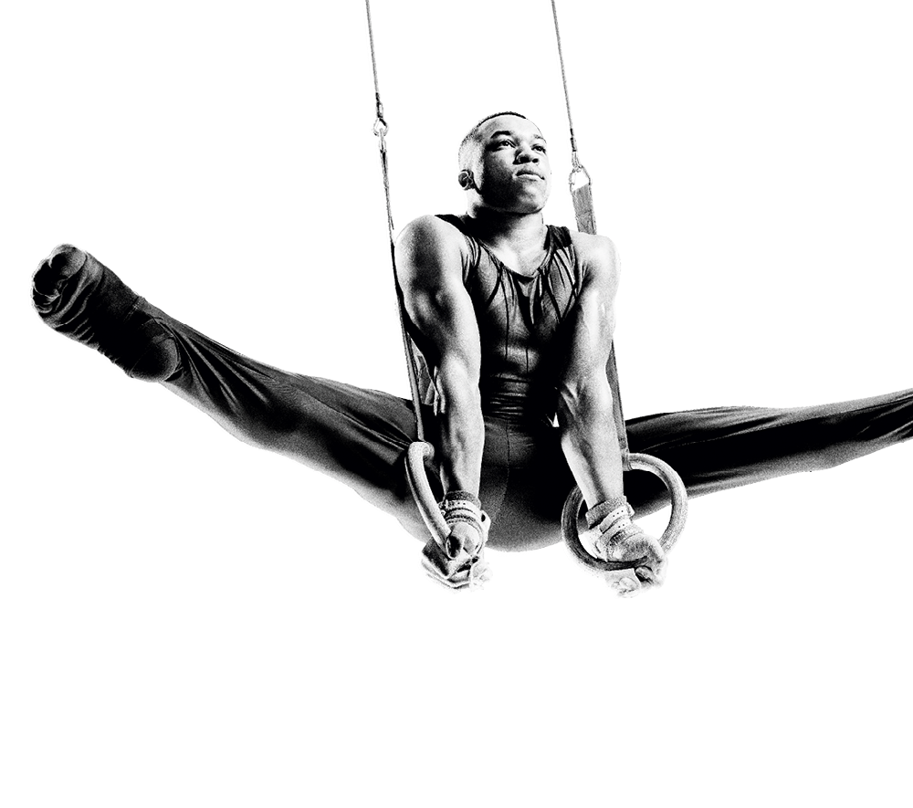
AGENTS OF CHANGE
MAKING CHANGE
Notes:
Agents Of Change Activity (15 mins)
Teacher notes:
TIME: 15 mins
PURPOSE OF ACTIVITY: The students identify and articulate a change that they would like to make.
RESOURCES: None
ACTIVITY INSTRUCTIONS:
Follow the Walk The Line activity with a discussion about what the students have discovered about themselves. This is an important step that allows the students to really consolidate their thoughts, be heard and be taken seriously.
Help the students to gather their thoughts and feelings by asking some questions:
During the Walk The Line activity did anything surprise you?
What did it feel like to have similar opinions to others?
What did it feel like to have different opinions to others?
Did anything make you feel excited? Passionate? Angry? Sympathetic? Compassionate?
Did anyone have thoughts about the environment, social justice, community?
Did it raise any questions for you about diversity, equality, human rights?
Did you identify anything that needs to be changed?
If you could change anything about _________what would it be?
Time’s up for what?
The key here is to create an atmosphere of trust and calm and to allow the students to realise that they can create real and ambitious change.
CLICK ON TO NEXT SLIDE

Slide 17



MAJOR CHALLENGES
CLIMATE CHANGE
CARBON NEUTRAL
SOCIAL JUSTICE
Notes:
Agents Of Change Activity (15 mins) Cont.
Teacher notes:
TIME: 15 mins
PURPOSE OF ACTIVITY: The students identify and articulate a change that they would like to make.
RESOURCES: None
ACTIVITY INSTRUCTIONS:
Follow the Agents of Change discussion with some examples of the broader challenges facing society.
Tell the students that the issues that they have spoken about chime with broader challenges that are faced by all of society: Climate Change, the journey to Carbon Neutral, the fight for Social Justice.
Explain to the students that we all have a responsibility to take action (no matter how small) to make the world a better place.
Ask the students to take a moment on their own to complete the following statement. Bearing in mind all that’s been explored so far:
I’m going to change our world, starting with…
Remind the students that there are no wrong answers. They could think of something small and close to home like:
…the litter around school
…encouraging my classmates to eat more healthily
Or something more far-reaching like the examples on the screen. For example:
…the way that we treat immigrants and people seeking asylum in this country
…the way that we’re treating the planet
…the way that we think about access and inclusion
…the way that we treat representation
Give the students 3-5 minutes to come up with their statement, they could work in pairs if appropriate
CLICK ON TO NEXT SLIDE

Slide 18
USE YOUR PLATFORM!
COMMONWEALTH GAMES ATHLETE ADVOCACY
The Commonwealth Games Federation (CGF) recognises that athletes are: inspirational leaders, agents of change, advocates for integrity, ambassadors for respect, impartiality and non-discrimination.
The CGF is supportive of freedom of expression and trusts, respects and understands that athletes may want to make positive expressions of their values in line with the CGF values of Humanity, Equality and Destiny.
Any such positive expressions of values are subject to the CGF Charter of Good Conduct.
Notes:
Agents Of Change Activity (15 mins) Cont.
Teacher notes:
TIME: 15 mins
PURPOSE OF ACTIVITY: Introduce students to the Commonwealth Games Athlete Advocacy.
RESOURCES: None
ACTIVITY INSTRUCTIONS:
This is a good opportunity to introduce the Commonwealth Games Athlete Advocacy.
Explain to the students that for change to be really effective you need to convince others to become passionate about the cause, too. Many people in the public eye use their platform (their position and existing audience) to promote the causes that are important to them. You could use the examples of Marcus Rashford and Jake Daniels who have used their platform to bring key issues to public attention (food poverty and LGBTQIA+ visibility in sport respectively). Greta Thunberg, Deborah James and Rose Ayling-Ellis are other strong, current examples.
We all have a platform – friends, family, classmates, teachers etc. These are our audience, the people who we can persuade to join us and make meaningful change happen.
The Commonwealth Games recognises that all the athletes have a voice and a platform to be heard. Athletes are encouraged to stand up for what they believe in and everyone here today is encouraged to do the same.
The are three guiding principles to the Commonwealth Games Athlete Advocacy:
The Commonwealth Games Federation (CGF) recognises that athletes are: inspirational leaders, agents of change, advocates for integrity, ambassadors for respect, impartiality and non-discrimination.
The CGF is supportive of freedom of expression and trusts, respects and understands that athletes may want to make positive expressions of their values in line with the CGF values of Humanity, Equality and Destiny.
Any such positive expressions of values are subject to the CGF Charter of Good Conduct.
More information about the Commonwealth Games Athlete Advocacy can be found here: https://thecgf.com/sites/default/files/2022-03/CWG%20AA%20Final.pdf
Ask the students to think again about their change statement. Beginning with the words I’m going to change the world, starting with… Remind the students that:
Like Commonwealth Games Athlete Advocacy the best ideas will be the ones that have special meaning to you. So try to think of something that you are passionate about
Now ask the students to think about the audience that they would like to influence.
CLICK ON TO NEXT SLIDE

Slide 19
ACTION PLAN
I’M GOING TO CHANGE THE WORLD STARTING WITH…
Notes:
Action Plan Activity (10 mins)
Teacher notes:
TIME: 10 mins
PURPOSE OF ACTIVITY: The students confirm what they want to change and form groups to agree an action that can begin that change.
RESOURCES: None
ACTIVITY INSTRUCTIONS:
Each individual young person should now have one sentence in mind. One area for change. The following activity is an opportunity for the students to group themselves according to shared values and goals. It will require some careful facilitation to synthesise the students’ ideas. The activity should be conducted in a supportive and celebratory way.
Invite one student to stand up and share their idea with the rest of the group. Using the phrase: I’m going to change the world starting with…
Ask the group if anyone has a similar idea. If so, they should stand up and say I’ll join you. They then join together as a small team.
Invite a second student with a different change statement or pledge to share their idea with the group and repeat the process of encouraging others to join them. In this way you will create groups of like-minded teams without anyone compromising their vision too much.
Aim for 5-6 groups (if all students have very similar ideas or if one group is disproportionately large, you may need to step in to organise them into several similar-sized groups).
CLICK ON TO NEXT SLIDE

Slide 20

PITCH JAM!
PERSUADING OTHERS
Notes:
Pitch Jam Activity (15 mins)
Teacher notes:
TIME: 15 mins
PURPOSE OF ACTIVITY: New group pitch jam! In their new groups the students come up with a quick and captivating pitch
RESOURCES: None
ACTIVITY INSTRUCTIONS:
Assign a different area of the room as a workspace to each of the newly-formed teams.
Tell the teams that they have 5 minutes to work together and quickly come up with: A memorable team name; a quick soundbite that encapsulates their idea; and a description of what their first step is going to be. Tell the teams that after their time is up they will need to pitch their idea to the other groups in the room.
Visit each team while they are working to assist with their preparations. Remind them to think about: What is their goal? Who is most affected by the issue? What will they be asking their audience to do?
After the 5 minutes of preparation time, ask the teams to get onto their feet and present to the room one by one. For example, We are Team Green. We are going to change the world by reducing littering around school. Litter not only looks horrible but is also bad for the environment – that affects us all! We’re going to start by creating anti-littering posters to put up around school and making a short film to show in an assembly.
After each presentation, ask the pitching team some quick-fire questions about their ideas and invite the other teams to do so too. The pitching team will enjoy thinking on their feet and will be amazed at the ideas that they come up with on the spot – as will the other teams!
Encourage some healthy competition as the teams pitch and again look for opportunities to synthesise their ideas.
Conclude the pitch jam by congratulating all of the teams for their great ideas and fantastic presentations! Remind the teams that they have all identified actions that they can take immediately to change the world.
Ask all of the students to commit to one small action, one small step that they will take towards their world-changing plan.
CLICK ON TO NEXT SLIDE

Slide 21
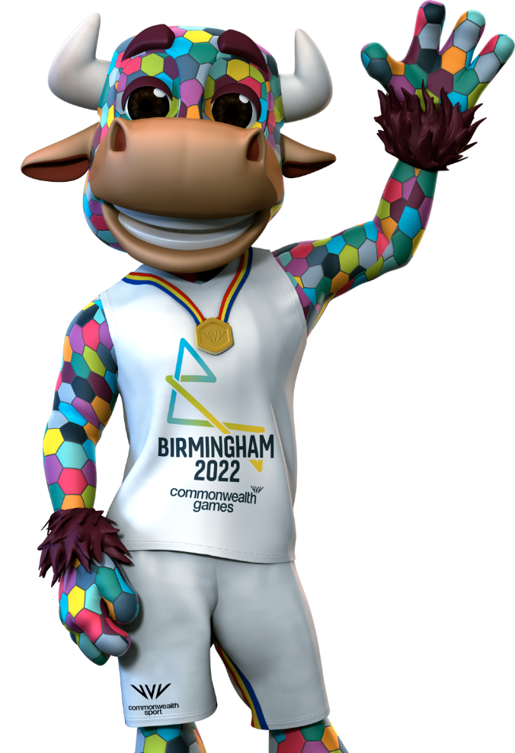
REFLECTIONS
If you were to look at a river and attempt to see the effect that water has on eroding rock, you’d see nothing. But if you observed that river for a long enough time you would see it carve out the Grand Canyon. Small consistent action over a long enough period of time can change the world.
We can change our world!
Notes:
End of workshop reflection (2 mins)
Teacher notes:
TIME: 5 mins
PURPOSE OF ACTIVITY: Wrap up the session and encourage students to reflect on what they have learned about the Hometown Heroes and the Birmingham 2022 Commonwealth Games. Remind the students that they can all be agents of change and they can genuinely change the world
RESOURCES: None
SET-UP
Gather the students in a large group in front of you.
ACTIVITY INSTRUCTIONS
Conclude the session with the following call to action:
If you were to look at a river and attempt to see the effect that water has on eroding rock, you would see nothing. But if you observed that river for a long enough time you would see it carve out the Grand Canyon. Small consistent action over a long enough period of time can change the world. We can change our world!
Thank the students and congratulate them for their contributions and ideas. Close the session.
CLICK ON TO NEXT SLIDE

Slide 22
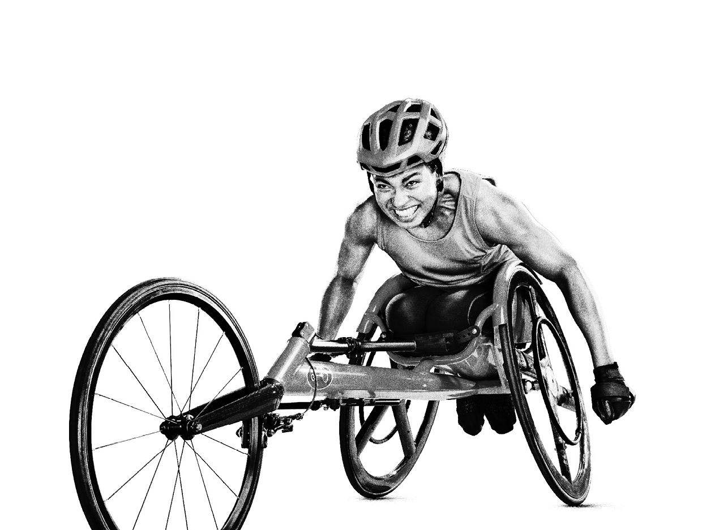
THANK YOU

