Slide 1

VALUES CHALLENGE

Slide 2
OVERVIEW
Bring the Power is the youth programme of the Birmingham 2022 Commonwealth Games. The programme aims to put children and young people at the heart of this exciting festival of sport and culture. This resource asks young people in schools across the country to Bring the Power of the Commonwealth Games and to express its Values of humanity, equality and destiny as a creative response to be shared with Birmingham 2022.
Learning objectives
To understand the significance and the importance of the Commonwealth Games​
​To understand the Values that underpin
the Games
To respond creatively to the Values
of humanity, equality and destiny
Key words:
friendship; nations; Values; champion
Age group
7-14 years (Key Stages 2-3)
Time required: 30 minutes
Please make sure you use this PowerPoint
in presentation mode to use the animation
on select slides.

Slide 3
POLITICAL IMPARTIALITY
Please refer to the Political impartiality in schools guidance: www.gov.uk/government/publications/political-impartiality-in-schools/political-impartiality-in-schools
Schools should use their discretion when deciding on the use of specific resources
and activities.

Slide 4
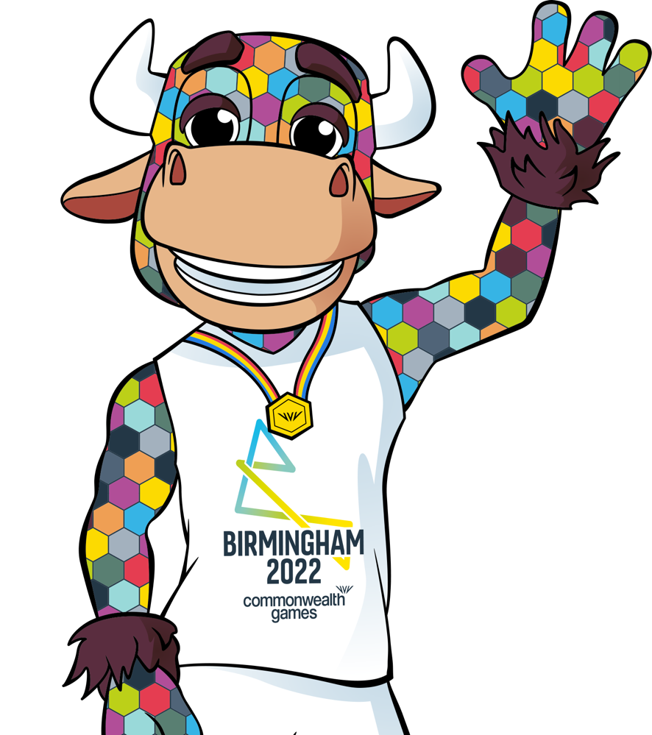
BRING THE POWER!
The Birmingham 2022 Commonwealth Games
is coming to Birmingham this summer – and
we want you to be a part of it!
The Games will run from 28 July - 8 August 2022
What is Bring the Power?
Bring the Power is the official youth programme
of the Birmingham 2022 Commonwealth Games.
We want children and young people to get closer
to the Games and take the lead in planning events as part of this Bring the Power: School Festival.
Notes:
Teacher notes:
Reflect on what the Commonwealth Games is and how everyone can get involved.
We hope your school is also planning a Festival Day as part of the Bring the Power: School Festival! Go to https://www.birmingham2022.com/power/schools/school-festival to find out more.

Slide 5
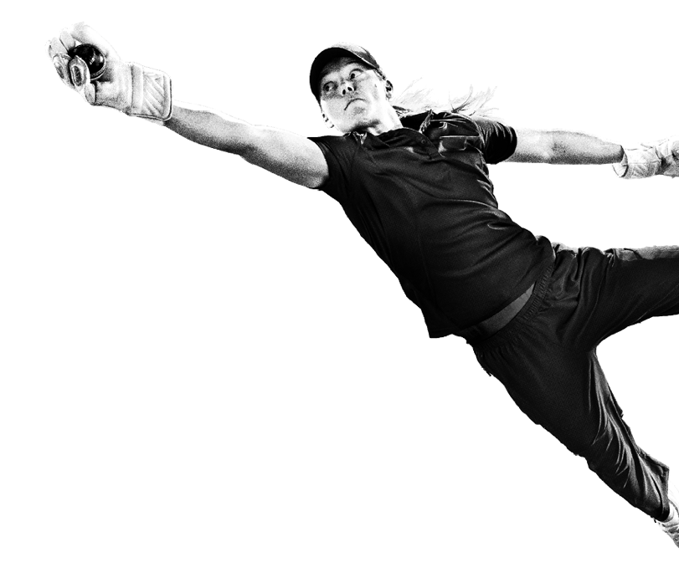
COMMONWEALTH GAMES
FEDERATION VALUES
Humanity
Equality
Destiny
Celebrating
our diverse Commonwealth countries and recognising that we are part of
a global family
Every person
is equal through participation
in sport
Creating our
own destiny and working hard to achieve our goals
Notes:
Teacher notes:
Read out the three words on the slide: Humanity, Equality and Destiny.
Ask for volunteers to call out definitions of each word and consider what they could mean in the context of the Commonwealth Games before they are revealed above
Explain that these are the Values of the Commonwealth Games.
Humanity – We are all human beings and the Commonwealth Games sees athletes and spectators from many nations coming together to celebrate sport.
Equality – The Commonwealth Games bring competitors together as equals. The Games are open to all and promote fairness and inclusion.
Destiny – The Games Federation aims to work with nations and communities to help build a peaceful future.
Explain that the Commonwealth Games is for everyone. It brings diverse nations together in sport, culture, togetherness and a shared vision of peace for the future. The Commonwealth Games is often referred to as the Friendly Games because of these core values that underpin them.
Read out the vision of the Birmingham 2022 Commonwealth Games: “Through a festival of thrilling, fast-paced sport, exhilarating culture and dynamic business, the 2022 Commonwealth Games will make a world of difference for everyone throughout the West Midlands and beyond. This momentous event is a chance to celebrate a global community and our human potential.”

Slide 6





THE VALUES OF THE COMMONWEALTH GAMES
A good way to remember this is with the acronym HEAD: Humanity, Equality and Destiny.
Humanity
Equality
Destiny
What do these Values mean to you and your school community?
How do you display them in your daily life?
Notes:
Teacher notes:
Reflect on how the Values relate to your students’ lives.
Ask students and/or class to answer the question:
How does your school community show these Values?
How might students demonstrate these in their participation in sport and more widely in their own lives?

Slide 7
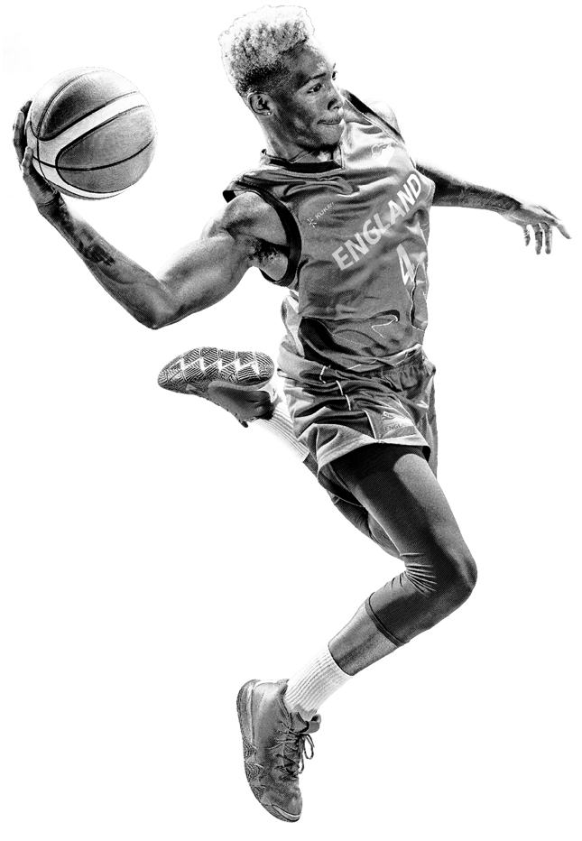
VALUES CHALLENGE
Now, it’s over to you! We want you to think about the Values
of the Commonwealth Games and respond to them creatively.
Humanity
Equality
Destiny
Express yourself and your vision in whichever way you wish!
Are you a budding poet? Then write a poem! Or maybe you see yourself as an artist – paint a picture! The creative options are endless.
Use the ideas on the following slides to help you get started and get those creative juices flowing!
Notes:
Teacher notes:
Express to the group that the aim of the challenge is to give a creative response - there is no right or wrong answer!
Younger pupils may find it easier to focus on just one of the Values.

Slide 8
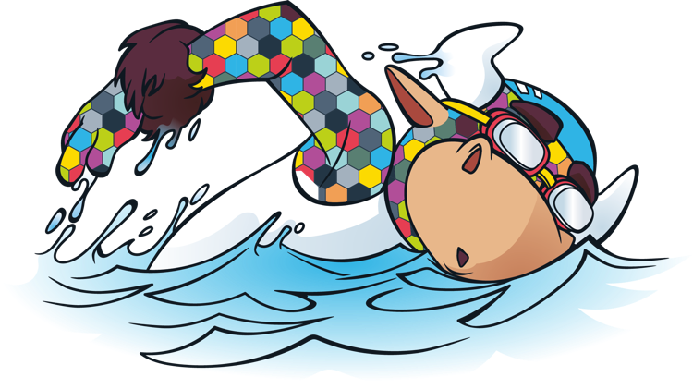








IDEAS – LITERARY
Why not try …
writing a poem about equality, humanity or destiny
writing a story with characters and a plot that display the Values
writing down your hopes for the future of the human race
writing some rules to live by that reflect the Commonwealth Games Values
writing a play to perform with your friends.
Equality
Destiny
Humanity
Notes:
Teacher notes:
You could ask the group some questions to begin their thinking, for example:
Have you ever read a book with a hero who displays any of these characteristics? How can you show how a main character has any of these traits?
How could you write a speech encouraging others to be agents of change using these traits?
How could you create characters for a play representing these Values?

Slide 9
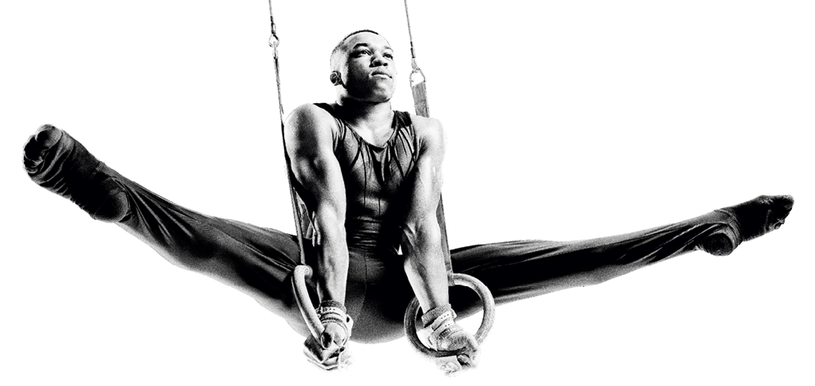








IDEAS – MUSICAL
Why not try …
writing then singing a song about humanity, equality and destiny
composing a piece of music for a group or individual to play, linked to one or more of
the Values
choreographing a dance to music based
around the emotions the Values inspire in you
Equality
Destiny
Humanity
Notes:
Teacher notes:
You could ask the group some questions to begin their thinking, for example:
Have you ever listened to a song mentioning any of the Values?
How do you think a song about these Values would make you feel?
How could you represent any of these Values with a few movements?

Slide 10
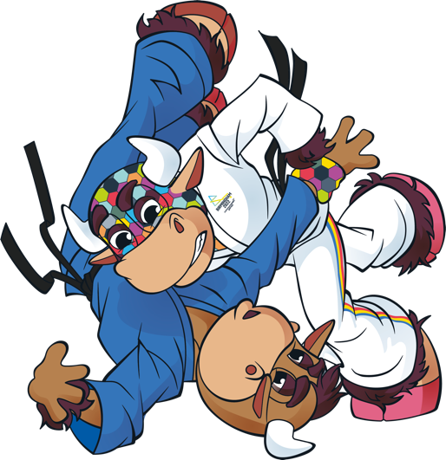







IDEAS – VISUAL ARTS
Why not try …
creating a poster to educate your community about
the meanings of humanity, equality and destiny
creating an abstract painting using colours
linked to the emotions the Values inspire in you
drawing and painting a piece of artwork based on
your hopes for the future of humanity
using words and/or sentences linked to the Values to create a piece of art which encourage positive change.
Equality
Destiny
Humanity
Notes:
Teacher notes:
You could ask the group some questions to begin their thinking, for example:
How can art be used to send a message such as any of the Commonwealth Games Values?
What feelings do the Values inspire in you? Are there any colours that represent these feelings?
Can you think of synonyms (a word or phrase that means exactly or nearly the same) or examples of the Values?

Slide 11
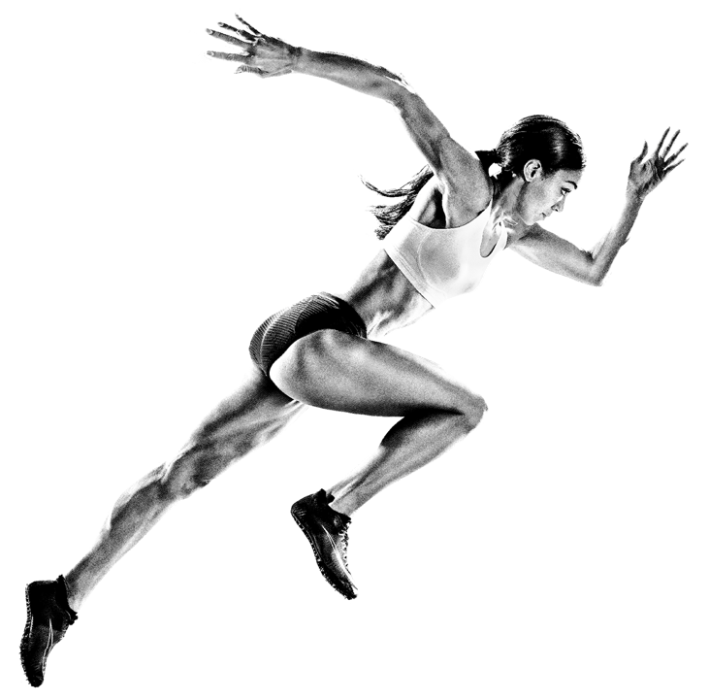







IDEAS – PHOTOGRAPHY/VIDEOGRAPHY
Why not try …
asking your friends to create a
pose or arrangement to demonstrate
humanity, equality and destiny and photograph it
taking a series of photographs to post together in a storyboard – photos could
show objects and words that you feel represent the Values
producing a mini documentary film discussing the values and your hopes and dreams for the future of humanity.
Equality
Destiny
Humanity
Notes:
Teacher notes:
You could ask the group some questions to begin their thinking, for example:
Can you think about a time you have seen someone demonstrate an example of one of the Values? Can you recreate it in a freeze frame?
How could you tell a story using the Values?
What real life examples can you think of that would demonstrate the values and be relatable to others?

Slide 12
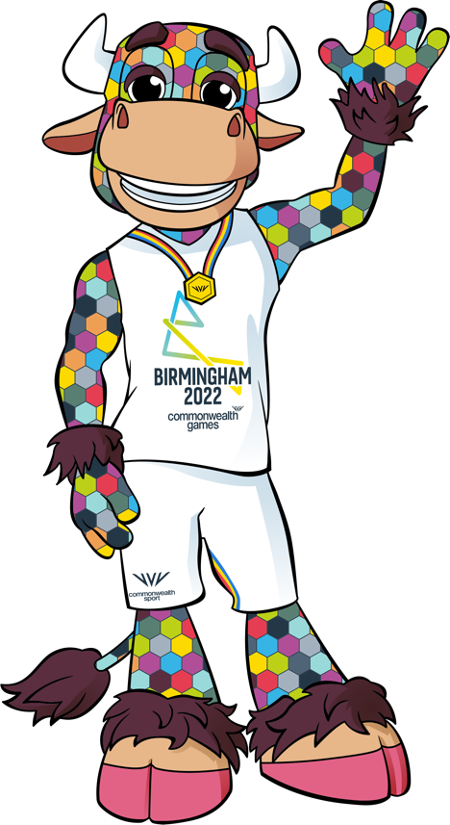
VALUES CHALLENGE
What to do next!
We would love to see your creative responses to the Values of the Commonwealth Games.
Ask your teacher to share them with
us on social media using the hashtags #BringThePower and #B2022 and you might win a special prize for your school!
Equality
Destiny
Humanity
Notes:
Teacher notes:
Terms and conditions apply: https://www.birmingham2022.com/terms-and-conditions/btp-festival-resources
Share on Facebook, Twitter, Instagram, TikTok and/or LinkedIn.
You could create a class display board for any art or literary entries or create a presentation afternoon for entries in your class. Or even share as a school the creative responses with an assembly for parents to see, too.

Slide 13





