Slide 1



WORKSHOPS
Notes:
Introduction and learning objectives (2-mins)
Teacher notes:
Tell pupils they are about to take part in a fun lesson about the Birmingham 2022 Commonwealth Games.
CLICK ON TO NEXT SLIDE

Slide 2
TEACHER NOTES
Audience: Key Stage 2 pupils (aged 7–11)
Time: 75-minutes approx.
Teacher resources: PowerPoint slides, 5 x sets of 6 Commonwealth sports cards,
6 x Commonwealth nations posters (download separately)
Student resources: Large play parachute (if available)
Preparation: Review the slides and teacher notes, print and prepare workshop resources
Curriculum Links
PSHE Association Programme of Study, Living in the Wider World: Ways of carrying out
shared responsibilities for protecting the environment in school and at home.
Science: The human impact on environments
Geography: Locate the world’s countries, concentrating on their environmental regions,
key physical and human characteristics, countries, and major cities

Slide 3
TEACHER NOTES Cont.
Lesson content:
Learn key facts about the Birmingham 2022 Commonwealth Games including: dates, venue locations
and key sustainability credentials
Physically and mentally warm-up and learn about the locations of some of the nations involved in the Birmingham 2022 Commonwealth Games
Learn about some of the sports included in the Birmingham 2022 Commonwealth Games
Learn about some the Commonwealth nations and territories that are competing in the Birmingham
2022 Commonwealth Games
Understand similarities and differences between some the Commonwealth nations that are competing
in the Birmingham 2022 Commonwealth Games
Call to action

Slide 4
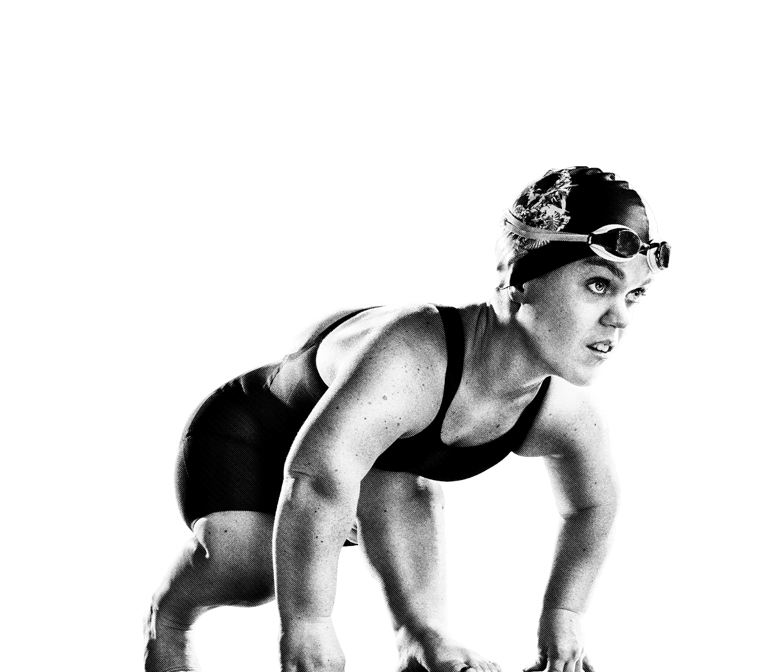

FINDING
COMMON
GROUND
KS2
Notes:
Introduction to Finding Common Ground (2-mins)
Teacher notes:
In the Finding Common Ground workshop the pupils will find out some key facts about the Birmingham 2022 Games including where the games will take place and some of the sports that are played. The pupils will explore and identify some of the Commonwealth countries that will be competing in the Commonwealth Games and think about what is different and what unites us. They will be using their geographical, physical and creative skills.
CLICK ON TO NEXT SLIDE

Slide 5
BIRMINGHAM 2022 COMMONWEALTH
GAMES FACTS & KEY INFO:
WHEN?
28th July to 8th August 2022
WHAT?
An international multi-sport event involving athletes from the Commonwealth of Nations
Often referred to as the Friendly Games
With the exception of 1942 and 1946, has taken place every four years
.
WHERE?
The Birmingham 2022 Commonwealth Games
is a West Midlands Celebration with Birmingham at its heart.
Notes:
Key facts about the Birmingham 2022 Commonwealth Games (6-mins)
Teacher notes:
Use the following slides (5-9) to tell your pupils some key details and a little about the mission of the 2022 Games in Birmingham. Edit the slides to highlight the information that is most relevant to your pupils. (This section of the workshop should last no more than 6 minutes)
Further information about the Birmingham 2022 Commonwealth Games can be found at: www.birmingham2022.com
When?
The Commonwealth Games will be taking place between Thursday 28th July and Monday 8th August 2022
What?
The Commonwealth Games are often referred to as the Friendly Games. It is an international multi-sport event involving athletes from the Commonwealth of Nations. The event was first held in 1930, and, with the exception of 1942 and 1946, has taken place every four years since then.
Where?
The Birmingham 2022 Commonwealth Games is a West Midlands Celebration with Birmingham at its heart.
CLICK ON TO NEXT SLIDE

Slide 6
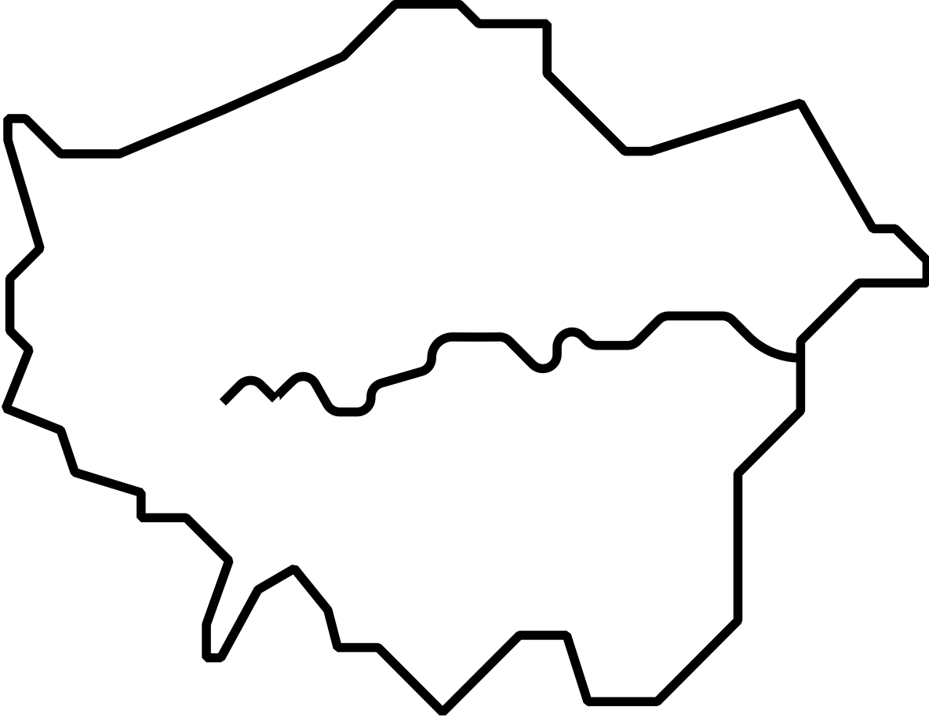
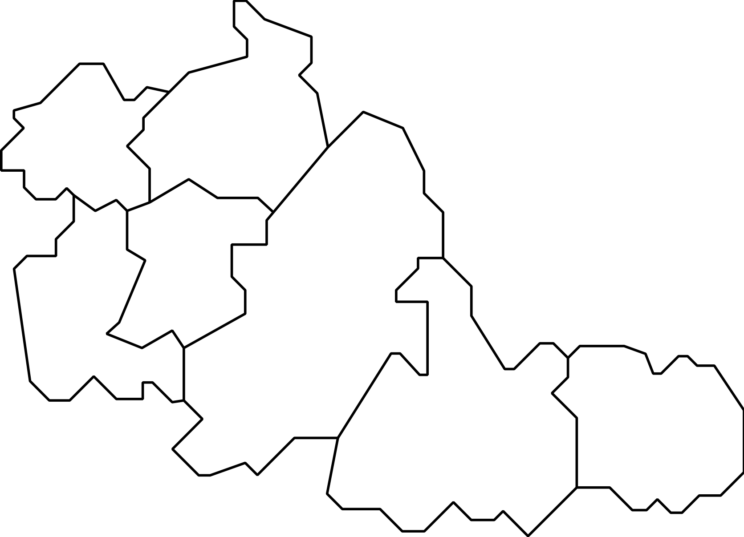
WEST MIDLANDS
ALEXANDER STADIUM
SMITHFIELD
LEE VALLEY VELOPARK
WALSALL
WOLVERHAMPTON
EDGBASTON STADIUM
LONDON
SANDWELL
DUDLEY
BIRMINGHAM
COVENTRY STADIUM
AND ARENA
SOLIHULL
COVENTRY
SANDWELL
AQUATICS CENTRE
Notes:
Key facts about the Birmingham 2022 Commonwealth Games (6-mins) Cont.
Teacher notes:
Where?
The venues being used for the Games stretch from Coventry, Solihull, and Royal Leamington Spa to Cannock Chase Forest, Royal Sutton Coldfield, and Wolverhampton.
Highlighted on screen are just a few of the venues:
Alexander stadium (This is the main arena for the Games - home to the opening and closing ceremonies and the Athletics & Para-Athletics events)
Coventry Stadium and Arena (Rugby 7’s will take place in Coventry Stadium, Judo and Wrestling will take place in the Arena)
Edgbaston Stadium (This world-famous venue for Cricket will be home to Cricket T20 at the Birmingham 20222 Commonwealth Games)
Sandwell Aquatics Centre (This is a brand-new venue constructed especially for the Birmingham 2022 Commonwealth Games. It will be home to Aquatics events)
Smithfield (This is a temporary Birmingham City Centre venue – home to Beach Volleyball, Basketball and Wheelchair Basketball)
Lee Valley Velopark in London (This is the venue for some cycling events – this is the only venue located outside of Birmingham and the West Midlands. Mountain biking will take place in the region – in Cannock Chase Forest)
Other venues include:
The NEC
Arena Birmingham
Cannock Chase Forest
St Nicholas Park
Sutton Park
University of Birmingham Hockey and Squash Centre
Victoria Park
Victoria Square
West Park
CLICK ON TO NEXT SLIDE

Slide 7
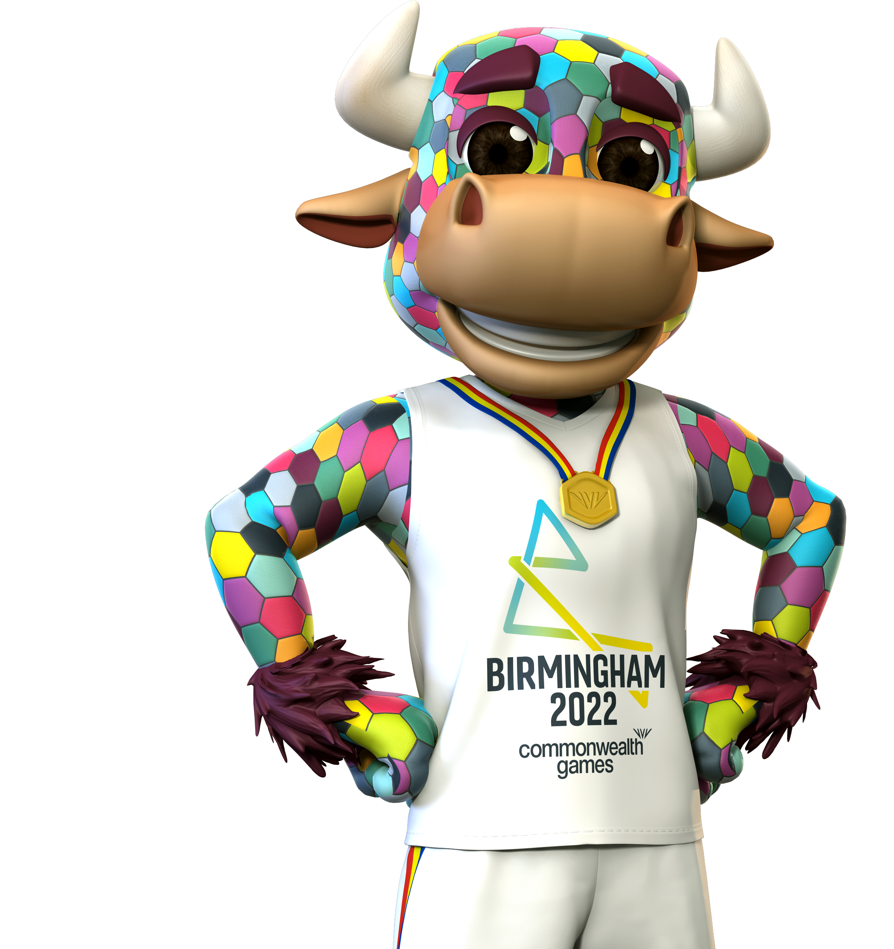
BIRMINGHAM 2022 COMMONWEALTH
GAMES FACTS & KEY INFO:
VISION
Through a festival of thrilling, fast-paced
sport and exhilarating culture, the 2022 Commonwealth Games will make a world
of difference for everyone throughout
the West Midlands and beyond.
This momentous event
is a chance to celebrate a global community
and our human potential.
Notes:
Key facts about the Birmingham 2022 Commonwealth Games (6-mins) Cont.
Teacher notes:
Vision
Birmingham 2022 has a clear vision:
A festival of thrilling, fast-paced sport and amazing cultural events!
The Birmingham 2022 Commonwealth Games will make a world of difference for everyone across the West Midlands and beyond.
The Birmingham 2022 Commonwealth Games is a chance to bring the Commonwealth nations together and celebrate our human potential.
CLICK ON TO NEXT SLIDE

Slide 8



COMMONWEALTH GAMES MISSION
BRING PEOPLE TOGETHER
BE A CATALYST FOR CHANGE
PUT US ON THE GLOBAL STAGE
HELP THE REGION TO GROW AND SUCCEED
IMPROVE HEALTH AND WELLBEING
Notes:
Key facts about the Birmingham 2022 Commonwealth Games (6-mins) Cont.
Teacher notes:
Mission
The Birmingham 2022 Commonwealth Games has a 5 – point Mission:
Bring people together These Games will embrace and champion the youth, diversity, humanity and pride of the region and the Commonwealth.
Be a catalyst for change Transform and strengthen local communities, working together to deliver new and improved homes, facilities and transport links.
Put us on the global stage Deliver an unforgettable, global Games in partnership, on time and on budget to showcase the best of Birmingham, the West Midlands and the Commonwealth.
Help the region to grow and succeed Drive sustainable growth and aspiration; creating opportunities through trade, investment, jobs, volunteering and skills.
Improve health and wellbeing Inspire, engage and connect communities and athletes to realise their full potential and live happier, healthier lives.
CLICK ON TO NEXT SLIDE

Slide 9
BIRMINGHAM 2022 COMMONWEALTH
GAMES FACTS & KEY INFO:
FACTS
First games to award more medals to
women than men.
First Commonwealth Games to create a carbon neutral legacy.
Our bold ambition - we will deliver the most sustainable Commonwealth Games since the event began nearly a century ago.
THE SEVEN PILLARS
Our approach to sustainability has seven
areas of focus:
  1. Accessibility
  2. Equality, diversity and inclusion
  3. Job creation and social value
  4. Human rights
  5. Carbon and air quality
  6. Circular economy principles to minimise waste
  7. Conservation
Notes:
Key facts about the Birmingham 2022 Commonwealth Games (6-mins) Cont.
Teacher notes:
Facts
Birmingham 2022 will be the first Commonwealth Games to award more medals to women than men.
Birmingham 2022 will be the first Commonwealth Games to create a carbon neutral legacy.
Birmingham 2022’s bold ambition is to deliver the most sustainable Commonwealth Games since the event began nearly a century ago.
The seven pillars of sustainability:
The Birmingham 2022 Commonwealth Games’ approach to sustainability has seven areas of focus:
1. ACCESSIBILITY
2. EQUALITY, DIVERSITY AND INCLUSION
3. JOB CREATION AND SOCIAL VALUE
4. HUMAN RIGHTS
5. CARBON AND AIR QUALITY
6. CIRCULAR ECONOMY PRINCIPLES TO MINIMISE WASTE
7. CONSERVATION
Once you have introduced your pupils to some key facts about the Birmingham 2022 Commonwealth Games, they will be ready to take part in a series of fun and active learning activities…
CLICK ON TO NEXT SLIDE

Slide 10
WHERE IN THE WORLD!
EUROPE
ASIA
NORTH AMERICA
AFRICA
EQUATOR
EQUATOR
SOUTH AMERICA
AUSTRALIA AND OCEANIA
Notes:
Warm up - Where in the World Activity (10-mins)
Teacher notes:
TIME: 10 mins
PURPOSE OF ACTIVITY A warm-up to learn about global geography and some Commonwealth countries
RESOURCES: Enough space to move around
ACTIVITY INSTRUCTIONS:
Begin by explaining that that the hall /classroom is going to transform into a giant map of the world! Different areas of the space represent different parts of the globe.
Draw an imaginary line through the centre of the space and explain to the pupils: Over here is the northern hemisphere and here is the southern hemisphere.
When you call - Northern hemisphere!, the pupils have to move as fast as they can to that location.
Next you can gradually assign continents to different parts of the room. On your command, the pupils should move around the space responding as fast as they can. Asia! North America! Africa! Southern Hemisphere! Europe!
Once you’ve agreed on a rough global map you can add in specific Commonwealth countries. For example, If you say Tuvalu! the participants have to move to which continent they think it is in and you can let them know if they’re right.
CLICK ON TO NEXT SLIDE

Slide 11






SPLIT!
Aquatics
Basketball
Lawn Bowls &
Para Lawn Bowls
Cricket
Cycling
Table Tennis
Notes:
Split (5-mins)
Teacher notes:
TIME: 5 mins
PURPOSE OF ACTIVITY: A fun miming activity to split the participants into groups
RESOURCES: 5 sets of 6 cards with a Commonwealth sport printed on them - Aquatics, Basketball, Lawn Bowls & Para Lawn Bowls, Cricket, Cycling, Table Tennis (See downloadable template.) or create hand-written cards (See Commonwealth sports on screen)
SET-UP
Give each participant a small card which has the name of a Commonwealth sport printed on it. (If you need 6 groups of 5 - use 6 sets of cards with 5 cards in each set.)
ACTIVITY INSTRUCTIONS:
Explain to the pupils that they must keep their sport a secret!
The challenge is to find all the participants who also have the same sport. But they must do it without making a sound! Shhhh…
The pupils will have fun roaming around the room, miming their sport until they've all succeeded in forming groups.
CLICK ON TO NEXT SLIDE

Slide 12
THE WORD IN YOUR HANDS!
INDIA
CANADA
EUROPE
ASIA
NORTH AMERICA
NAURU
AFRICA
JAMAICA
SOUTH AMERICA
NEW ZEALAND
AUSTRALIA AND OCEANIA
NIGERIA
MOZAMBIQUE
KENYA
Notes:
The World in Your Hands! (40-mins)
Teacher notes:
TIME: 40 mins
PURPOSE OF ACTIVITY: Pupils learn key facts and information about a selection of Commonwealth nations
RESOURCES: Enough space to move around, 6 x Commonwealth nation information sheets (available to download). A giant play parachute (if available)
SET-UP
Print each of the Commonwealth nation sheets separately onto A4 paper (you may wish to print more than one set). Place the giant play parachute in the centre of the space. The pupils can be positioned around the parachute in their groups. If a parachute is not available, this activity can be delivered with pupils positioned in a big circle.
ACTIVITY INSTRUCTIONS:
First assign each group a different Commonwealth nation to study and give each group the relevant Commonwealth nation information sheet.
Ask the teams to take a few minutes to quickly familiarise themselves with all of the information available. Suggest that they quiz each other within their group or chose to all remember one fact each.
Next, instruct the pupils in their groups to take hold of the edge of the parachute / form a large circle. Explain that when a fact is called out the pupils should raise the parachute upwards (or, if no parachute, the pupils should raise both hands in the air) Any of the pupils whose nation shares that fact must move under the parachute / across the circle and find a new place.
Then explain: Can each of you think of a fact about your nation? It could be whether it’s in the northern or southern hemisphere. Whether it’s in Africa or North America or whether the flag has any green in it. What sports do they play? Have they ever hosted the Games? Do they have any major environmental problems or solutions?
Now nominate a pupil to first name their nation and then share a fact. The teams should move under the parachute / across the circle every time they hear a fact that relates to their nation.
The game continues as pupils share and learn more and more about the different Commonwealth nations. You can prompt discussion about the similarities and differences between the nations as well as key issues around environment, energy etc.
If safe to do so, you could add the rule that whenever you call Commonwealth Games! - all the participants throw up the parachute, move under it and find a new spot. Or, all move at once to find a new place.
At times the pupils are likely to contribute facts that no-one else will have - this can provide an opportunity to discuss this unique aspect of their nation.
Next, instruct the pupils to waft the parachute up in the air, step forward and then sit down on the material, sealing in the air. In this way they can keep the parachute inflated in a kind of dome with everyone inside, creating a more cosy and intimate space. If not using a parachute, ask the pupils to step forward and slowly sit down in a circle all at the same time.
Explain that similar to before, you’re going to make a statement. This time whoever agrees with that statement must move across the circle to find another space. You might say: I have black shoes on or I have a sister or I walk to school etc.
You could make statements that get the pupils thinking about their similarities and differences such as: I play cricket, I enjoy swimming, My parents/grandparents /carers were born overseas, I speak a different language when I’m at home
This activity can be rounded off with a frank discussion about what unites us in our school, our city, our country and what we have in common with young people from other nations. The pupils will likely be in a calm introspective mood and this could create some honest and interesting discussion.
Alternatively you could challenge the young people to come up with their own single uniting statement that makes everyone find a new space.
CLICK ON TO NEXT SLIDE

Slide 13
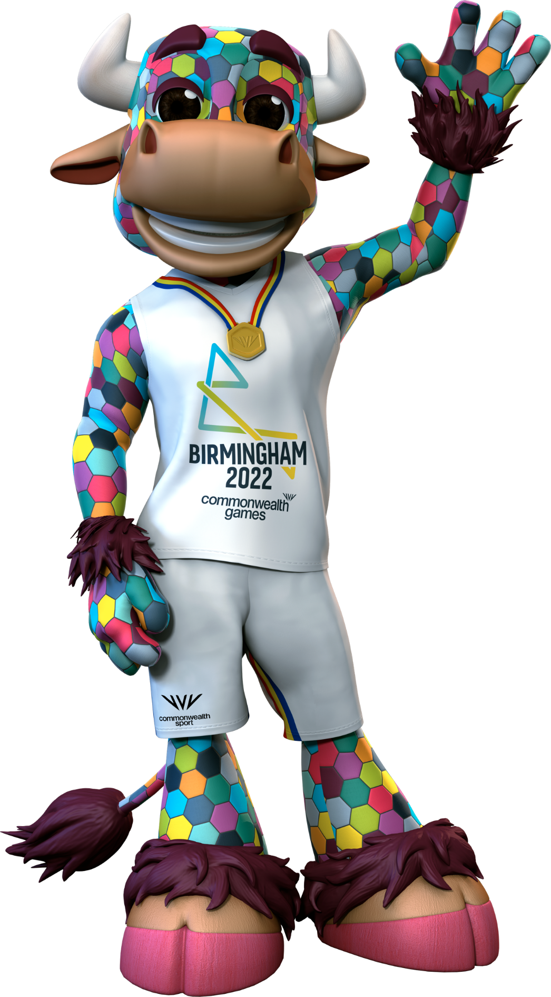
REFLECTIONS
When you leave here today try and remember all the things that unite us that we talked about - We all want to be happy, we all deserve to be treated with respect. But also remember that we are all unique and diverse and that's what makes the world so great!
Notes:
End of workshop reflection (5-mins)
Teacher notes:
TIME: 5 mins
PURPOSE OF ACTIVITY: Wrap up session and encourage pupils to reflect upon what they have learned about the nations who are competing in the Birmingham 2022 Commonwealth Games
RESOURCES: None
SET-UP
Gather the pupils in a large group in front of you
ACTIVITY INSTRUCTIONS
Conclude the session with the following call to action:
When you leave here today try and remember all the things that unite us that we talked about - We all want to be happy, we all deserve to be treated with respect. But also remember that we are all unique and diverse and that's what makes the world so great!
CLICK ON TO NEXT SLIDE

Slide 14
THANK YOU

