Slide 1



WORKSHOPS
Notes:
Introduction and learning objectives (2-mins)
Teacher notes:
Tell pupils they are about to take part in a fun and active lesson about the Birmingham 2022 Commonwealth Games
CLICK ON TO NEXT SLIDE

Slide 2
TEACHER NOTES
Audience: Key Stage 1 pupils (aged 5 – 7)
Time: 60-minutes approx.
Teacher resources: PowerPoint slides, triangular flags with Commonwealth Games dates and facts printed on them, Birmingham 2022 Bring the Power paper banners (download separately)
Student resources: Various art materials – colouring pens, colouring pencils, pencils, sharpeners, erasers
Preparation: Review the slides and teacher notes, print and prepare workshop resources
Curriculum Links
PSHE Association Programme of Study, Living in the Wider World: Ways of carrying out shared responsibilities for protecting the environment in school and at home.
Maths: Preparation for understanding/using larger numbers. Sequence events in chronological order. Recognise and use language relating to dates, including months and years

Slide 3
TEACHER NOTES Cont.
Lesson content:
Learn key facts about the Birmingham 2022 Commonwealth Games including: dates, venue locations and key sustainability credentials
Physically and mentally warm-up and learn about some of the sports included in the Birmingham 2022 Commonwealth Games
Learn about key dates and locations in the history of the Commonwealth Games
Create display banners with positive and welcoming messages for athletes competing in the Birmingham 2022 Commonwealth Games
Call to action

Slide 4

JOURNEY
TO THE
GAMES
KS1
Notes:
Introduction to Journey to the Games (2-mins)
Teacher notes:
In the Journey to the Games workshop the pupils will find out some key facts about the Birmingham 2022 Games including where the games will take place and some of the sports that are played. The pupils will explore the timeline of the Commonwealth Games and think about key dates and locations in the history of the event. They will create welcome and celebration messages for visitors to the region. Pupils will use their numerical, physical and creative skills.
CLICK ON TO NEXT SLIDE

Slide 5
BIRMINGHAM 2022 COMMONWEALTH
GAMES FACTS & KEY INFO:
WHEN?
28th July to 8th August 2022
WHAT?
An international sporting event with athletes from the Commonwealth of Nations
Known as the Friendly Games
The Games take place every four years
WHERE?
The Birmingham 2022 Commonwealth Games
will take place in Birmingham and across the West Midlands
Notes:
Key facts about the Birmingham 2022 Commonwealth Games (5-mins)
Teacher notes:
Use the following slides (5-10) to tell your pupils some key details and a little about the mission of the 2022 Games in Birmingham. Edit the slides to highlight the information that is most relevant to your pupils. (This section of the workshop should last no more than 5 minutes)
Further information about the Birmingham 2022 Commonwealth Games can be found at: www.birmingham2022.com
When?
The Commonwealth Games will be taking place between Thursday 28th July and Monday 8th August 2022
What?
The Commonwealth Games is an international multi-sport event involving athletes from the Commonwealth of Nations. – Nations from all across the world
The event is often referred to as the Friendly Games.
The games take place every four years
Where?
The Birmingham 2022 Commonwealth Games is a sporting competition and celebration taking place in Birmingham and across the West Midlands region.
CLICK ON TO NEXT SLIDE

Slide 6
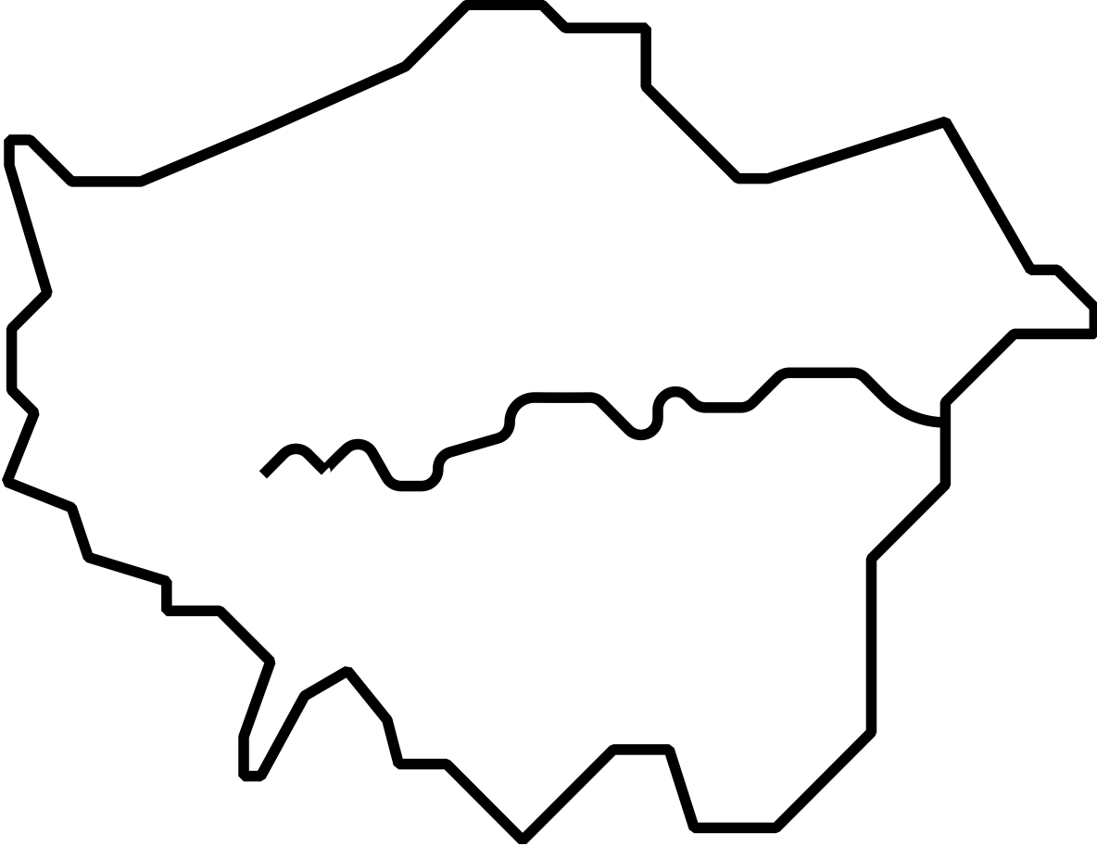
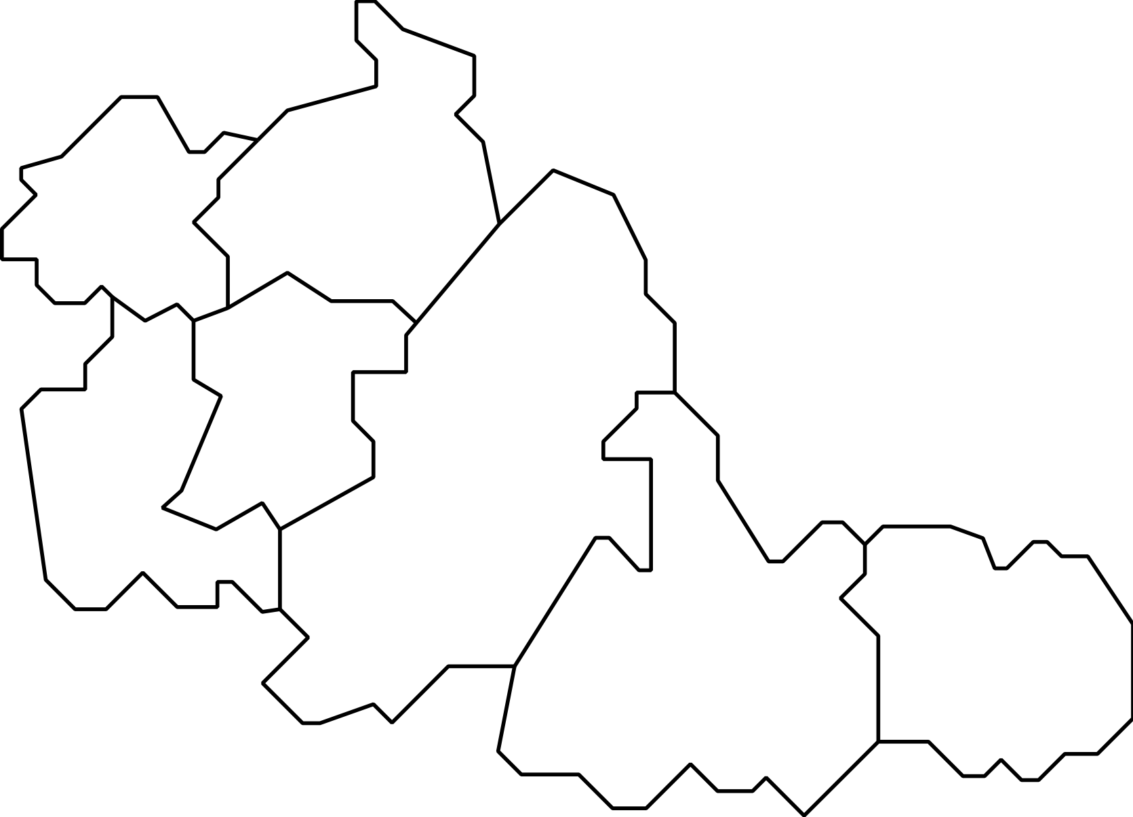
WEST MIDLANDS
ALEXANDER STADIUM
SMITHFIELD
LEE VALLEY VELOPARK
WALSALL
WOLVERHAMPTON
EDGBASTON STADIUM
LONDON
SANDWELL
DUDLEY
BIRMINGHAM
COVENTRY STADIUM
AND ARENA
SOLIHULL
COVENTRY
SANDWELL
AQUATICS CENTRE
Notes:
Key facts about the Birmingham 2022 Commonwealth Games Cont. (5-mins)
Teacher notes:
Where?
The venues being used for the Games stretch all across the region from Cannock Chase in the north to Leamington Spa in the south. From Wolverhampton in the west to Coventry in the East. There are even activities taking place on London!
On screen you can see where just a few of the Games venues are located
Alexander stadium (This is the main arena for the Games - home to the opening and closing ceremonies and the Athletics & Para-Athletics events)
Coventry Stadium and Arena (Rugby 7’s will take place in Coventry Stadium, Judo and Wrestling will take place in the Arena)
Edgbaston Stadium (This world-famous venue for Cricket will be home to Cricket T20 at the Birmingham 20222 Commonwealth Games)
Sandwell Aquatics Centre (This is a brand-new venue constructed especially for the Birmingham 2022 Commonwealth Games. It will be home to Aquatics events)
Smithfield (This is a temporary Birmingham City Centre venue – home to Beach Volleyball, Basketball and Wheelchair Basketball)
Lee Valley Velopark in London (This is the venue for some cycling events – this is the only venue located outside of Birmingham and the West Midlands. Mountain biking will take place in the region – in Cannock Chase Forest)
CLICK ON TO NEXT SLIDE

Slide 7
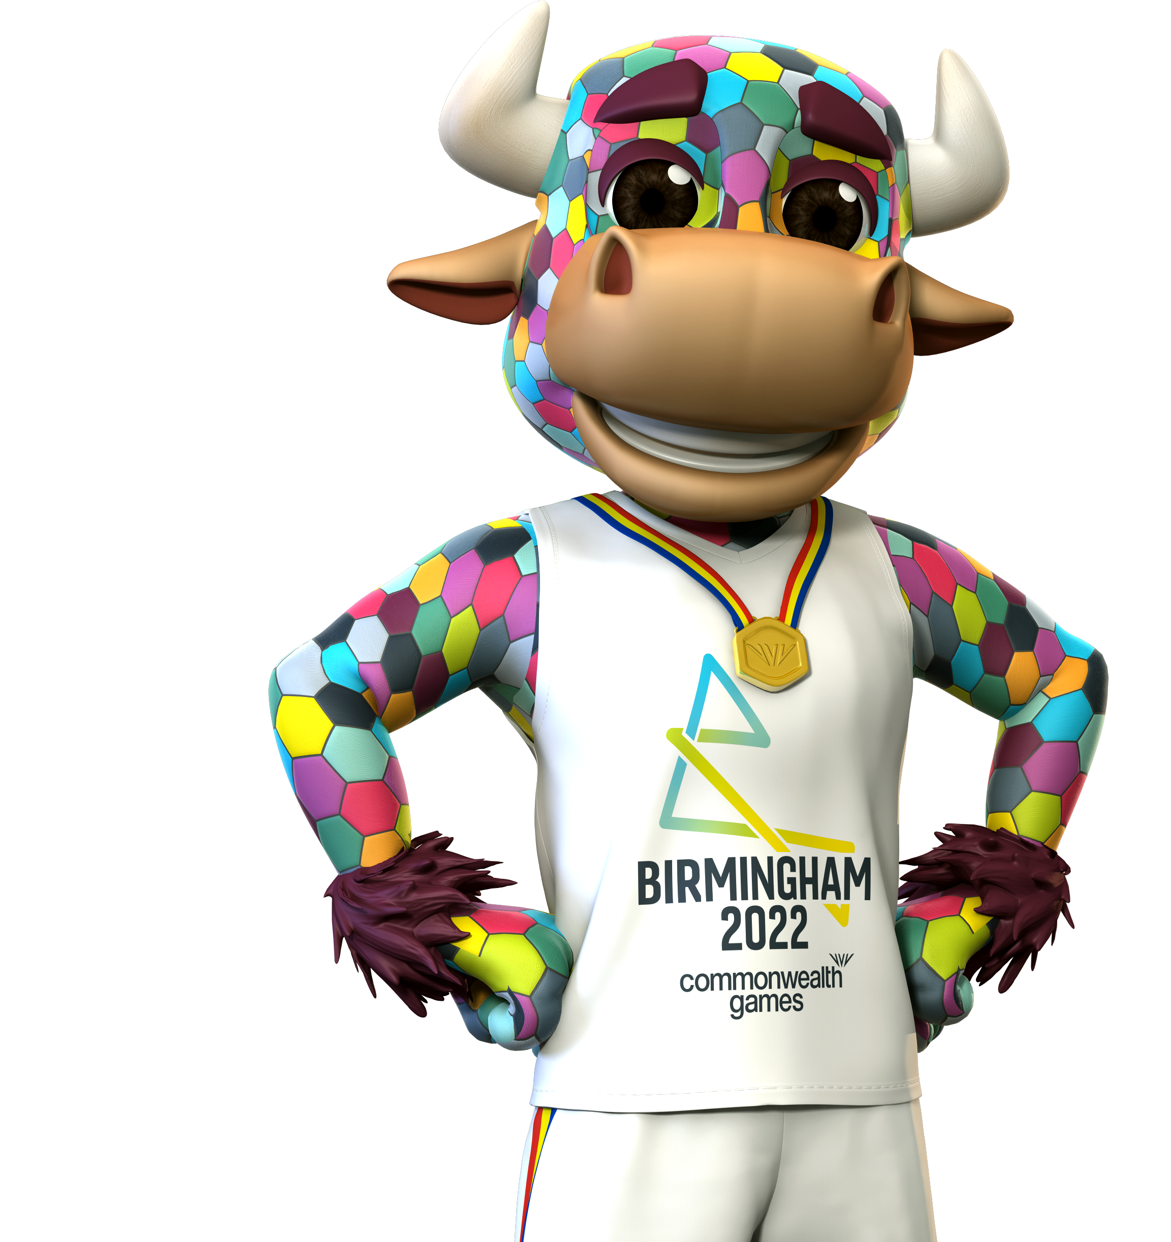
BIRMINGHAM 2022 COMMONWEALTH
GAMES FACTS & KEY INFO:
VISION
A festival of thrilling, fast-paced sport
and amazing cultural events
The Birmingham 2022 Commonwealth Games will make a world of difference for everyone across the West Midlands and beyond.
The Birmingham 2022 Commonwealth Games
is a chance to bring the Commonwealth nations together and celebrate our human potential.
Notes:
Key facts about the Birmingham 2022 Commonwealth Games Cont. (5-mins)
Teacher notes:
Vision
Birmingham 2022 has a clear vision:
A festival of thrilling, fast-paced sport and amazing cultural events!
The Birmingham 2022 Commonwealth Games will make a world of difference for everyone across the West Midlands and beyond.
The Birmingham 2022 Commonwealth Games is a chance to bring the Commonwealth nations together and celebrate our human potential.
CLICK ON TO NEXT SLIDE

Slide 8
COMMONWEALTH NATIONS
INDIA
CANADA
EUROPE
ASIA
NORTH AMERICA
NAURU
AFRICA
JAMAICA
SOUTH AMERICA
NEW ZEALAND
AUSTRALIA AND OCEANIA
NIGERIA
MOZAMBIQUE
KENYA
Notes:
Key facts about the Birmingham 2022 Commonwealth Games Cont. (5-mins)
Teacher notes:
Commonwealth Nations
Nations from all over the world will be coming to Birmingham and the region to compete in the 2022 Commonwealth Games including:
Canada, India, Jamaica, Nauru, Nigeria, Mozambique, Kenya and New Zealand!
CLICK ON TO NEXT SLIDE

Slide 9



COMMONWEALTH GAMES MISSION
BRING PEOPLE TOGETHER
BE A CATALYST FOR CHANGE
PUT US ON THE GLOBAL STAGE
HELP THE REGION TO GROW AND SUCCEED
IMPROVE HEALTH AND WELLBEING
Notes:
Key facts about the Birmingham 2022 Commonwealth Games Cont. (5-mins)
Teacher notes:
Mission
The Birmingham 2022 Commonwealth Games has a 5 – point Mission:
Bring people together These Games will embrace and champion the youth, diversity, humanity and pride of the region and the Commonwealth.
Be a catalyst for change Transform and strengthen local communities, working together to deliver new and improved homes, facilities and transport links.
Put us on the global stage Deliver an unforgettable, global Games in partnership, on time and on budget to showcase the best of Birmingham, the West Midlands and the Commonwealth.
Help the region to grow and succeed Drive sustainable growth and aspiration; creating opportunities through trade, investment, jobs, volunteering and skills.
Improve health and wellbeing Inspire, engage and connect communities and athletes to realise their full potential and live happier, healthier lives.
CLICK ON TO NEXT SLIDE

Slide 10
BIRMINGHAM 2022 COMMONWEALTH
GAMES KEY FACTS:
FACTS
First games to award more medals to
women than men.
First Commonwealth Games to create a carbon neutral legacy.
Our bold ambition - we will deliver the most sustainable Commonwealth Games since the event began nearly a century ago.
THE SEVEN PILLARS
Our approach to sustainability has seven
areas of focus:
  1. Accessibility
  2. Equality, diversity and inclusion
  3. Job creation and social value
  4. Human rights
  5. Carbon and air quality
  6. Circular economy principles to minimise waste
  7. Conservation
Notes:
Key facts about the Birmingham 2022 Commonwealth Games Cont. (5-mins)
Teacher notes:
Facts
Birmingham 2022 will be the first Commonwealth Games to award more medals to women than men.
Birmingham 2022 will be the first Commonwealth Games to create a carbon neutral legacy.
Birmingham 2022’s bold ambition is to deliver the most sustainable Commonwealth Games since the event began nearly a century ago.
The seven pillars of sustainability:
The Birmingham 2022 Commonwealth Games’ approach to sustainability has seven areas of focus:
1. ACCESSIBILITY
2. EQUALITY, DIVERSITY AND INCLUSION
3. JOB CREATION AND SOCIAL VALUE
4. HUMAN RIGHTS
5. CARBON AND AIR QUALITY
6. CIRCULAR ECONOMY PRINCIPLES TO MINIMISE WASTE
7. CONSERVATION
Once you have introduced your pupils to some key facts about the Birmingham 2022 Commonwealth Games, they will be ready to take part in a series of fun and active learning activities…
CLICK ON TO NEXT SLIDE

Slide 11

WARM-UP STOP, START, SPORT!
Birmingham 2022 Commonwealth Games sports:
AQUATICS
ATHLETICS
BADMINTON
BEACH VOLLEYBALL
BOWLS
BOXING
CRICKET
CYCLING
GYMNASTICS
JUDO
HOCKEY
NETBALL
RUGBY 7S
SQUASH
TABLE TENNIS
TRIATHLON
WEIGHTLIFTING
WRESTLING
Notes:
Stop, Start, Sport Activity (6-mins)
Teacher notes:
TIME: 6 mins
PURPOSE OF ACTIVITY: Physical and mental warm-up, learn about the different sports featured in the Birmingham 2022 Commonwealth Games
RESOURCES: Enough space to move around
ACTIVITY INSTRUCTIONS:
Ask your pupils to find a space in the room to stand
Invite the pupils to move freely around the space until you call ‘Stop!’ - then everyone stops. Explain that when you call ‘Go!’ they should start moving again. Test it out by calling ‘Go!’
When you call out a sport, the students have to mime doing a sport. For example, when you call out Weightlifting! the pupils have to mime lifting up a heavy weight over their heads.
As they continue to move around, test them on this new instruction - ‘Stop! Go! Weightlifting! Stop!’
To add a new challenge you can swap ‘Stop!’ and ‘Go!’ so that when you say ‘Go!’ the young people have to stop and when you say ‘Stop!’ they have to go.
Hopefully the pupils will get into a fun muddle - making mistakes together and physicalising the various sports.
Continue the game by adding in as many Birmingham2022 Commonwealth Games sports (displayed on screen) as you wish so it all becomes fast, frantic and fun!
CLICK ON TO NEXT SLIDE

Slide 12
TERIFFIC TIMELINE!
Christchurch, New Zealand
Tanzanian runner Filbert Bayi breaks the record
for running the 1500 m. This Commonwealth
Games record has still
not been broken!
Auckland, New Zealand
Marcus Stephen wins
the first of 7 career gold medals in weightlifting. He later becomes president of Nauru!
Vancouver, Canada
Two athletes run a mile in under 4 minutes!
It becomes known as The Miracle Mile!
Hamilton, Canada
The very first games
are held!
1930
1934
1954
1970
1974
1978
1990
London, U.K
The games are held in
the U.K. for the first time. The main venue, Empire Pool is still in use today
as Wembley Arena.
Edinburgh, U.K.
The games are broadcast on TV
in colour for the
first time.
Edmonton, Canada
The first time the event
is officially called The Commonwealth Games
Notes:
Terrific Timeline Activity (20-mins)
Teacher notes:
TIME: 20 mins
PURPOSE OF ACTIVITY: Learn about the history and legacy of the Commonwealth Games
RESOURCES: Long rope, 13 triangular flags (See downloadable template) or hand-written A4 fact cards (See timeline facts on screen – slides 12-13)
SET-UP
Print out the key Commonwealth Games dates and facts (Triangular Flags) double-sided onto A4 sheets (See downloadable template.)
Lay out a long rope in a straight line or snaking pattern across the floor. Along the length of the rope there should be space for 13 triangular flags to be placed. Each flag should have a date printed on one side and some key information on the other. The flags should be placed in chronological order with the date facing up. Choose 7 of the flags to already set in place.
In a clear space in the room place the 6 remaining flags. They should be placed with the date facing up.
ALTERNATIVE SET-UP
In place of the rope and printed flags, the facts could be simply written onto A4 or A3 card - with the date in bold on one side and the fact on the other (See timeline facts on screen).
As above, the cards can be laid out in a line or snaking pattern in chronological order (date uppermost) with the 6 cards for the pupils to use, placed to one side.
ACTIVITY INSTRUCTIONS:
Split the pupils into six groups of 5 or 6 by numbering them off (or any method that works for the group.)
Explain: Here we have a line that represents the timeline of the Commonwealth Games - from the first games in 1930 all the way to Birmingham in 2022. See those flags (or pictures)? They represent significant events along the timeline. Over here we have some key dates that haven’t yet been placed on the timeline. Can you help me? When I say go I’d like one member of your team to come over and take a flag. There is one for each team. Then you’ll have a few minutes to read the fact and then come up with a still picture to represent it. Everyone got it?… Go!
Visit each group and help them decide how they will interpret their date and fact as a still picture.
When all of the groups are ready they can take turns presenting to the other teams. You can say, On your marks, Get Set, Go! and the presenting team freezes in place. Don’t wobble!; Try not to giggle!
You can then ask the onlooking groups what they can see - for example in the case of the first fact - (1930 - Hamilton, Canada - The very first games are held.) Ask the groups: Do you think it looks like a kind of celebration? Can you see people making a number-one sign? What could be happening here?
The team can then confirm what they were trying to show and quickly tell the class what their fact was and when it happened.
Ask the team to choose where their flag goes in the timeline. They can place it down with the date uppermost.
When the next team presents they need to think about where their fact goes on the timeline, so they might need to move the previous team’s fact forward or back to make room.
Once the facts are in the correct order you can take the group on a rapid dash through the entire history of the Games, reading each fact in order from the start all the way to Birmingham 2022.
The young people can then act out each fact in turn as they travel along the timeline learning all about the history of the Commonwealth Games.
CLICK ON TO NEXT SLIDE

Slide 13
TERIFIC TIMELINE!
Birmingham, U.K.
These are the first games that will award more medals to women than to men!
The first games to create
a carbon neutral legacy!
Glasgow, U.K.
Usain Bolt and his team
win gold in the 400m relay. The lap of honour takes
longer than the race!
Kuala Lumpur, Malaysia
Team sports are included for the first time.
1994
1998
2002
2014
2018
2022
Victoria, Canada
The games include
Para-sports for the very first time.
Manchester, U.K.
The triathlon event is included for the first time. The Stadium goes on to become Manchester City football ground.
Gold Coast, Australia
For the first time there are an equal number of events for men and women.
Notes:
Terrific Timeline Activity Cont. (20-mins)
Teacher notes:
TIME: 20 mins
PURPOSE OF ACTIVITY: Learn about the history and legacy of the Commonwealth Games
RESOURCES: Long rope, 13 triangular flags (See downloadable template) or hand-written A4 fact cards (See timeline facts on screen – slides 12-13)
SET-UP
Print out the key Commonwealth Games dates and facts (Triangular Flags) double-sided onto A4 sheets (See downloadable template.)
Lay out a long rope in a straight line or snaking pattern across the floor. Along the length of the rope there should be space for 13 triangular flags to be placed. Each flag should have a date printed on one side and some key information on the other. The flags should be placed in chronological order with the date facing up. Choose 7 of the flags to already set in place.
In a clear space in the room place the 6 remaining flags. They should be placed with the date facing up.
ALTERNATIVE SET-UP
In place of the rope and printed flags, the facts could be simply written onto A4 card - with date in bold on one side and fact on the other (See timeline facts on screen).
As above, the cards can be laid out in a line or snaking pattern in chronological order (date uppermost) with the 6 cards for the pupils to use, placed to one side.
ACTIVITY INSTRUCTIONS:
Split the pupils into six groups of 5 or 6 by numbering them off (or any method that works for the group.)
Explain: Here we have a line that represents the timeline of the Commonwealth Games - from the first games in 1930 all the way to Birmingham in 2022. See those flags (or pictures)? They represent significant events along the timeline. Over here we have some key dates that haven’t yet been placed on the timeline. Can you help me? When I say go I’d like one member of your team to come over and take a flag. There is one for each team. Then you’ll have a few minutes to read the fact and then come up with a still picture to represent it. Everyone got it?… Go!
Visit each group and help them decide how they will interpret their date and fact as a still picture.
When all of the groups are ready they can take turns presenting to the other teams. You can say, On your marks, Get Set, Go! and the presenting team freezes in place. Don’t wobble!; Try not to giggle!
You can then ask the onlooking groups what they can see - for example in the case of the first fact - (1930 - Hamilton, Canada - The very first games are held.) Ask the groups: Do you think it looks like a kind of celebration? Can you see people making a number-one sign? What could be happening here?
The team can then confirm what they were trying to show and quickly tell the class what their fact was and when it happened.
Ask the team to choose where their flag goes in the timeline. They can place it down with the date uppermost.
When the next team presents they need to think about where their fact goes on the timeline, so they might need to move the previous team’s fact forward or back to make room.
Once the facts are in the correct order you can take the group on a rapid dash through the entire history of the Games, reading each fact in order from the start all the way to Birmingham 2022.
The young people can then act out each fact in turn as they travel along the timeline learning all about the history of the Commonwealth Games.
CLICK ON TO NEXT SLIDE

Slide 14
BRILLIANT BANNERS!
Notes:
Brilliant Banners Activity (20-mins)
Teacher notes:
TIME: 20 mins
PURPOSE OF ACTIVITY: Get creative to make a supportive banner
RESOURCES: Birmingham 2022 Bring the Power paper banners (download separately), art materials
SET-UP
Each team or young person is given an A4 paper banner that’s blank apart from the Bring the Power / Birmingham 2022 logo. (Available to download.)
Depending on time available you can provide pens, pencils, crayons, paint or collage materials.
ALTERNATIVE SET-UP
If you are not able to print out the banner template in A4 you could simply print the logo and glue it onto a larger piece of card.
Alternatively, you could print several logos and glue them onto a card or cloth big enough for lots of pupils to hold and have the whole class work on one huge banner!
ACTIVITY INSTRUCTIONS:
Lead a discussion with your pupils: Imagine you were coming to the Games from another country, what messages would you like to see? What kind of things would make you feel welcome? Can you come up with a really positive message?
Ask each young person to come up with a message and feedback to the class. Is there a way we can make it even better? Can we make it even more positive?
After the young people have come up with a message, they can draw it onto their banner and decorate it. Make sure it’s really bold and clear.
Once they have created their messages, ask the pupils to take their places along the timeline. Instruct them to work together to hold the timeline and their banners up and shout out their positive messages in a really positive way!
Conclude the activity by asking the young people what they can do with their banners - how they can have a long life over the games, be displayed in school and eventually be recycled.
CLICK ON TO NEXT SLIDE

Slide 15
REFLECTIONS
Soon teams will be arriving from all over
the world to take part in the Games.
Can we be as welcoming to them as we
can? Remember the long history of being friendly and welcoming that the Games have. That way when the teams go home again they’ll tell their friends how friendly and positive the people of the UK were!
Notes:
End of workshop reflection (5-mins)
Teacher notes:
TIME: 5 mins
PURPOSE OF ACTIVITY: Wrap up the session and encourage pupils to reflect upon what they have learned about the history of the Commonwealth Games
RESOURCES: None
SET-UP
Gather the pupils in a large group in front of you
ACTIVITY INSTRUCTIONS
Conclude the session with the following call to action:
Soon teams will be arriving from all over the world to take part in the games. Can you do me a huge favour and be as welcoming to them as you can? Remember the messages that you created here today and the long history of being friendly and welcoming that the Games have. That way when the teams go home again they’ll tell their friends how friendly and positive the people of the UK were!
CLICK ON TO NEXT SLIDE

Slide 16
THANK YOU
Notes:
Teacher notes:

